Slide 1
TENX LEADERSHIP TALKS:
REDEFINING PRIORITIES
WHY ARE OUR PEOPLE OFTEN AN
AFTERTHOUGHT WHEN IT COMES TO ACCOMMODATION?
PATRICK SMITH
CHIEF OPERATING OFFICER, STRIVE SERVICES GROUP
Notes:
Good morning
Thank you for the opportunity to put a spotlight on an sector very close to my heart – which is staff accommodation.

Slide 2
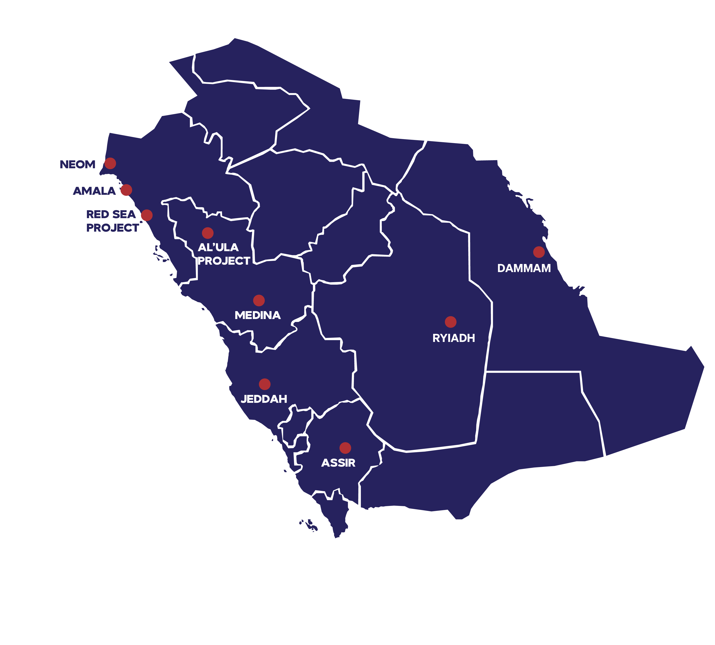
KSA
GIGA
MEGA
ONE-OFF
PROJECTS
URBAN DISTRICTS
Notes:
Going to be hearing over the next few days about amazing hospitality, hotel and touristic developments. One-off projects, mega-projects and even Giga Projects!
For all their astonishing features and hospitality groundbreaking achievements – they will count for nothing if they are not serviced by the right people working within them.
HUGE ASSETS – WITH VASTS AMOUNT OF CAPITAL BEING DEPLOYED

Slide 3
HAPPY
STAFF =
YOUR
BEST
ASSET
Notes:
Happy Staff, trained staff, well rested and loyal staff – they will be the one responsible for consistently delivering “Service Excellence” day in day out.

Slide 4
HUMAN CAPITAL
PEOPLE
Notes:
The Human Capital engaged in all the projects that you are going to hear about - are at the heart of the critical success factor for the same.

Slide 5
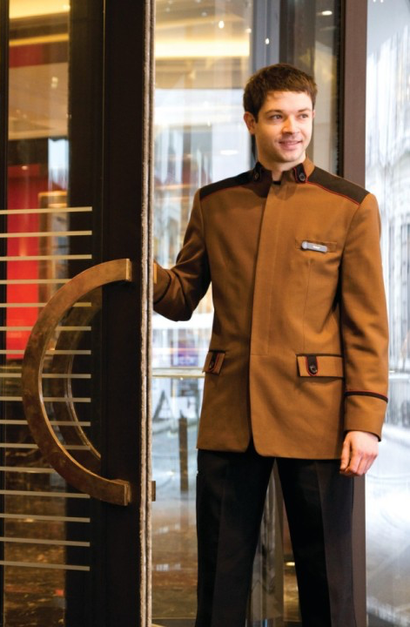





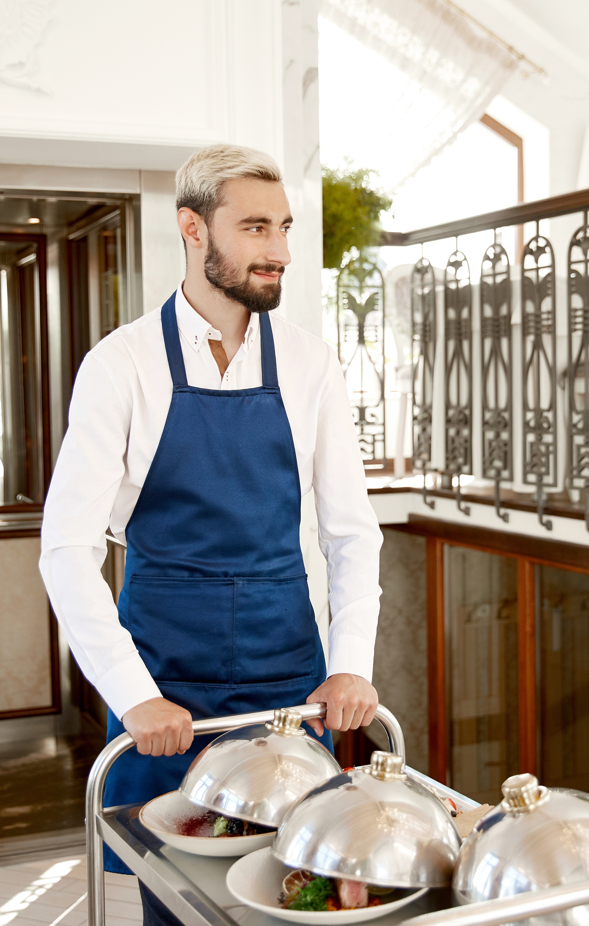


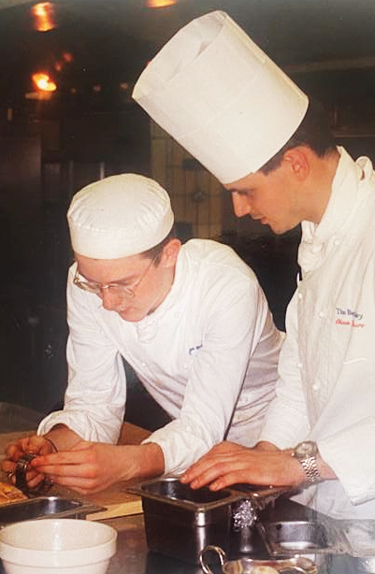
HOSPITALITY
IS IN OUR DNA
Notes:
I should know – because this was me;
I didn’t go to University, I was rather schooled through The Savoy Group’s Five Year Management Training Scheme.
There’s not much I haven’t done in a hotel from serving the staff themselves in the staff canteen, right through to being a doorman at Claridges!

Slide 6
PROVEN
EXPERIENCE
Notes:
ME!

Slide 7


FOR EXCELLENCE
WE STRIVE
Notes:
With “Excellence” at the heart of what we, I refer you to Horst Schulz and is book “Excellence Wins”
He coined the phrase “Ladies and Gentleman serving Ladies and Gentleman”

Slide 8

Notes:
And we’ve adopted this into the very being of our Company at Strive Services Group – a fully integrated Property Services Group.
One of our companies is Domus Managed Housing – which is focused on providing a turn-key solution for staff housing.

Slide 9

SLIDE 5 – SIZE OF THE MARKET
10%
32,000
KSA OTHER
14%
RIYADH
JEDDAH
DAMMAM
45,000
MARKET SIZE
76%
GIGA
243,000
?
320,000
HOTEL ROOMS
Notes:
So how big is the SAUDI hospitality market?

Slide 10
500,000+
>300,000
>SAR4.8b
HOTEL
STAFF
STAFF
ACCOMMODATION ROOMS
STAFF
ACCOMMODATION
EXPENSE

Slide 11
HOW

Slide 12
BALANCING
FACTORS
VISION
2030
LOCATION
+ MARKET
MOMRA
REGULATIONS
INCREASED RENTAL DEMANDS
Notes:
Ministry of Municipal Rural Affairs and Housing

Slide 13


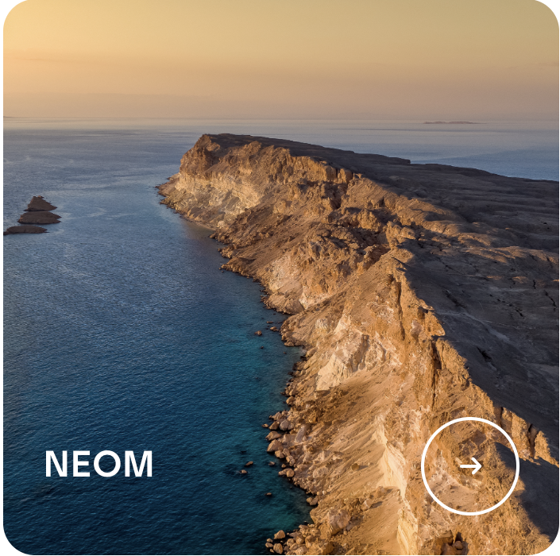



IMPROVING QUALITY
OF LIFE
MAX 4 PER ROOM + 4.8 M² PER PERSON
FRESH WATER, NATURAL LIGHT
+ AIR
ON-SITE FACILITIES
NET ZERO BY 2060
KEY PROJECTS
+ MANDATES
SINGLE SEX HOUSING
REGULAR DISINFECT
+ SANITISE
ON-SITE HEALTH SPECIALIST
SAUDI GREEN INITIATIVE
Notes:
https://www.vision2030.gov.sa/v2030/a-sustainable-saudi-vision/

Slide 14
BUILDING SMARTER
PROTECT
AGAINST
RENTAL
INCREASE
INVESTMENT OPPORTUNITIES
+ RETURNS
URBAN DISTRICTS
RE-PURPOSING
EXISTING
REAL ESTATE
Notes:
Rising rent prices

Slide 15



HIGH
HIGH-TO-MID
RESIDENTIAL
AFFORDABLE HOUSING / MANAGERS
HOSPITALITY / NON-MANAGERS
MARKET
SEGMENTATION
AFFORDABLE
HOUSING
MID
UPPER LABOUR
PREMIUM
STAFF
HOUSING
JUNIOR
STAFF
HOUSING
QUALITY
LABOUR
CAMP
LABOUR
CAMP
LOW
Notes:
Historically, the region has received a bad reputation for housing staff.
If you look at the residential housing, it can be segmented as follows;
Affordable Housing
Hospitality
Upper Labour

Slide 16





SLIDE 4
AFFORDABLE
HOUSING /
MANAGERS
UPPER
LABOUR
HOSPITALITY
SINGLE
SITE
MULTI TENANTED
OPEN
MARKET
Notes:
This can be further broken into the following type of communities:
Purpose Built Multi Tenanted Communities
Purpose Built Single Site
Open Market Residential Units

Slide 17
17%
MARRIED
43%
FEMALE
57%
MALE
83%
SINGLE
100%
EXPAT
DEMOGRAPHICS
Notes:
And for each of these you need to consider the demographics
Male vs Female
Single vs married (and families)
Expats – from global destinations – different cultures

Slide 18









SLIDE 4
ALL-IN-ONE LOCATION
SEGMENTATION
DIVISION
BY RANK
Notes:
And the appropriate segmentation
Either all staff in same location
Split managers and Line Staff into separate locations
Divide by male and female

Slide 19
CLEAN + SANITISED
COMPLEX SHIFT PATTERNS
ORGANISED
ACTIVITIES
HEALTH + SAFETY
RANGE
OF CULTURES
ACCESS TO AMENITIES
ROOM ALLOCATION
OPERATIONAL
CHALLENGES
SECURE BELONGINGS
MEDICAL
GUARANTEED
NIGHT SLEEP
SAFE
SPACES
911
TRANSPORT
Notes:
And it doesn’t stop there….
There are the operational parameters to consider

Slide 20
15%
IN-UNIT MANAGEMENT
OPERATIONS
SERVICES
15%
FURNITURE
EQUIPMENT
WHITE GOODS + TV
FITTINGS
15%
WATER
ELECTRICITY
WIFI
COST COMPONENTS
UTILITIES
55%
ROOMS
COMMON AREAS
FACILITIES
GYM
POOL
RENTAL

Slide 21
90%
HOUSING
LEASED
>10%+
RENT
INCREASES
6+
COLLEAGUES
PER ROOM
SECTOR CHALLENGES
> 4
COLLEAGUES PER BATHROOM
1hr
MINUTE
COMMUTES
Notes:
Plus the challenges in this sector

Slide 22
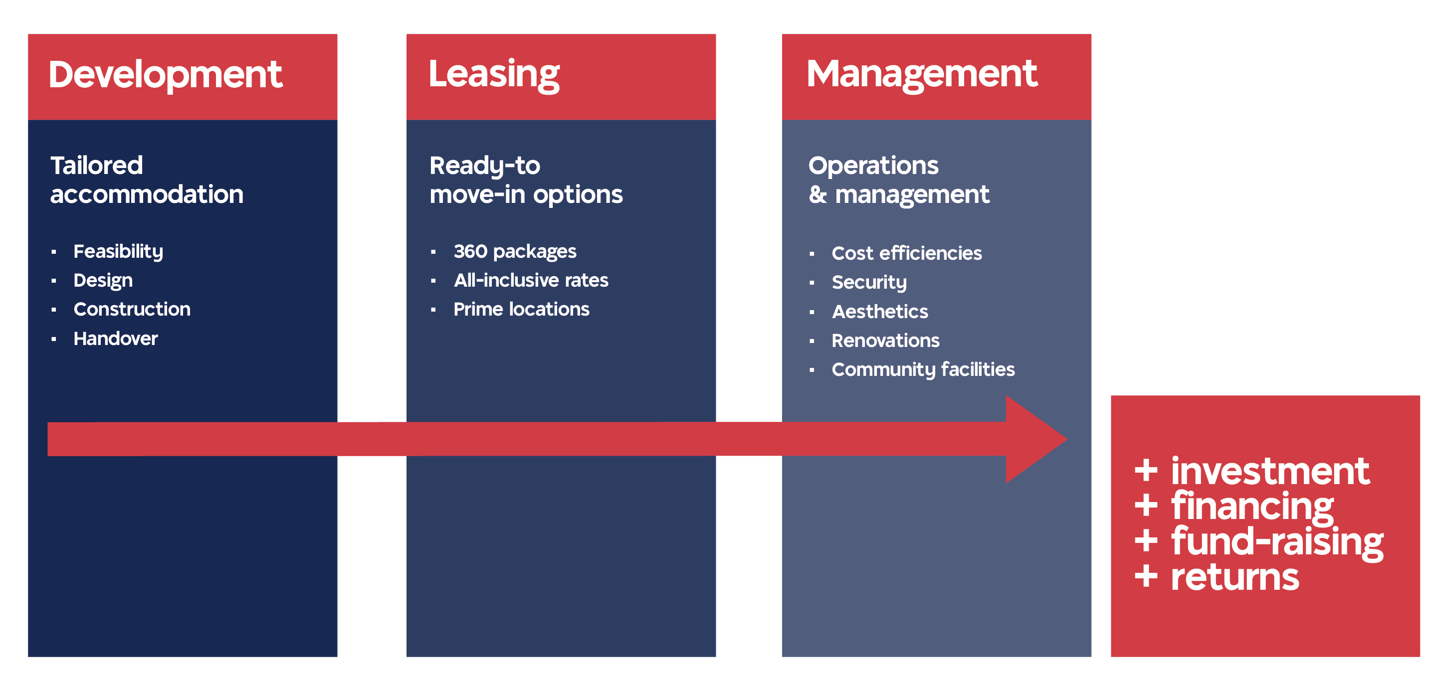
OUR DELIVERY CYCLE
Notes:
Will you build?
Will you lease?
Will you manage and operate?

Slide 23
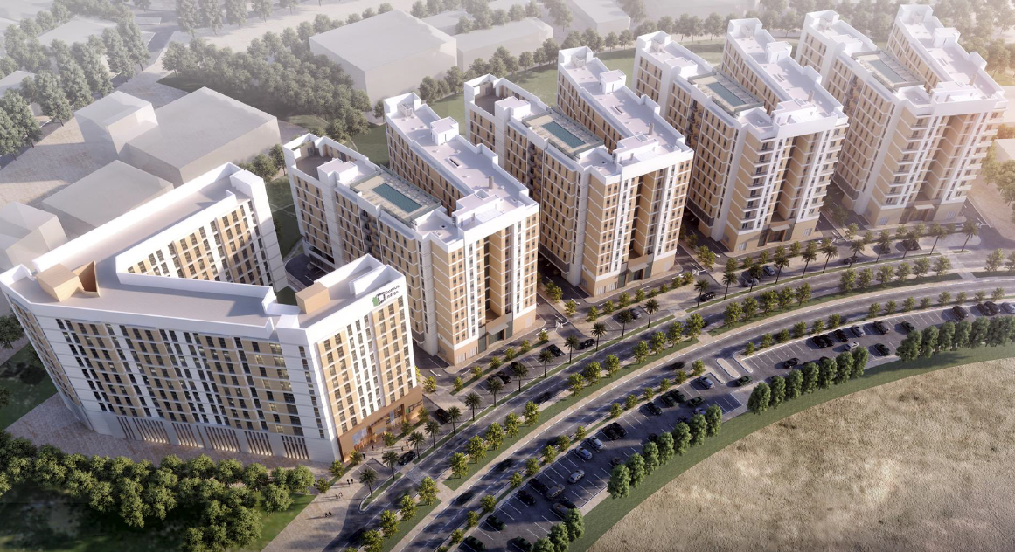
DOMUS INDIGO

Slide 24
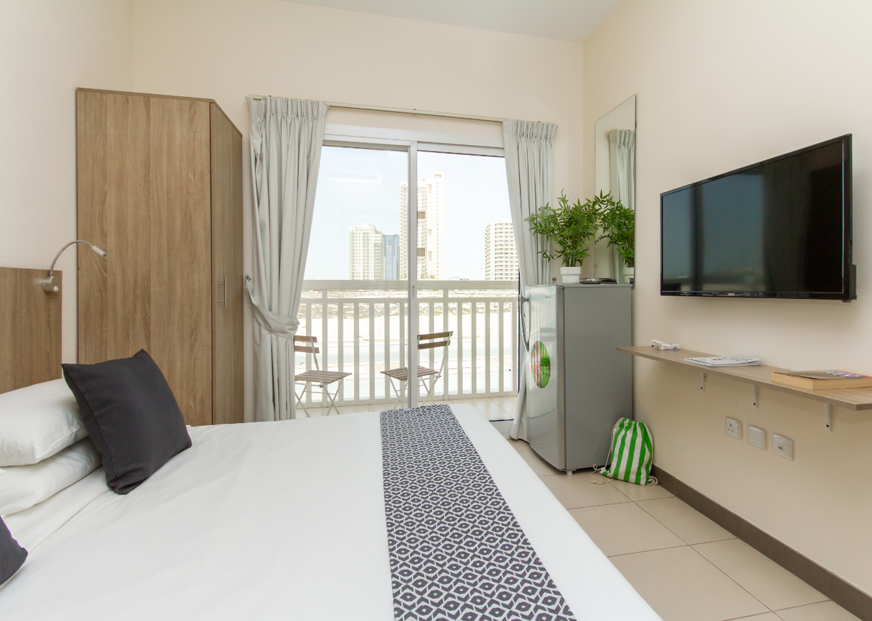
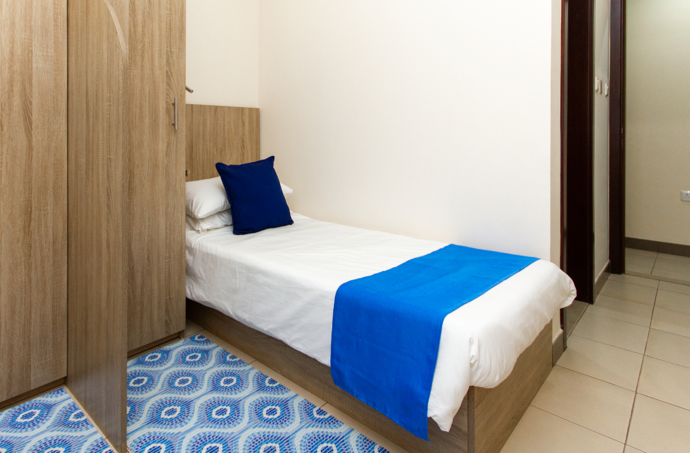
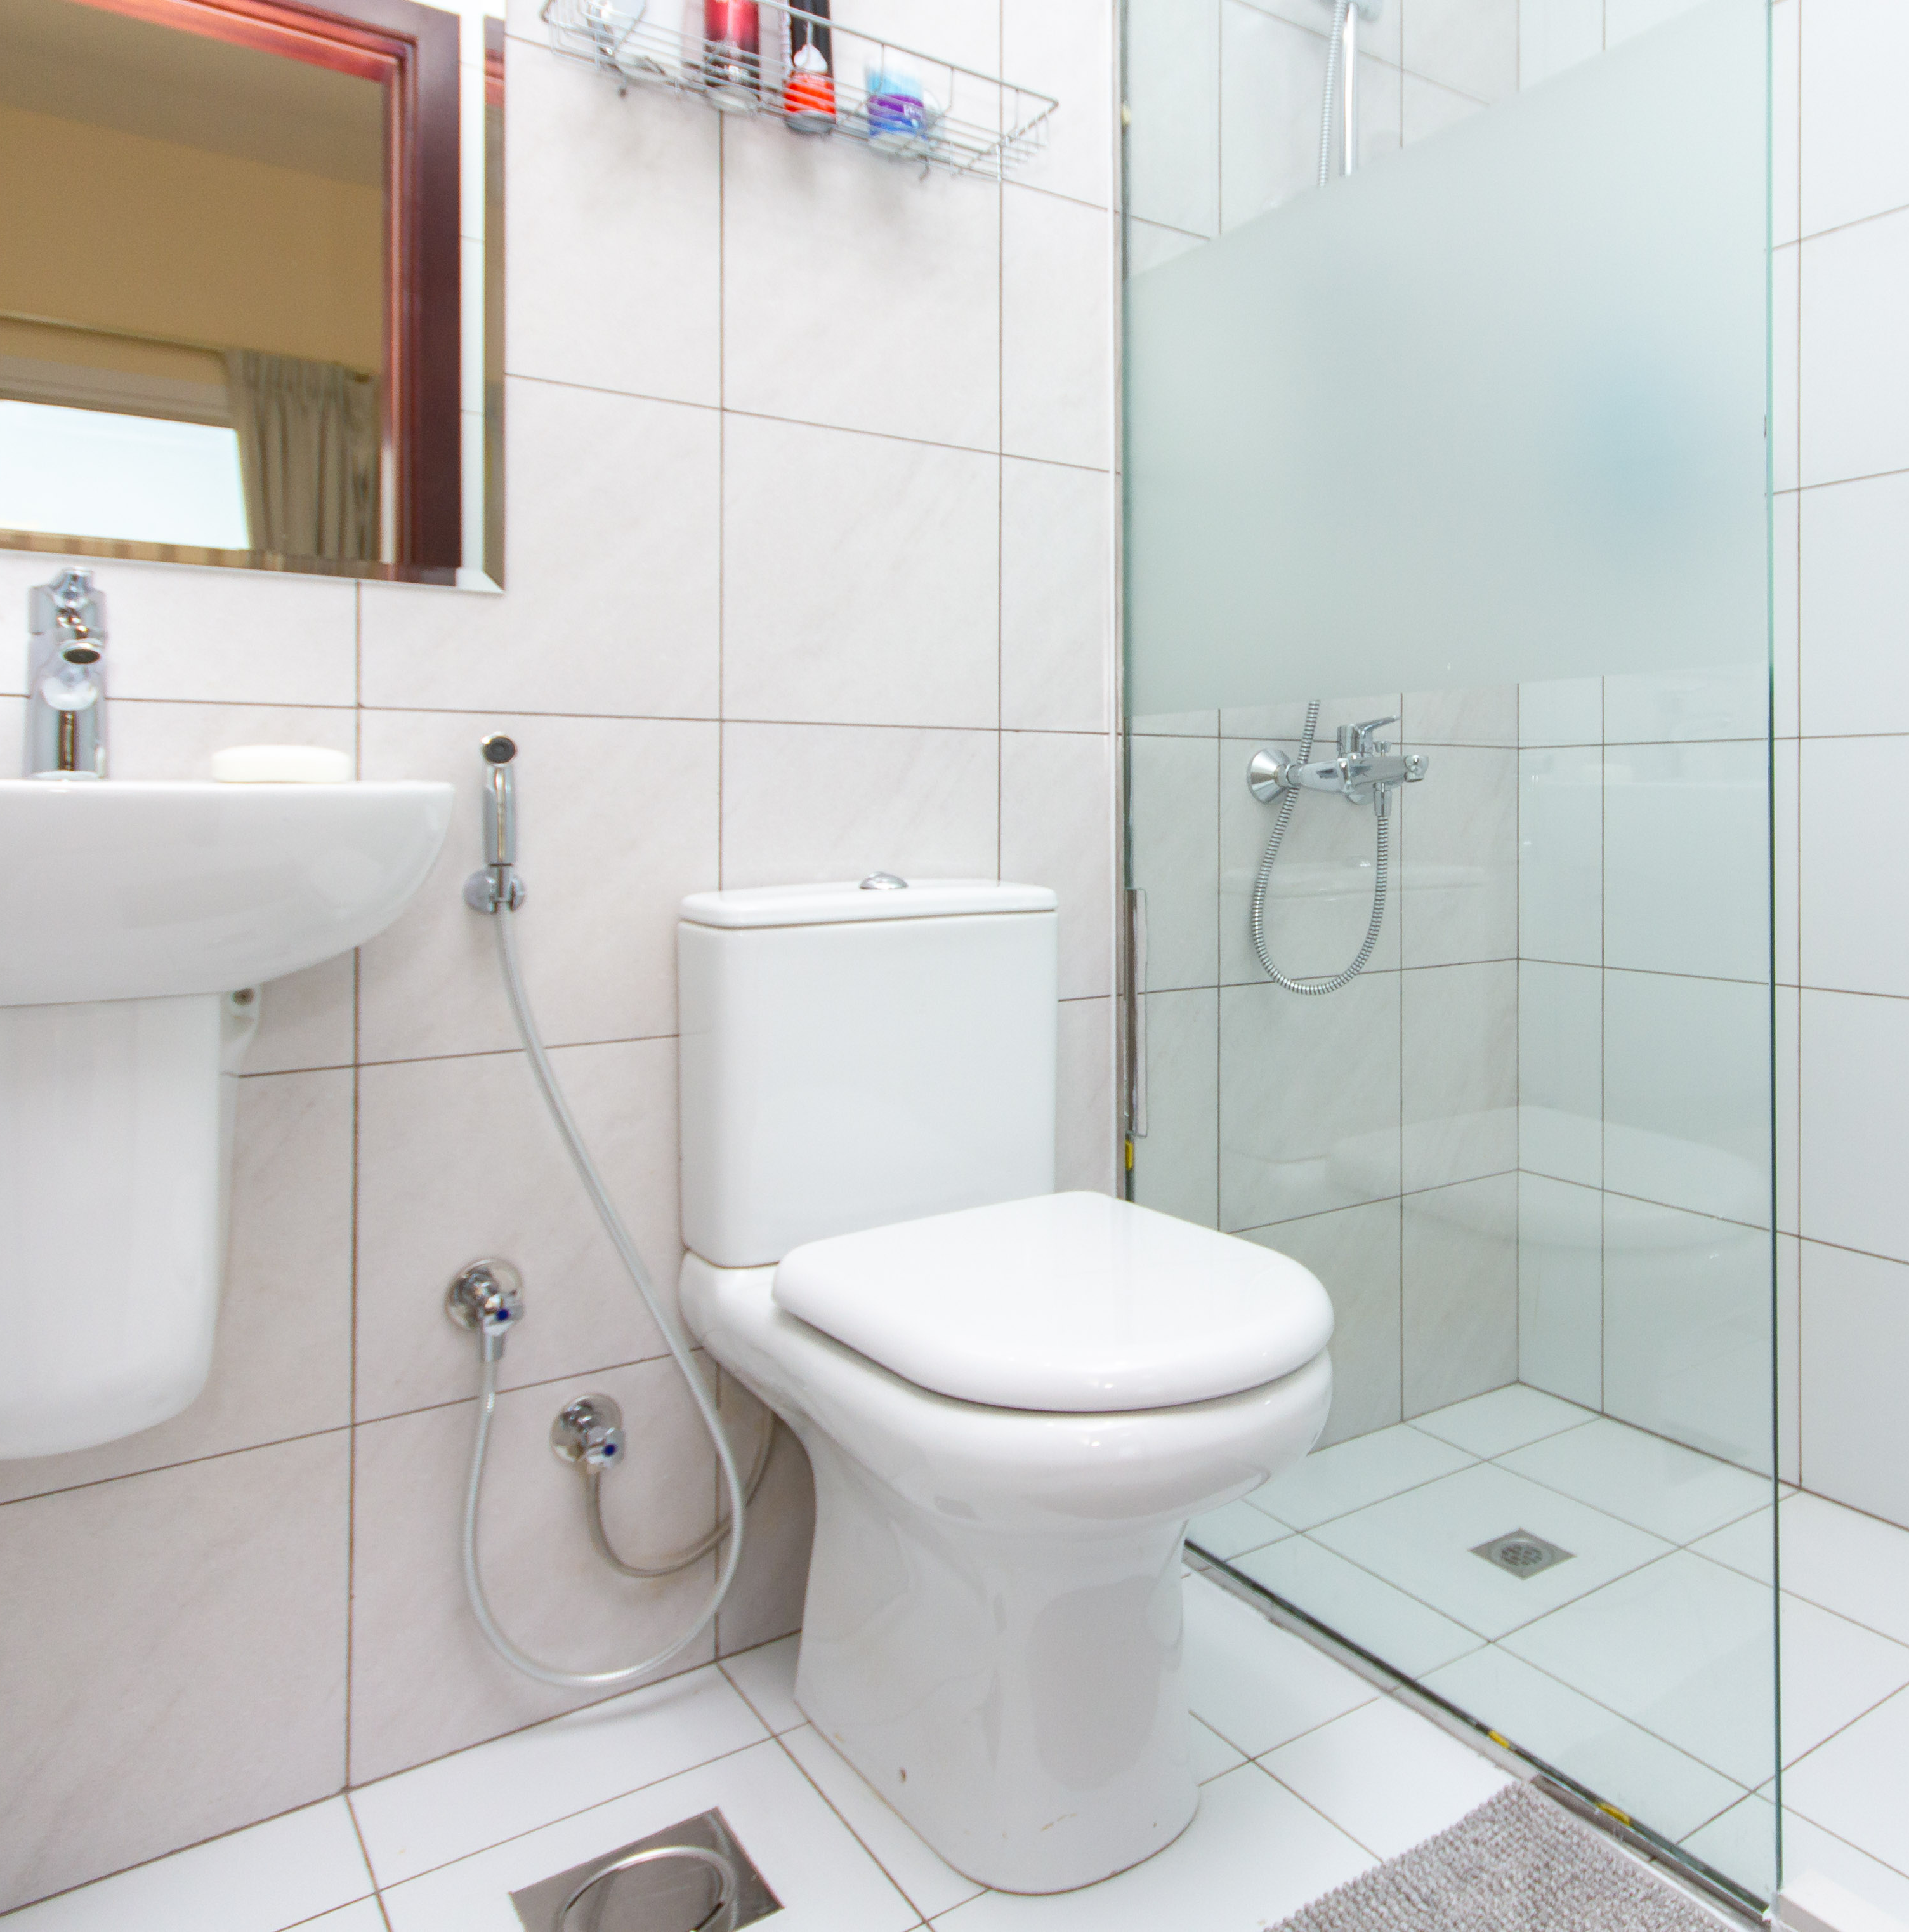
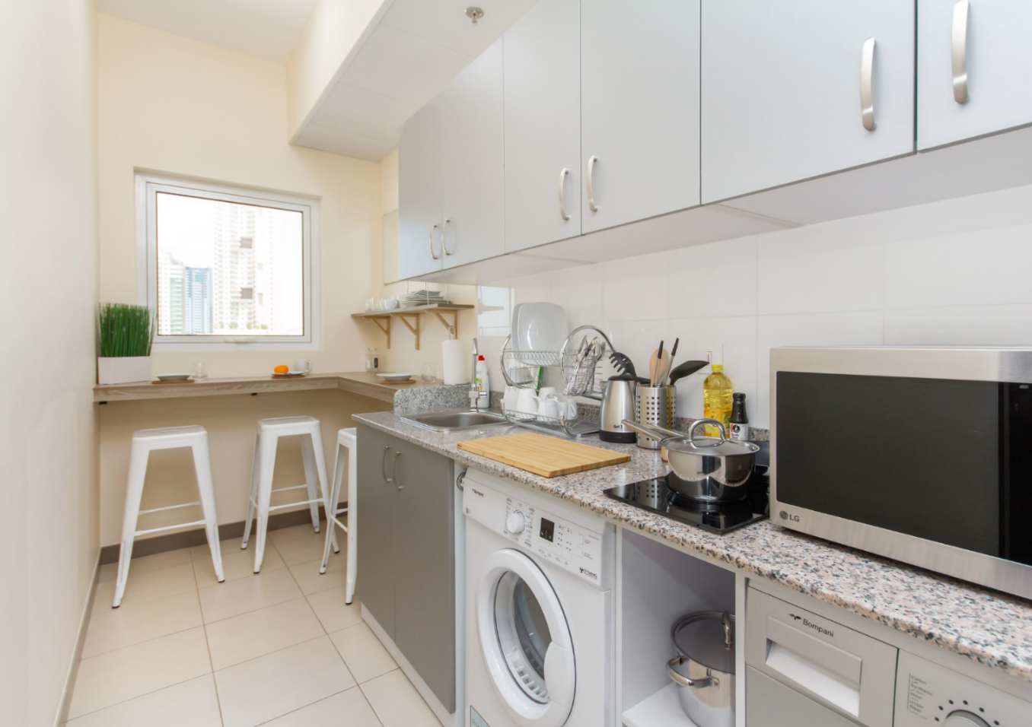
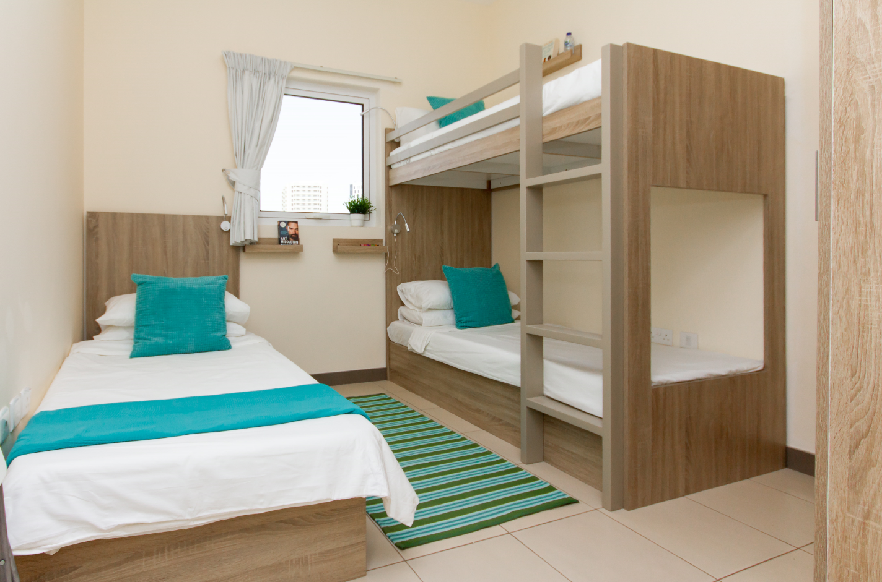
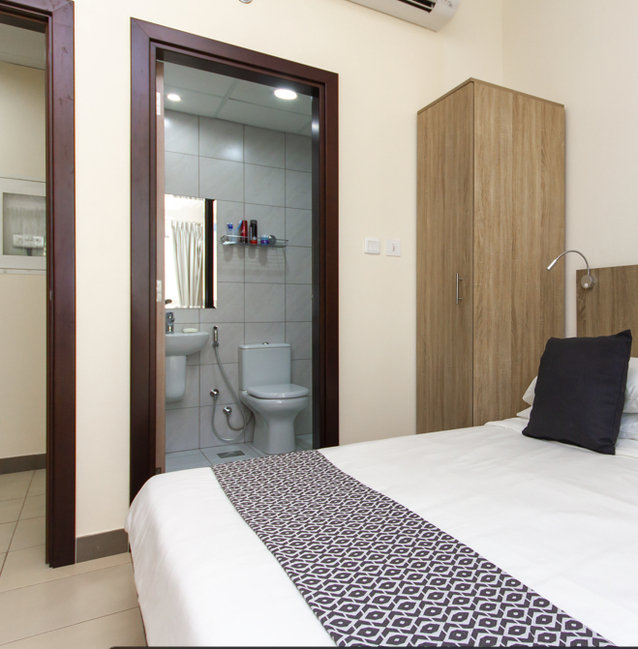
SLIDE X– INDIGO SHOWCASE (EXAMPLE)
SUPERVISOR (1:1)
SKILLED (2:1)
ENSUITE ROOMS
ALL ROOMS EN-SUITE
KITCHENETTE
SEMI-SKILLED (3:1)

Slide 25
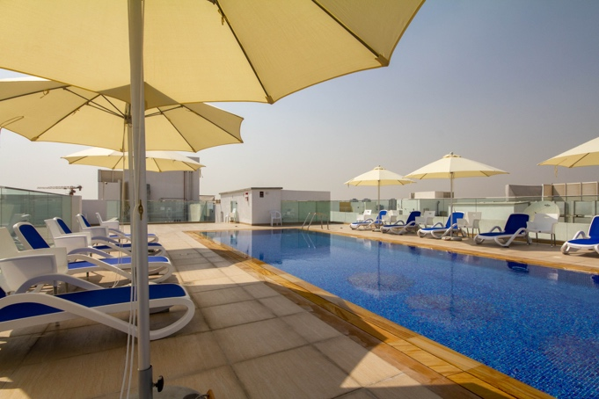

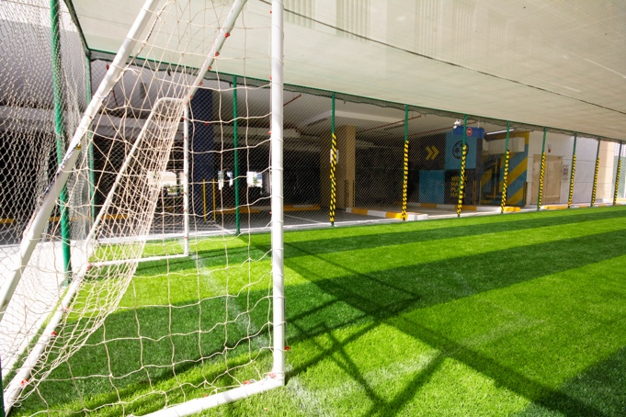
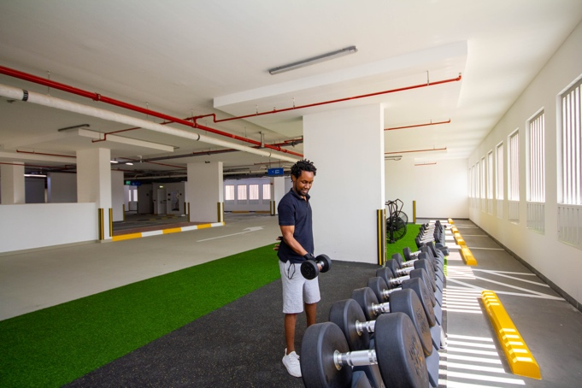
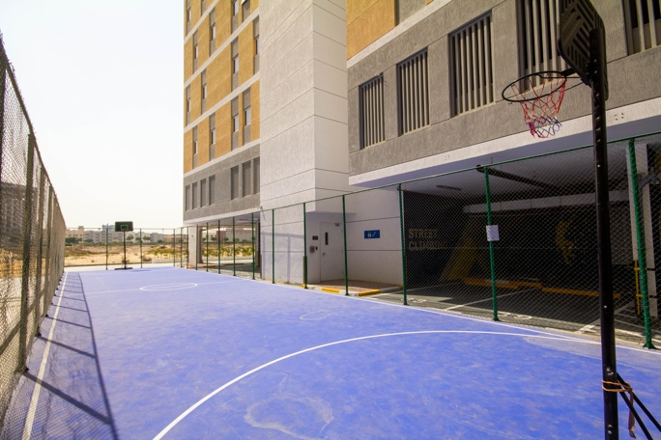

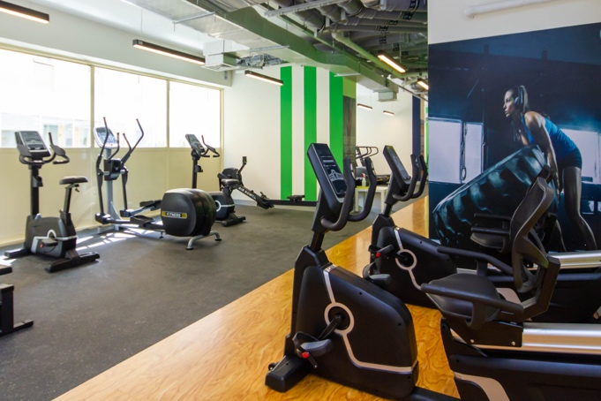
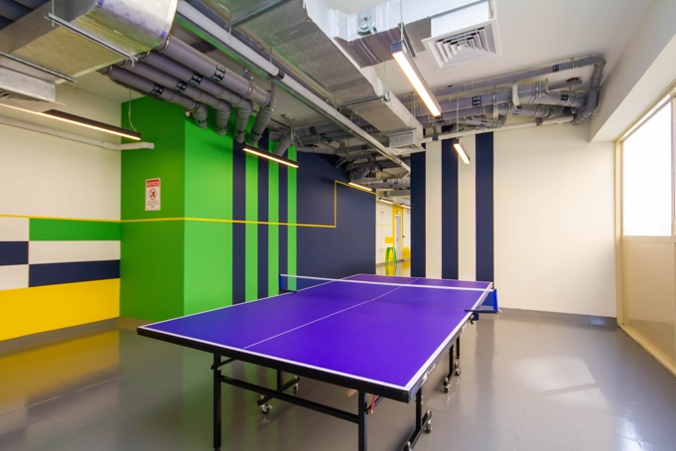
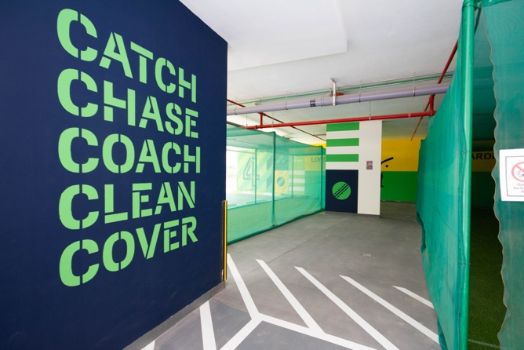
Swimming Pool
Climbing
Football
Crossfit
Basketball
Weights
INDOOR + OUTDOR SPORT FACILITIES
Gym
Table Tennis
Cricket Nets

Slide 26
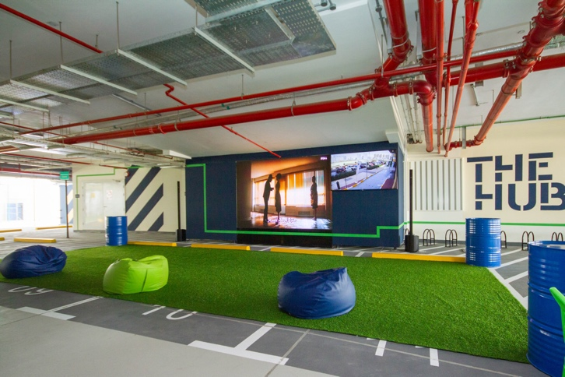

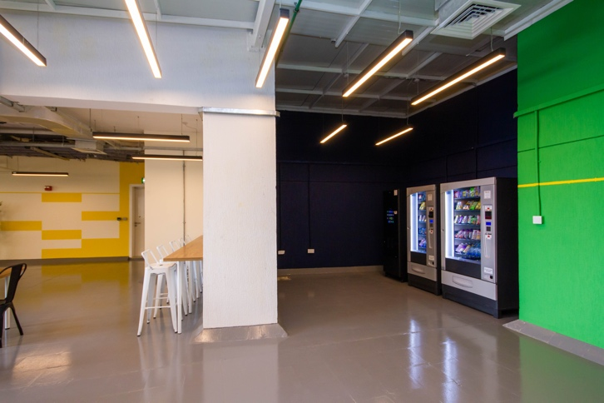
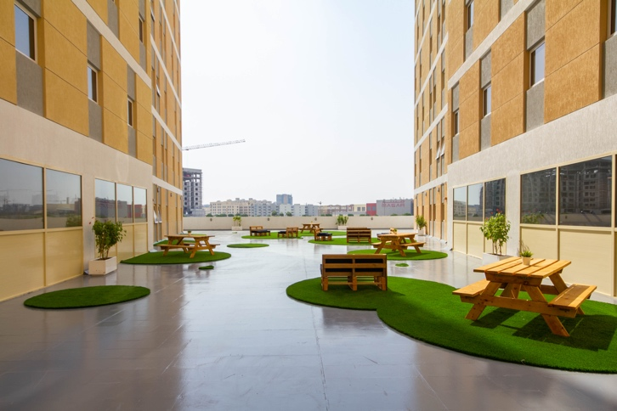

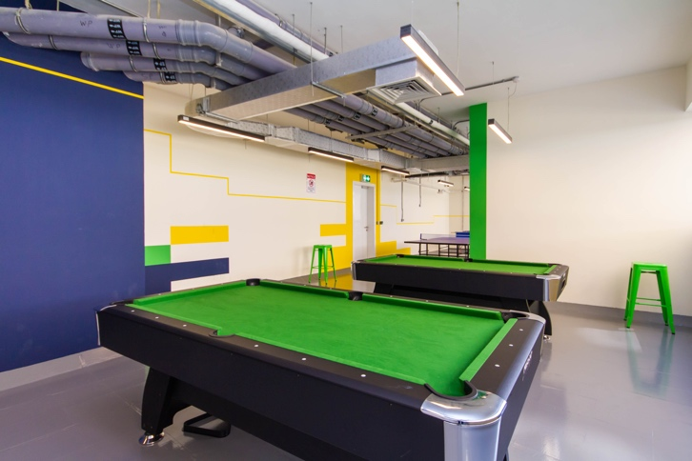
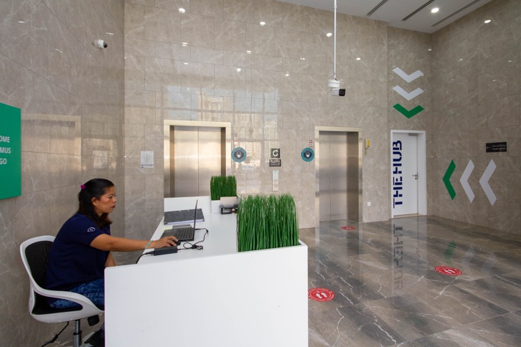
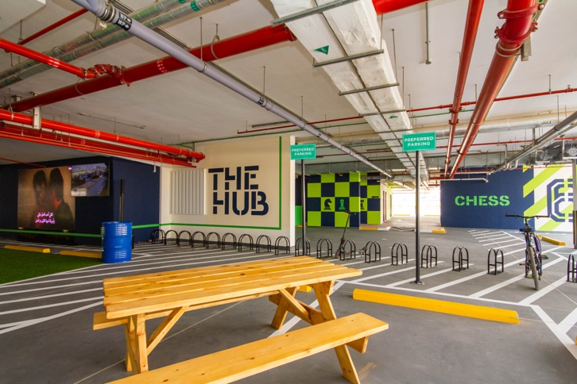
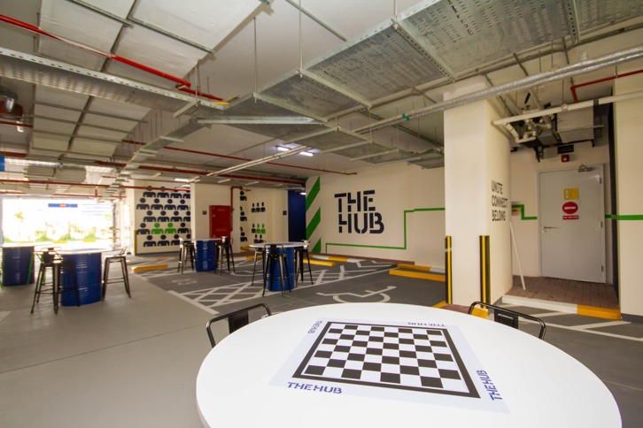
Large Screen
The Social
Vending
Terrace
Fussball
Pool
SOCIAL AREAS
+ GAMES
Reception
Social Seating
Games

Slide 27
HAPPY
STAFF =
YOUR
BEST
ASSET
Notes:
SO I APPEAL TO YOU – PLEASE PUT QUALITY STAFF HOUSING FIRMLY ON YOUR AGENDA.
LETS RAISE THE BAR, AND SET NEW STANDARDS OF EXCELLENCE WITHIN THIS REGION FOR OUR INDUSTRY
So

Slide 28

THANK
YOU
VISIT US AT STAND G19 FOR MORE INFORMATION

