Slide 1
MASTERING DIGITAL PLATFORMS
Oli Thomas

Slide 2
A BIT ABOUT ME
18 years working within media and consumer tech
Helping brands build digital strategies and create compelling online experiences
Advising digital startups and connecting with strategic partners

Slide 3
DIGITAL IS JUST THE PAPER…

Slide 4
…EXPERIENCE IS THE PEN

Slide 5
WHERE TO PLAY
/
/
OWNED ESTATE: YOUR WEBSITE AND APPS
THIRD PARTY PLATFORMS

Slide 6
THESE PLATFORMS ARE BIG…
Monthly active users (Globally, Ms)

Slide 7
...AND HAVE DIFFERENT STRENGTHS
Monthly active users (Globally, Ms)
Brand Awareness
Real-Time engagement
Youth-focused
Storytelling
Immersive experiences

Slide 8
UNDERSTAND THE DEMOGRAPHICS
Average age of audience
Younger
Older
41
35
38
35
34
31
38
17
24
Source: eMarketer

Slide 9
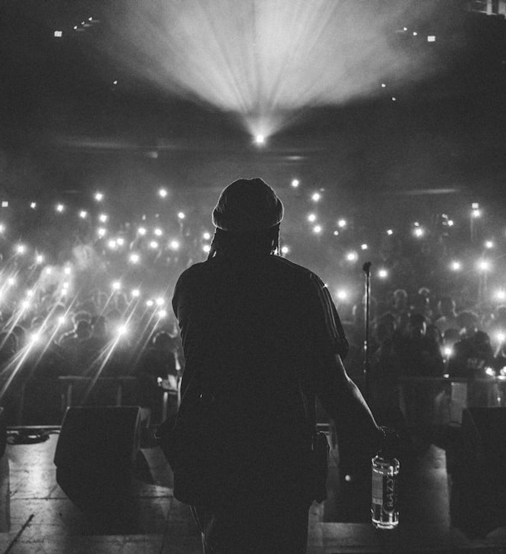
PLAN DISCOVERY
HOW WILL YOU STAND OUT ?
Every day…
3.7M videos published on YouTube
80k+
podcast episodes released

Slide 10
A BIT MORE ON SOME OF THE EMERGING PLATFORMS…
REAL-TIME ENGAGEMENT
IMMERSIVE EXPERIENCES

Slide 11
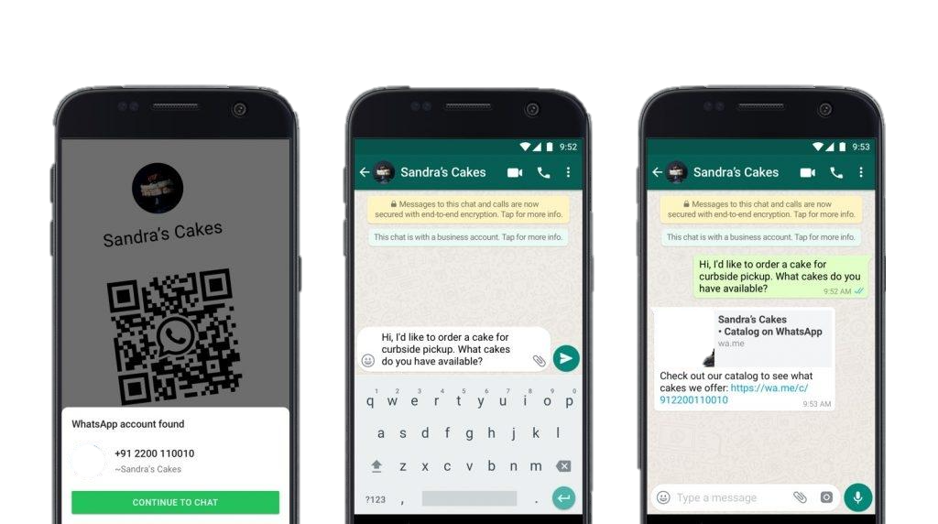
WHATSAPP
Offer promotions
Take payments
Upsell
Marketing
Real-time engagement
Customer insights
Service updates
Customer Experience

Slide 12
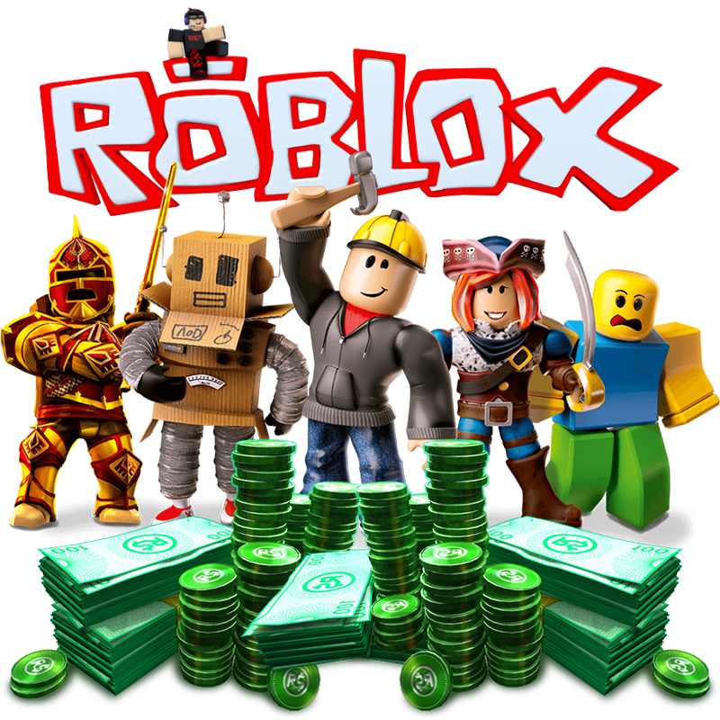
GAMING PLATFORMS
Closed
Ecosystems
Open
Ecosystems
Game only
Major publishers
Older skewing
Limited opportunities for brand involvement
Platform + Community
User-generated content
Younger skewing
Significant opportunities for brand involvement

Slide 13
GAMING PLATFORMS
Closed
Ecosystems
Open
Ecosystems
Game only
Major publishers
Older skewing
Limited opportunities for brand involvement
Platform + Community
User-generated content
Younger skewing
Significant opportunities for brand involvement
50% of Roblox audience under-13
63% of Fortnite audience 18-24

Slide 14
GAMING PLATFORMS - OPTIONS
1
2
3
4
Direct / Programmatic Ads
Create branded merchandise
Collaborate with an existing experience
Build a dedicated experience
Intrinsic ads (eg. billboards)
Sponsorships
Clothing & Accessories
Opportunity to build revenue streams
Temporary activations or permanent experiences

Slide 15
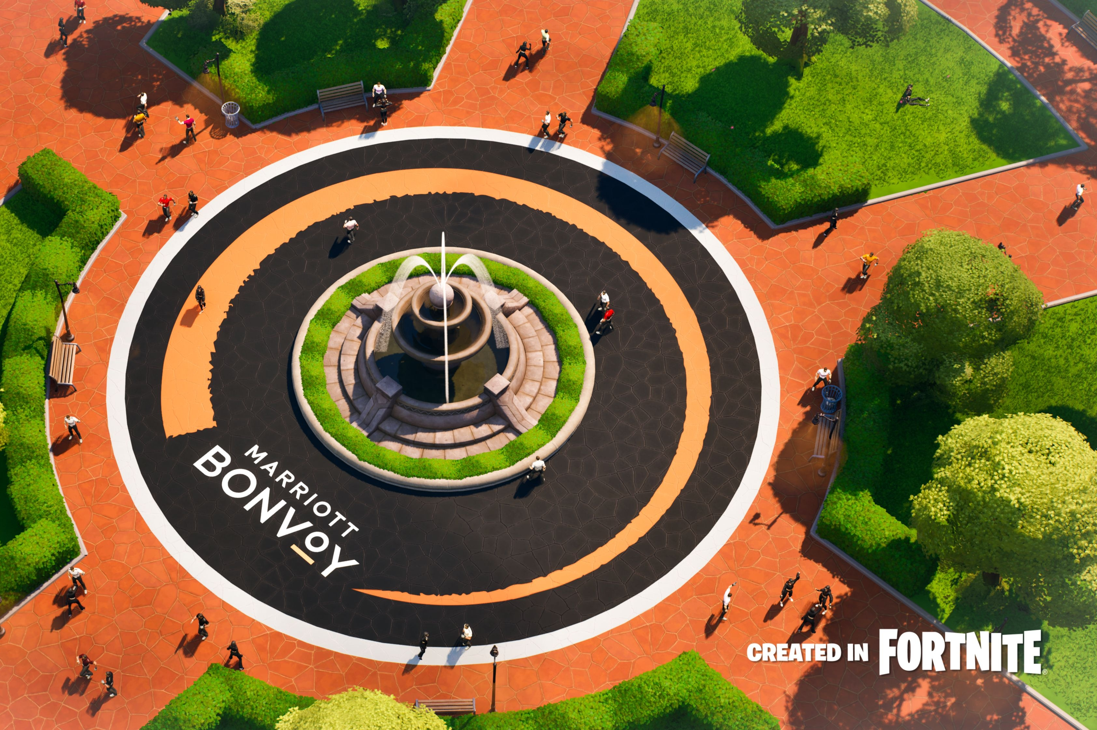
GAMING PLATFORMS - EXAMPLES
Hilton @ Roblox
Marriott Bonvoy @ Fortnite

Slide 16
THE KEY: BUILD THE FLYWHEEL
Entertain the youth
Engage the adults

Slide 17
DIGITAL IS THE PAPER, EXPERIENCE IS THE PEN
Keep the reader turning the page…

Slide 18
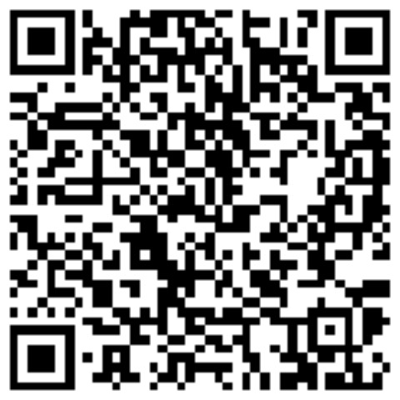
Email:
oli@gethatchin.com
THANK YOU
LinkedIn:

