Slide 1
From Data to Dollars:
Optimising Restaurant Financial Performance
Through Revenue Management
Rohit Sachdev
Chief Executive Officer
Soho Hospitality

Slide 2
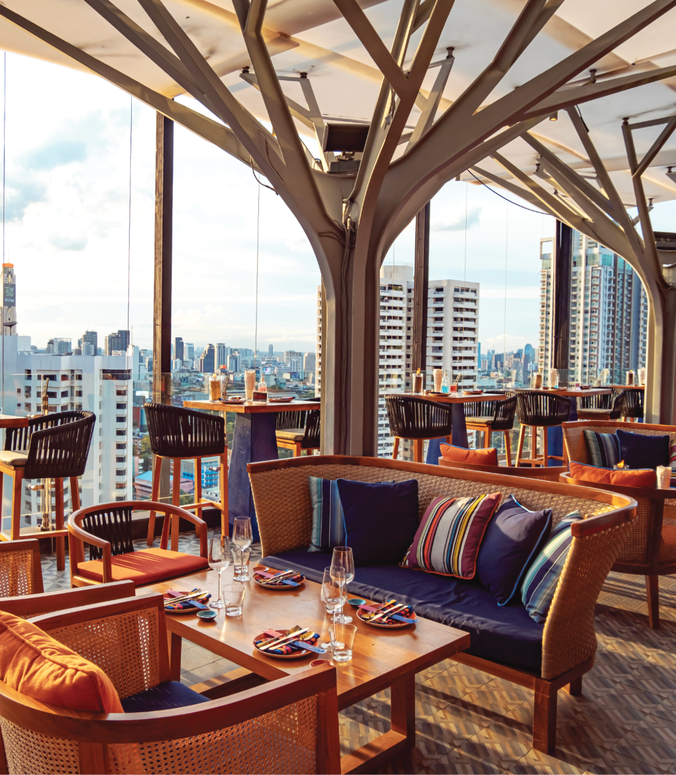
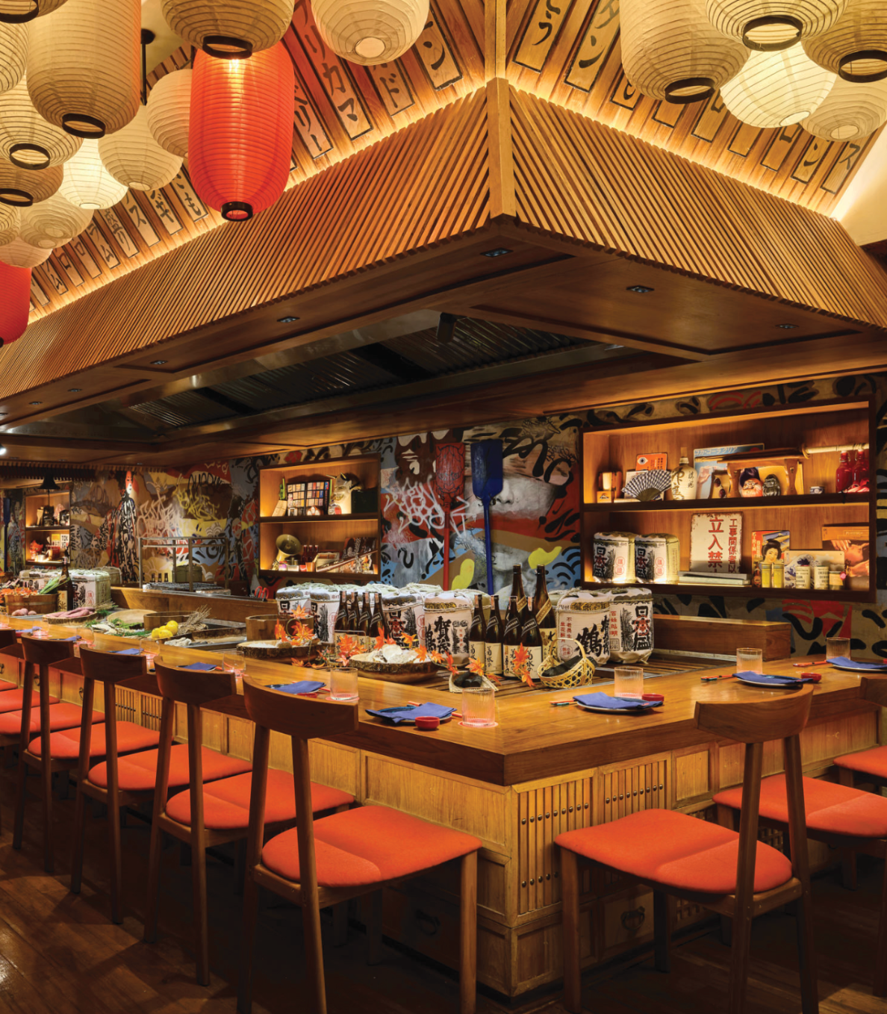
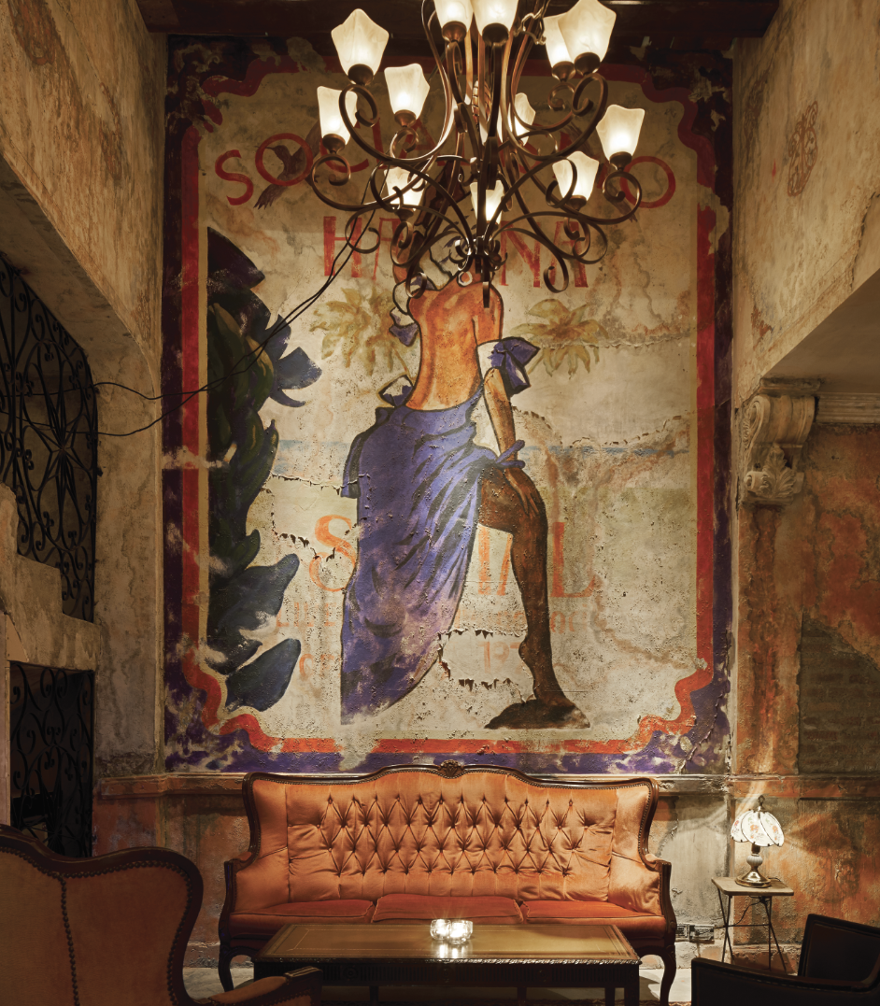
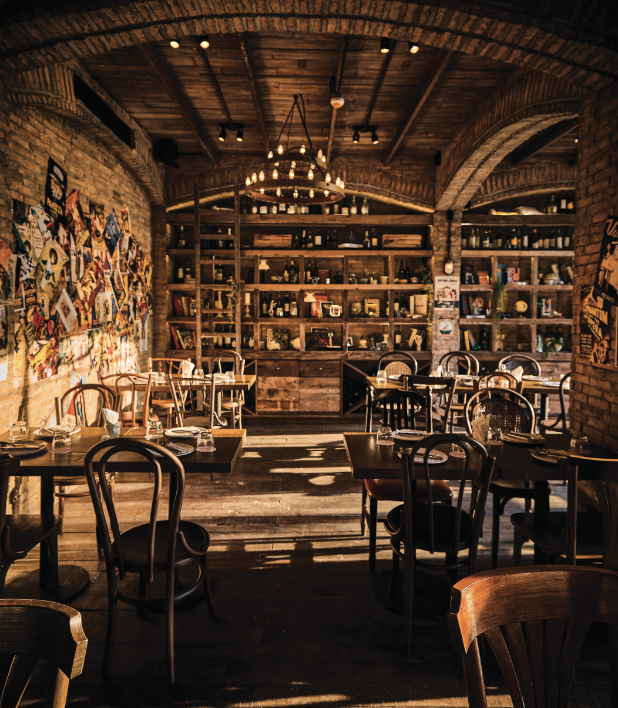
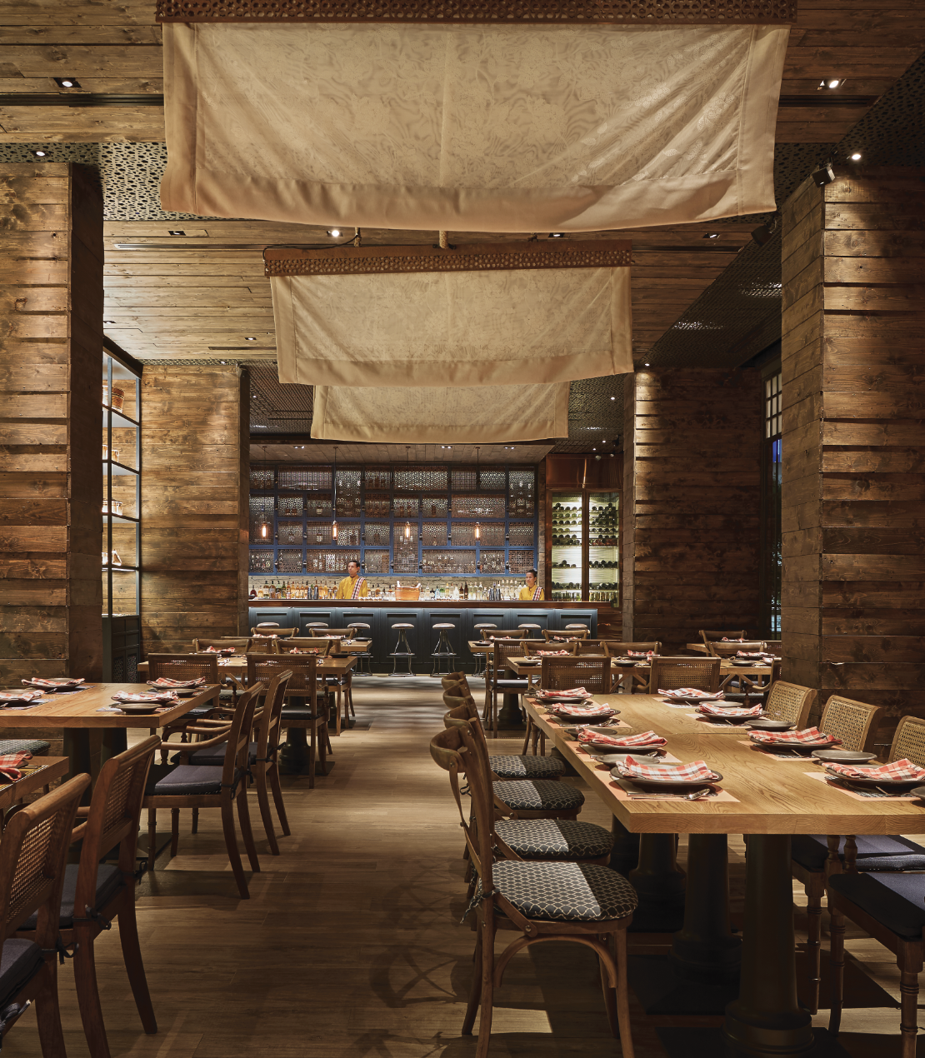
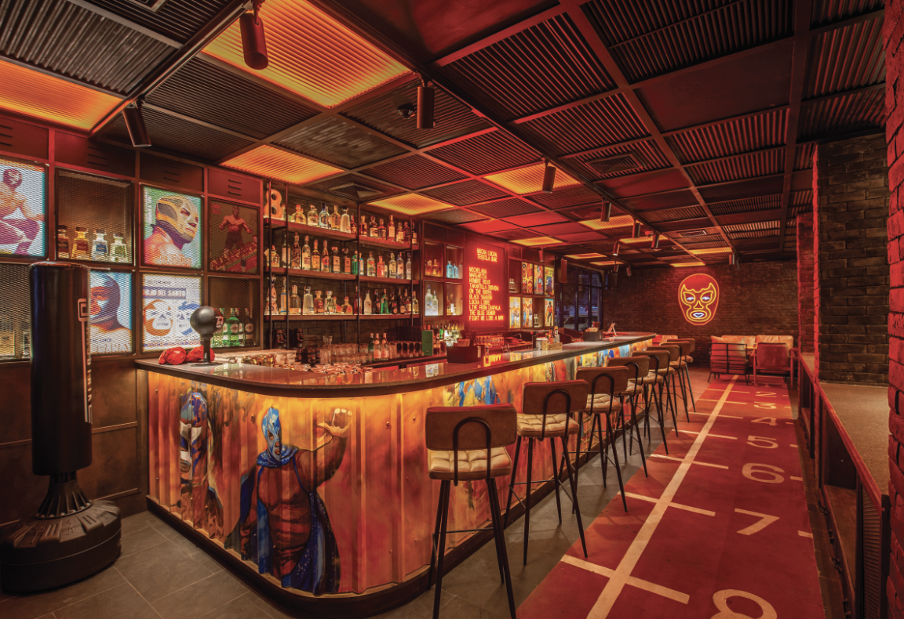
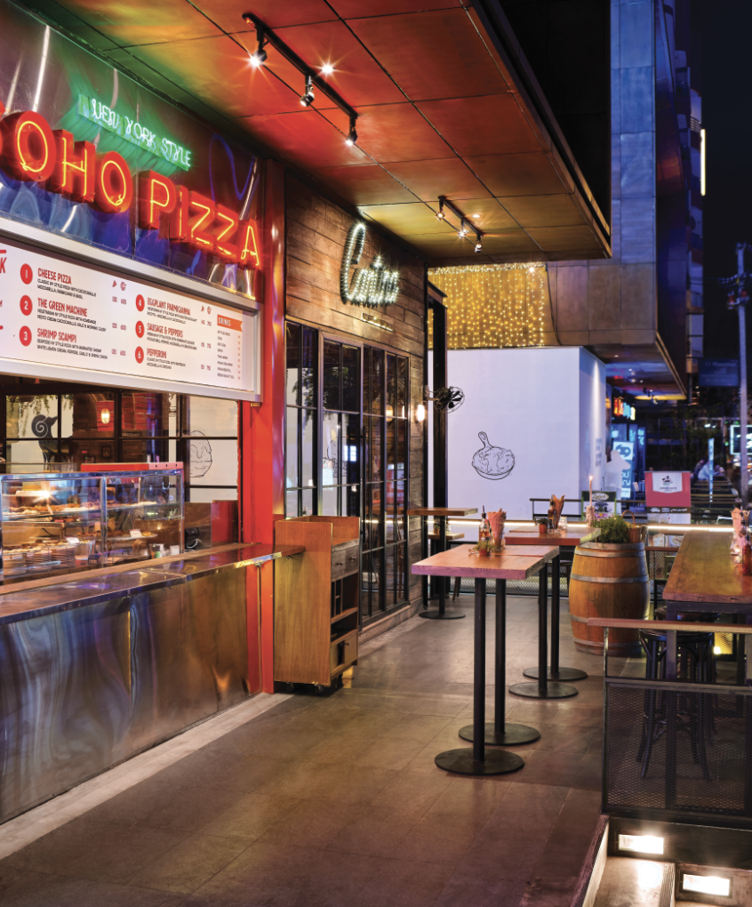
About Soho Hospitality
LIFESTYLE
QSR

Slide 3
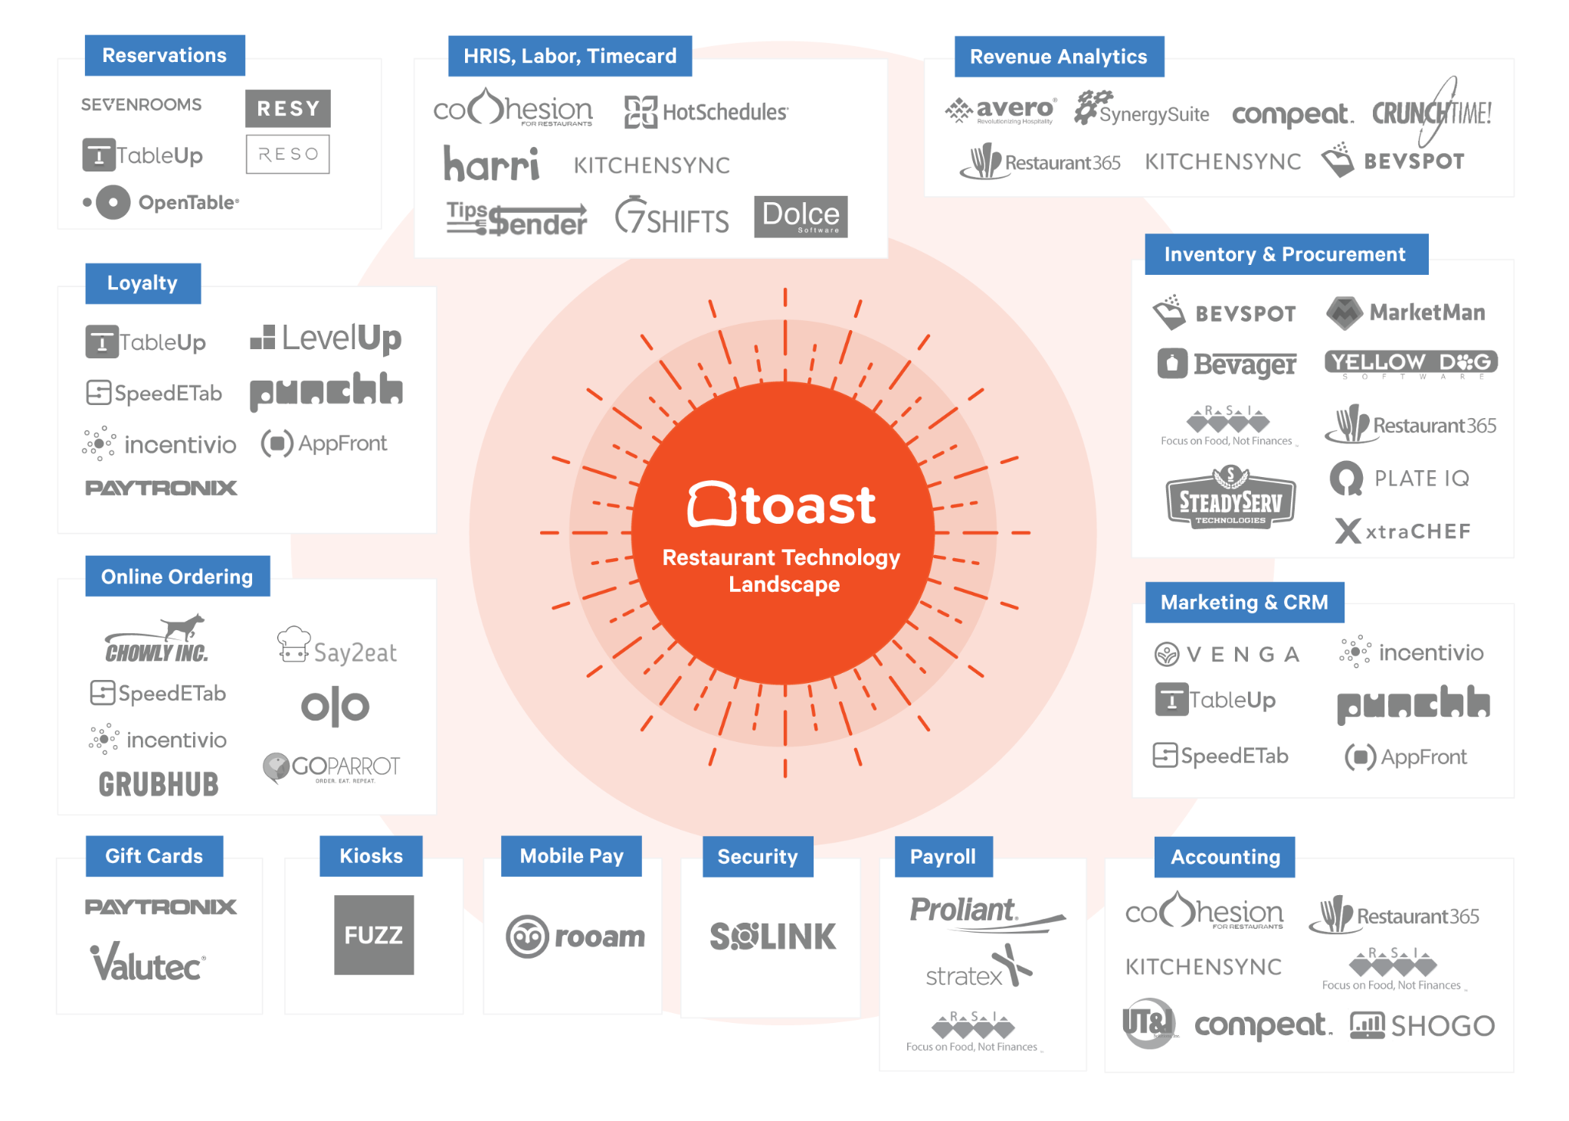
Obstacles Impacting Our Business
Data Quality and Consistency
Our data was often duplicated, incomplete, or inconsistent
Server performance
Real-TIme Data Analytics
No real-time access to any analytics
Business intelligence
Analytics and Reporting
Reporting is fragmented and manually department driven
Cost and Resource Constraints
Operational teams are time poor
Operating margins are under pressure
Customer Experience
We were not maximizing the capabilities of our technology platforms
Data Integration
Disparate systems not speaking to one another
HRIS/PAYROLL
MOBILE PAY
ONLINE ORDER
MARKETING

Slide 4
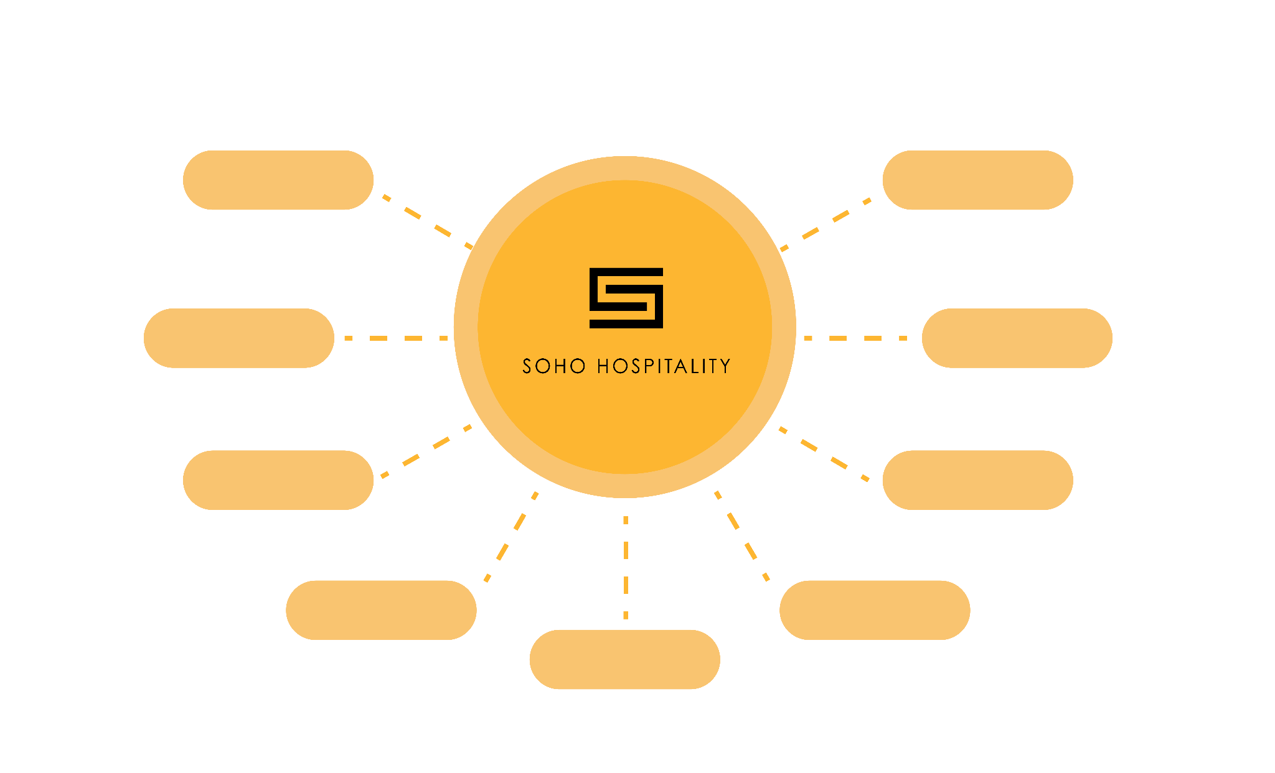
Mapping Data Sources Across Technology Platforms
RESERVATIONS
MANAGEMENT
POS
ACCOUNTING
HRIS/PAYROLL
INVENTORY
MOBILE PAY
REVENUE ANALYTICS
DELIVERY PLATFORMS
?
MARKETING

Slide 5
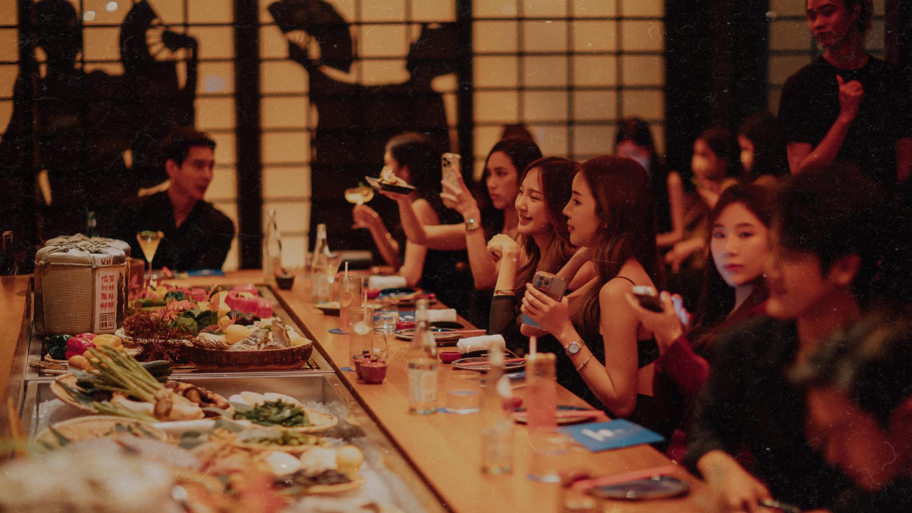
Enhanced Customer Experience Through Integration
Revel X Seven Rooms
360 degree view of the guest journey
Total spend
Number of Visits
Menu Selection
Customer Reviews
Tagging customer preferences
Visibility across all Soho Hospitality restaurants in terms of of spending data
Created a new role for a Seven Rooms champion
Implemented Training acorss all our restaurants

Slide 6
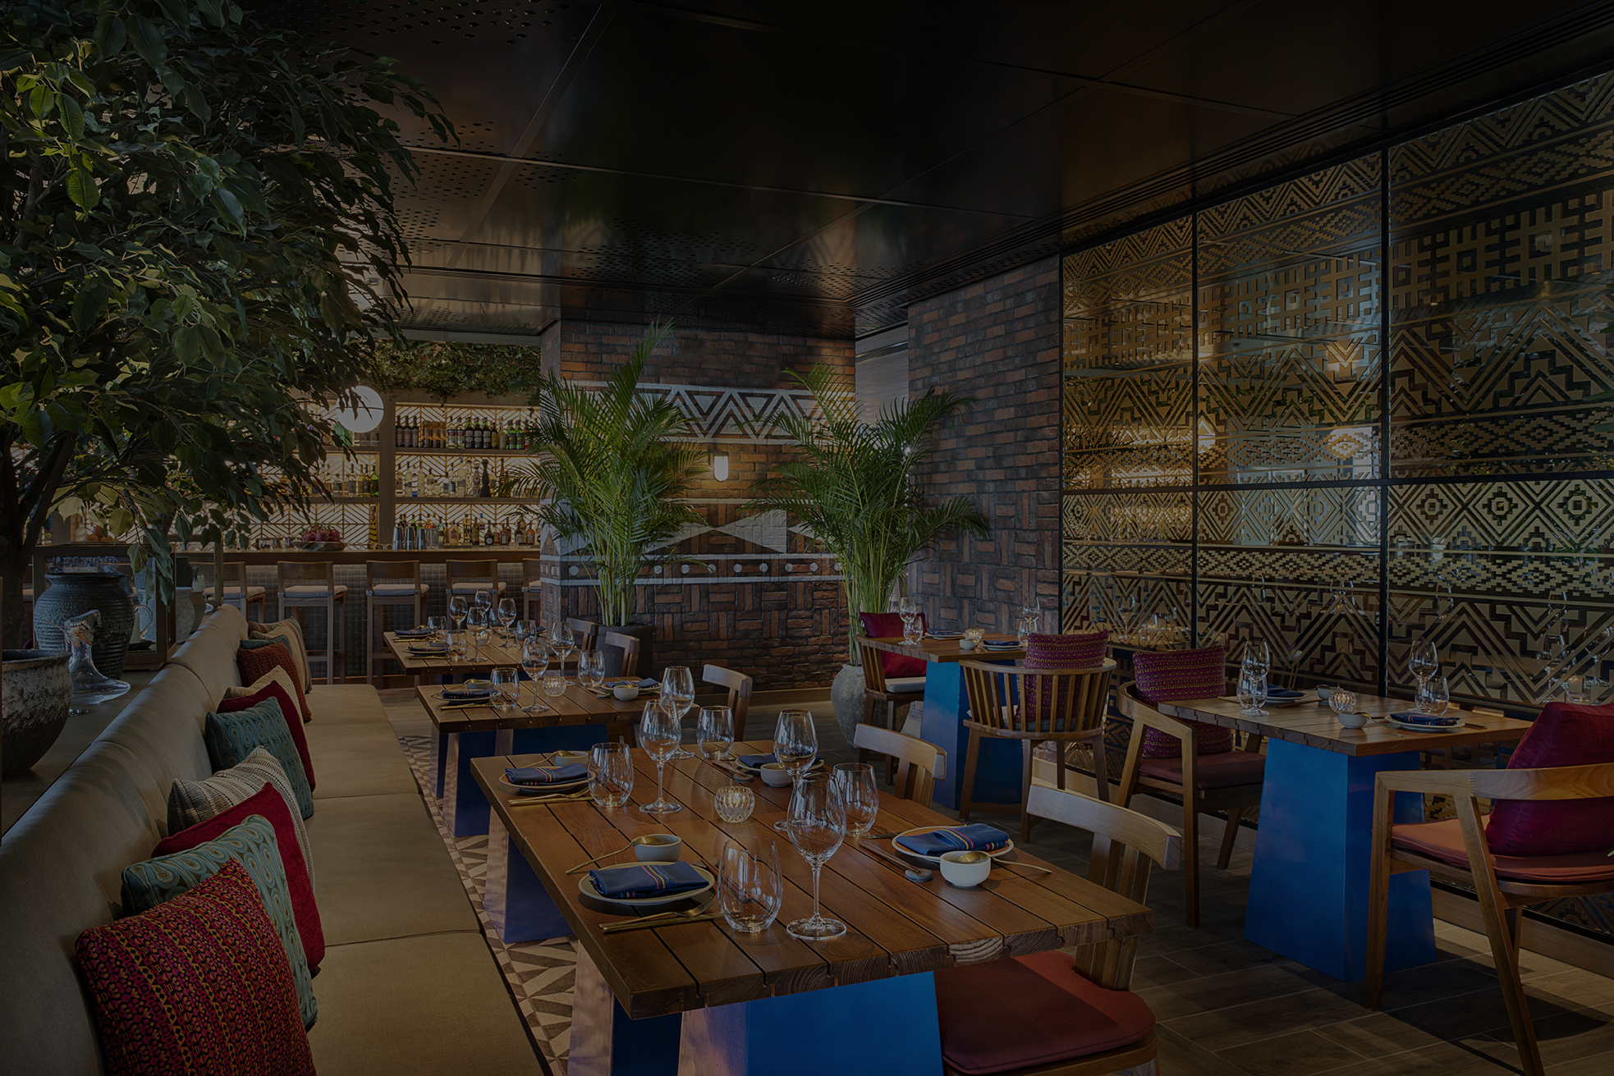
Putting Pricing Front and Center
Cantina - reorganized the menu from high to low prices
(before menu) (after menu) Result increase in % of revenue
(robert cialdini please)
Understanding Pricing Challenges:
Restaurants, including those under Soho Hospitality, often struggle with effective pricing strategies
No Idea what to do!
Expert Insight on Pricing Mistakes
There are two main errors in pricing - charging too much or too little!
Perceived Value of Products
Pricing decisions should be based on the perceived value of goods and services
Lack of precise understanding of the true value of the products sold
Simplified Strategy for Financial Gains:
Increasing prices can be a straightforward method to enhance financial yield and positively impact the balance sheet

Slide 7
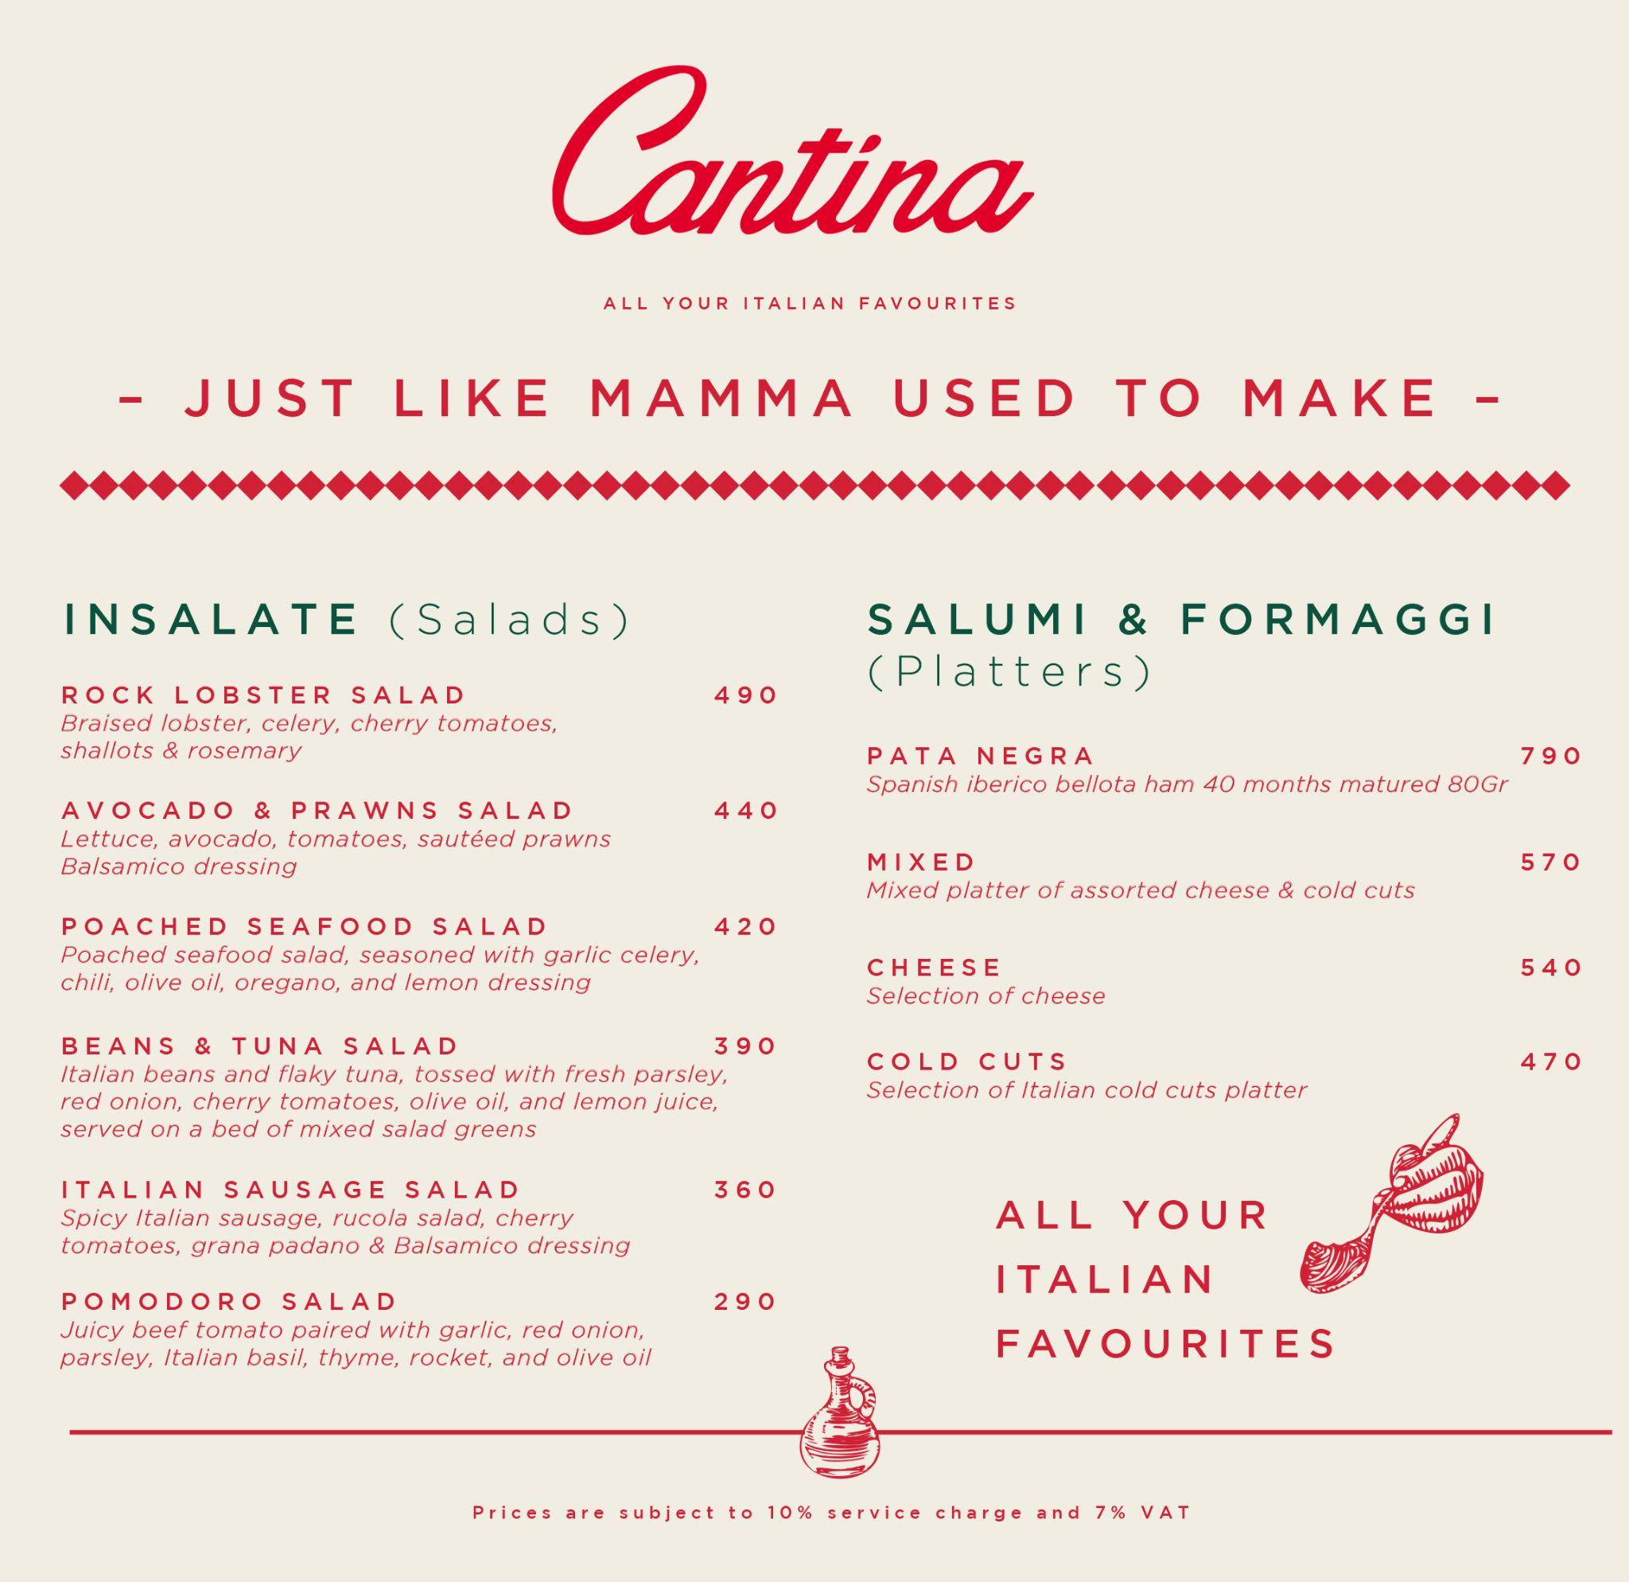
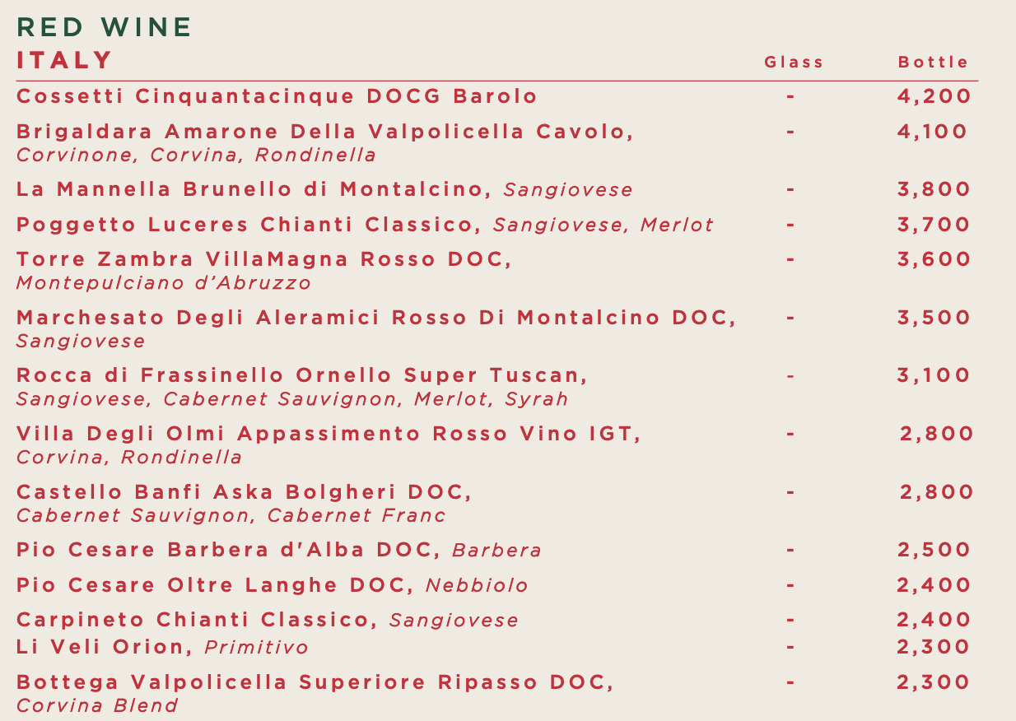
Practical Application and Results
Cantina Italian Kitchen is Soho Hospitality’s Lifestyle Italian Restaurant in Bangkok.
BEFORE
Typically, our menus were organized from least expensive ro the most expensive
Average Per Cover is amongst the highest of all Soho Restaurants
By simply reversing the arrangement and adding more premium wines, from most expensive to least, the revenue jumped
AFTER
We witnessed a 6% increase in revenue from our food menu and a 12% increase in revenue from our wine list

Slide 8
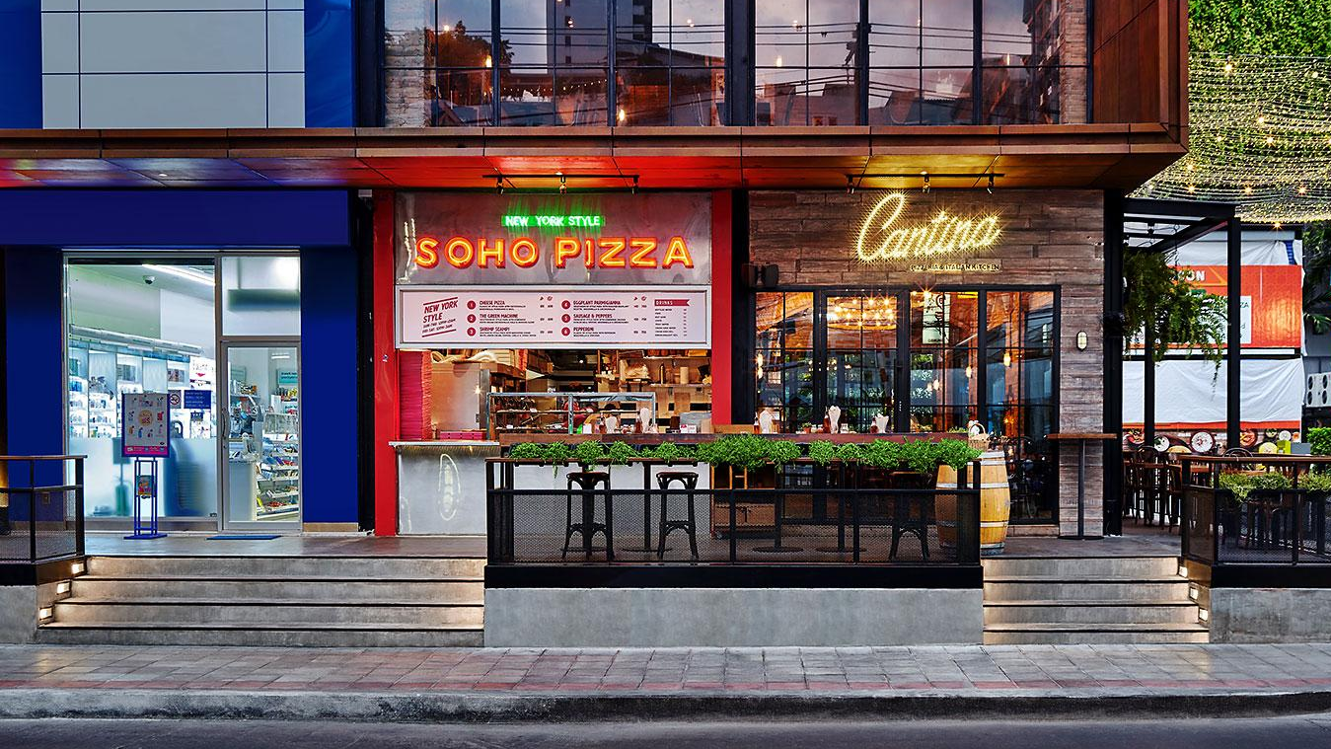
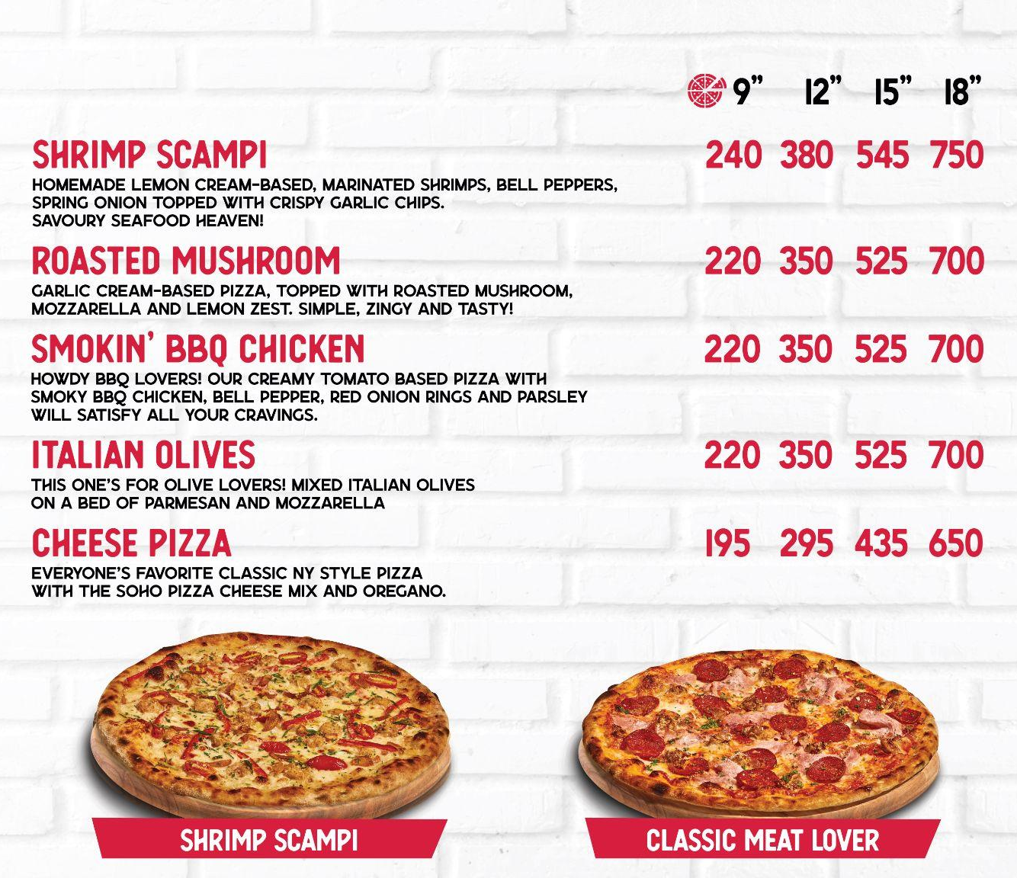
Practical Application and Results
Soho Pizza is Soho Hospitality’s Grab & Go New York Pizza Brand
BEFORE
We have a number of Grab & Go Pizza shops at tourist centric neighbourhood, near popular bars and clubs
We noticed that demand was very high especially during peak hours from 11pm to 4am
AFTER
We installed digital menu boards and implemented dynamic pricing, increasing the price of our 18” pizza slices by 10-12% during peak hours
Revenues were up by almost 10% per month

Slide 9
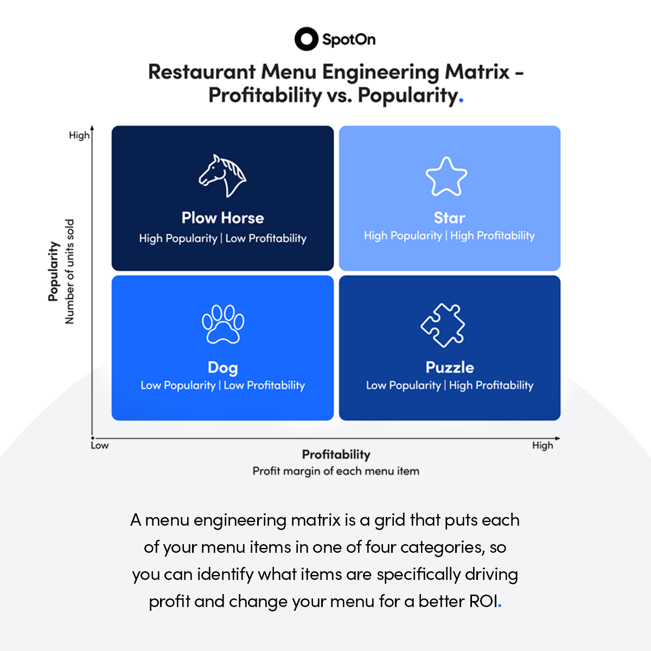
Our menu is our playlist, and not every dish is a chart-topper. By analyzing dish performance, we fine-tuned our offerings, focusing on those that performed like platinum hits. This meant saying goodbye to about 15% of our less popular dishes and spotlighting those that our customers would sing praises for. The result? More applause and encores, less changeover and silence.
Maximizing Profitability through Menu Engineering
Continuous Evaluation
Menu Engineering is not new!
Regular assessment of each menu items popularity and profitability
Menu Optimization
Popular but less profitable dishes are reengineered to increase margins.
Unprofitable and unpopular items are either removed or replaced.
Menus are a restaurant’s real estate!
Menu Size Reduction
Decreasing menu sizes to reduce inventory and holding costs.
Older menus reduced to 25-32 items
Lower food costs by 1-2%
Impact of Menu Design
Limited knowledge about the psychological impact of menu design on consumer behavior
Streamlining menus to enhance revenues and operational efficiency
Plow Horse High Popularity |
Low Profitability
Star High Popularity |
High Profitability
Dog Low Popularity |
Low Profitability
Puzzle Low Popularity |
High Profitability

Slide 10
Our menu is our playlist, and not every dish is a chart-topper. By analyzing dish performance, we fine-tuned our offerings, focusing on those that performed like platinum hits. This meant saying goodbye to about 15% of our less popular dishes and spotlighting those that our customers would sing praises for. The result? More applause and encores, less changeover and silence.
Understanding Our Restaurant Distribution
Hotel vs. Restaurant Revenue Awareness
Hotel GMs are adept at discussing rooms distribution sources
Conversations about restaurant distribution yielding less clarity
Soho Hospitality's Approach
Weekly reviews of revenue distribution to understand and track sources
Benchmarking to identify trends and gaps
Post-Pandemic Strategy Shift
Anticipated a rise in corporate events at restaurants
Hired Corporate sales professionals
Transformed our Restaurants intoi hybrid spaces
Result: Corporate groups are now accounting for up to 8% of our overall restaurant revenues

Slide 11
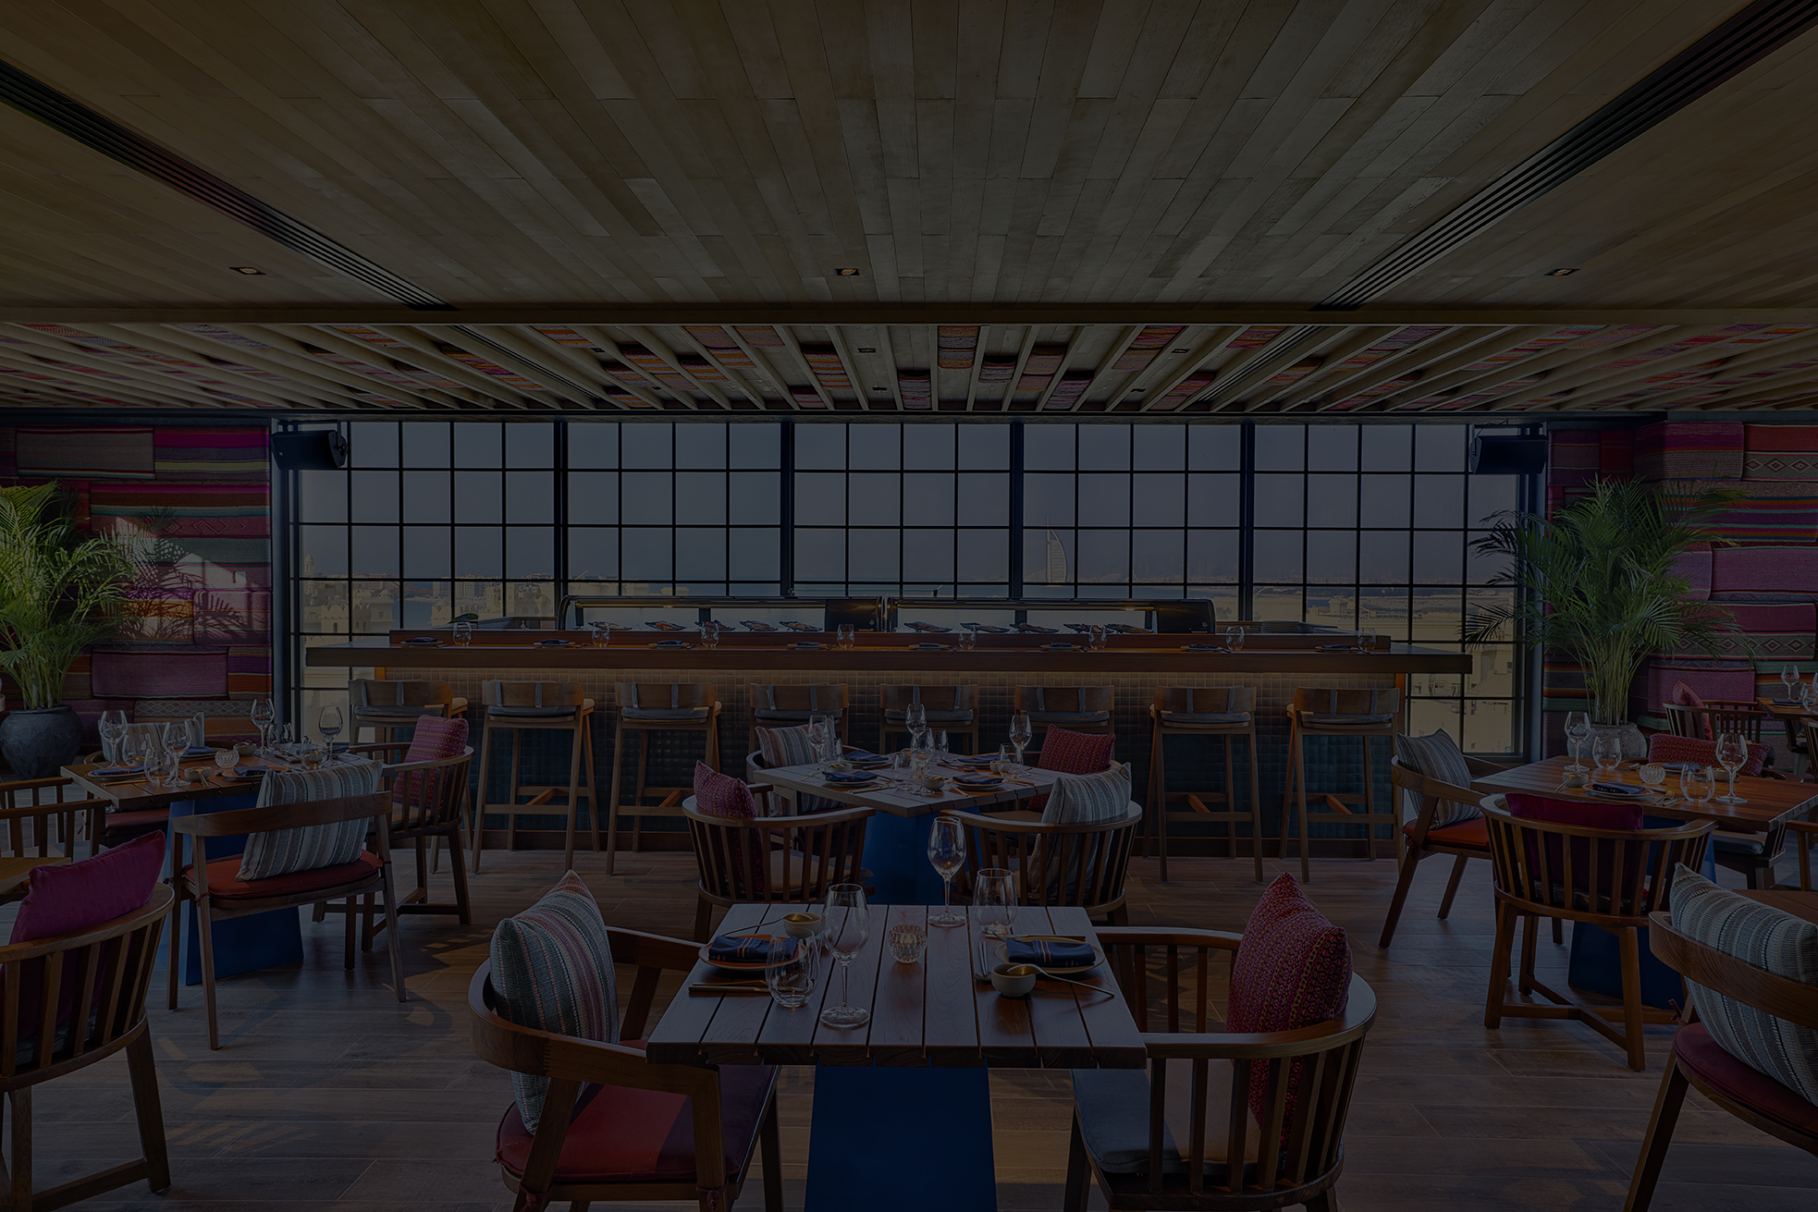
Our menu is our playlist, and not every dish is a chart-topper. By analyzing dish performance, we fine-tuned our offerings, focusing on those that performed like platinum hits. This meant saying goodbye to about 15% of our less popular dishes and spotlighting those that our customers would sing praises for. The result? More applause and encores, less changeover and silence.
Enhancing Restaurant Efficiency Via Table Management
Understanding Current Shortcomings
Restaurants do not really understand table and seat management analytics
(Group Sizes, Dining Time Per Table, Seating Preferences)
Static Strategies
Lack of expertise in the industry
Proposed Strategies for Improvement
Advanced Reservation Management
Software and algorithms for real-time table management
Revenue generating strategies to optimise turn times
Which configurations drive the highest yield at what times of the day?

Slide 12
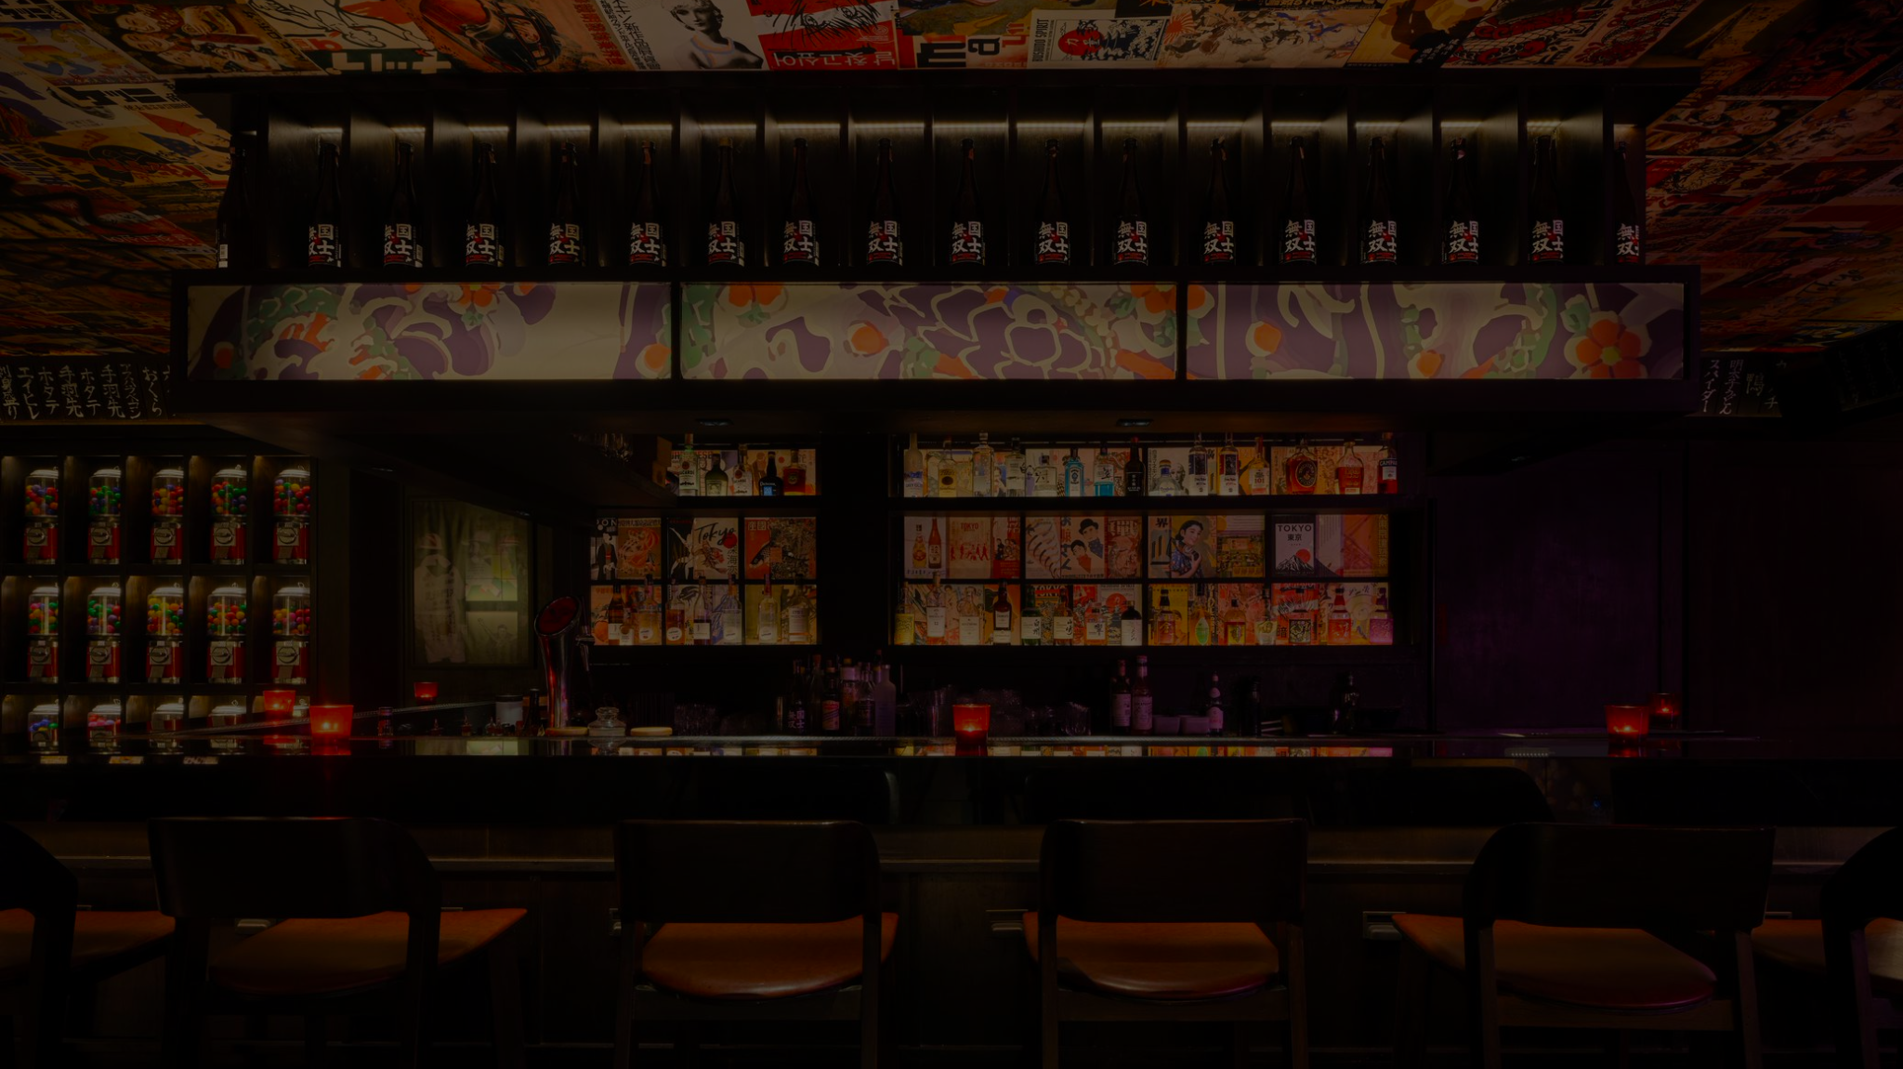
Practical Application and Results
Yankii Robatayaki is Soho Hospitality’s Japanese Entertainment Dining Restaurant.
BEFORE
With only 38 seats and high labour costs, efficiency was a critical factor!
Due to the entertainment programming and gamification, dwell time and spend varies depending on group sizes
All bookings were allocated 2.5 hours per seating
AFTER
By restricting two tables to the beginning of each night and focusing on four tables during peak hours on weekends, revenues increased by almost 10%
TIME
TIME
4PM
5PM
6PM
7PM
8PM
9PM
10PM
11PM
12PM
BEFORE
OPTIMIZATION
1
2
3
4
AFTER
OPTIMIZATION
1
2
3
4
5
5 1/3

Slide 13
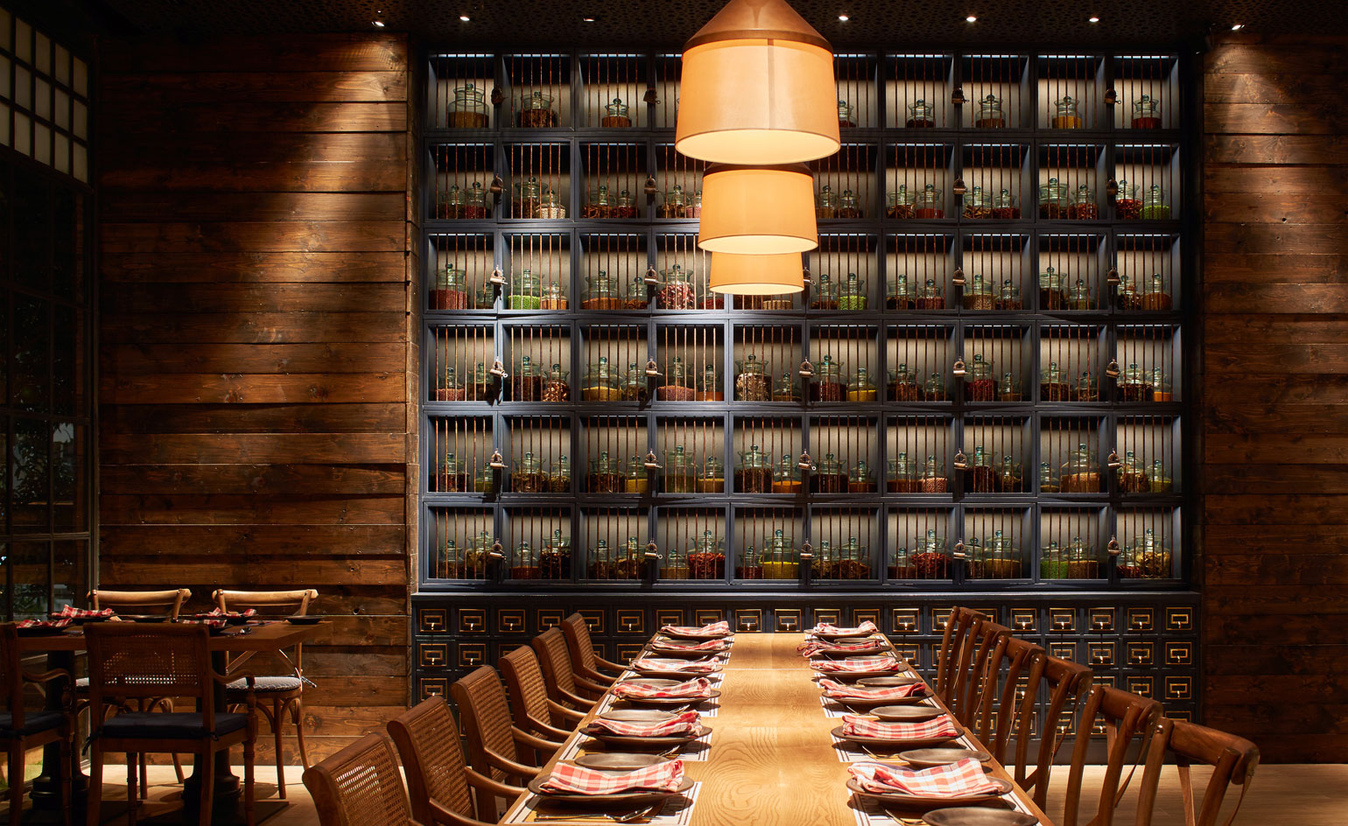
Future of Restaurant Revenue Management
The Future is Bright!
Technology Vs. Consumer Psychological Barriers
New AI tools are driving efficiency
EatLabs uses pixelated cameras installed in kitchens to optimize performance
Emerging Players in the Restaurant Revenue Management Technology Space
Juicer recently raised 5.3 Million USD in seed funding
Perfect Check in Singapore
Restaurant Revenue Management is here to stay!

Slide 14
Email: rohit@sohohospitality.com
www.sohohospitality.com

