Slide 1
SAUDI ARABIA
HOSPITALITY & TOURISM CONSIDERATIONS
DR. MARTIN BERLIN, HOSPITALITY & LEISURE LEAD, PWC MIDDLE EAST

Slide 2
AGENDA
01
Global Challenges & Market Resilience
02
Hospitality & Tourism Market
03
KSA Vision 2030 & Government Initiatives

Slide 3
01
Global Challenges & Market Resilience

Slide 4
GLOBAL THEMES & CHALLENGES
Current Global Themes
Current Global Challenges
DIGITIZE
Harnessing Technology across the value chain from strategy to execution
(e.g AI, fractional ownership, harnessing data)
INFLATION
RECESSION RISK
DECARBONIZE
ESG, Net Zero, Sustainability
WAR IN UKRAINE
AND GAZA
POLITICAL UNREST
LOCALIZE
Supply Chain
PRIVATIZE
Governance, Sector Transformation
GLOBAL CLIMATE CHANGE
SUPPLY CHAIN DISRUPTION
MODERNIZE
Operational activities, fiscal reforms

Slide 5
GLOBAL INFLATION – A SOFT LANDING
KSA INFLATION
GCC inflation witnessed broad-based decline in 2023
2.7%
March 2023
1.6%
March 2024
RUSSIA
INFLATION COMPONENTS IN THE GCC
7.4%
6.4%
UK
8.9%
3.2%
HIGHEST AND LOWEST YEAR-ON YEAR CHANGE (2022-2023)
CHINA
JAPAN
FRANCE
4.8%
2.3%
0.2%
1.7%
HOUSING
USA
3.2%
3.5%
3.2%
2.9%
19.5% UAE
KSA
INDIA
-3.6% Bahrain
2.7%
1.6%
3.2%
4.6%
F&B
11.5% Bahrain
-4.5% UAE
UAE
HOSPITALITY
6.2% KSA
3.6%
2.1%
-2.3% Qatar
LEISURE
As of March
1.7% Oman
14.9% Qatar
2023
2024
Source: IMF, Bloomberg

Slide 6
SAUDI TOURISM FIGURES BEYOND PRE-COVID LEVELS
Inbound Tourism
2019
Pre-COVID
2022
Post-COVID
2023
H1
2023
Annualized¹
Number of Tourists
17.5 mn
16.6 mn
14.6 mn
27.4 mn
Overnight Stays
189.0 mn
270.7 mn
261.7 mn
460.2 mn
Tourist Spending in SAR
103.4 bn
98.3 bn
76.9 bn
135.0 bn
Average Length of Stay
10.7 nights
16.3 nights
17.9 nights
16.7 nights
Domestic Tourism
Number of Tourists
47.8 mn
77.8 mn
30.0 mn
79.2 mn
Overnight Stays
268.8 mn nights
369.7 mn nights
246.5 mn nights
547.2 mn nights
Tourist Spending in SAR
61.2 bn
107.3 bn
63.1 bn
150.0 bn
Average Length of Stay
5.6 nights
4.7 nights
6.3 nights
6.9 nights
Source: MOT KSA, STA, Euromonitor
1: 2023 H1 figures from MOT annualized (PwC analysis)

Slide 7
STONG HOSPITALITY MARKET RESILIENCE IN KSA
Expanding Visa offerings to attract tourists & investors
Introducing new laws to develop an internationally competitive tourism sector
Kingdom achieves ~100 million tourist visitors as of 2023 – 80% of which are domestic tourists
Creating job opportunities in the hospitality & tourism sector
2017
2019
2021
2022
2023
Increased investment in the hospitality & tourism sector
Relocating companies HQs in the capital Riyadh
Saudi FDI inflows rise 29% amid ongoing economic reforms
Oil production cuts slowed GDP yet non-oil activities grew by 4.6% in 2023
Source: WTTC, Euromonitor

Slide 8
02
Hospitality & Tourism Market

Slide 9
MARKET OVERVIEW & OUTLOOK
Inbound Tourism
OUTLOOK
KSA is aims to attract 150 million visitors by 2030, by increasing visa facilitation
Increasing capital investment towards enhancing its travel and tourism industry
Growth in tourism is expected to have positive spillover effect on complementary sectors such as entertainment, hospitality and retail
POSITIVE
Hospitality
5-star and 4-star hotels will dominate forthcoming supply:
5-star and 4-star keys supply: +9.4% and +8.8% respectively by 2027
3-star keys supply: +10% by 2027
The hotel sector in Makkah is the strongest in the Middle East. The city is also expected to receive 30mn pilgrims by 2030
POSITIVE

Slide 10
SAUDI TOURISTS BY PURPOSE
Inbound Tourism
VISITING FRIENDS
& FAMILY
BUSINESS
LEISURE
RELIGIOUS
OTHER
(Medical, transit etc.)
2019
Pre-COVID
15%
18%
6%
57%
4%
2023
32%
10%
15%
36%
7%
Domestic Tourism
2019
Pre-COVID
30%
3%
42%
23%
2%
2023
40%
6%
38%
10%
6%
Source: MOT, STA

Slide 11
RELIGIOUS TOURISM IN SAUDI
PIGRIM (Hajj) DATA
Whilst Hajj pilgrims are slowly moving back to pre-COVID and historical levels, Makkah saw a record-breaking 13.5 million Umrah visitors in 2023 – bringing total pilgrim numbers to ~15 million visitors
Domestic Pilgrims
International Pilgrims
3.2
2.8
2.9
2.4
2.4
2.5
+106%
2.0
2.1
2.0
1.9
1.9
0.1
COVID-19 effect
0.9
0.0
0.0
0.1
0.0
0.0
2010
2011
2012
2013
2014
2015
2016
2017
2018
2019
2020
2021
2022
2023
Source: GASTAT

Slide 12
HOSPITALITY MARKET SUPPLY & PERFORMANCE
HOSPITALITY STOCK & SUPPLY
HOSPITALITY
PERFORMANCE
Hotel Assets
Keys/Rooms
There are 11 planned hotels and resorts across the Kingdom with a total of 1,563 upcoming keys which will be delivered between 2024 and 2025
RIYADH
JEDDAH
MAKKAH
DMA
2023
CITY-WIDE
OCCUPANCY
77.5%
79.9%
80.0%
79.3%
Y-O-Y ADR
CHANGE (2022-2023)
17.5%
0.4%
21.9%
-1.6%
25,254
Y-O-Y REVPAR
CHANGE (2022-2023)
23.5%
12.9%
29.8%
13.1%
5,882
5-Star
4-Star
3-Star & below
Hotel Apartments
Source: GASTAT, STR

Slide 13
03
KSA Vision 2030 & Government Initiatives

Slide 14
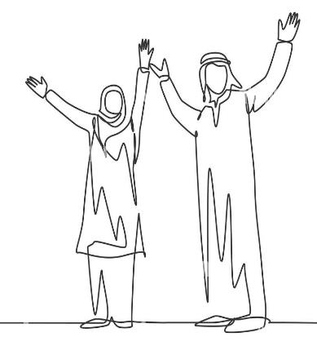
VISION 2030
& NATIONAL TOURISM STRATEGY
The Saudi Arabia Vision 2030 aims to follow pillars of the world’s top livable cities, including those that would boost tourism
A Thriving
Economy
A Vibrant
Society
An Ambitious
Nation
The National Tourism Strategy aims to contribute to Vision 2030 objectives by developing and enhancing 10 destinations across 35 sites
2023
100 million
2030
150 million
VISITS
2023
882 thousand
2030
1 million
NEW JOBS
2023
27.20 million
2030
55 million
INTERNATIONAL VISITORS
2023
4.5%
2030
+10%
CONTRIBUTION
TO GDP
Source: Vision 2030, MT

Slide 15
KEY INITATIVES BOOSTING TOURISM IN THE KINGDOM
Tourist Visa
Tourists from EU countries, Asian countries, American countries, countries of Oceania can obtain visa
Tourism Development Fund
“Awn” Program supports the launch of existing & new tourism establishments with financing support from 10K upto 1Mn SAR
Umrah Plus Program
The Program includes tourist trips, besides the Umrah rituals
Tourism Human Capital Development
Tourism Human Capital Development at MoT is offering a number of possible programs, which will contribute to achieve Vision 2030
New Tourism Law
Ten new regulations to develop the tourism sector to keep pace with Saudi Arabia’s renaissance
Virtual Tourist sights & landscaping
MoT is providing extended tourism reality applications, such as: Virtual 3D visits to the Holy mosques & Virtual Al-Ula tours
Tourism Licenses
As part of the digital transformation of e-government procedures, MoT provides electronic services related to tourism licenses
Free Overnight Stopover
In a bid to attract new visitors to the destination, KSA has launched a new stopover visa to encourage travellers to explore the country
Source: Vision 2030, MT

Slide 16
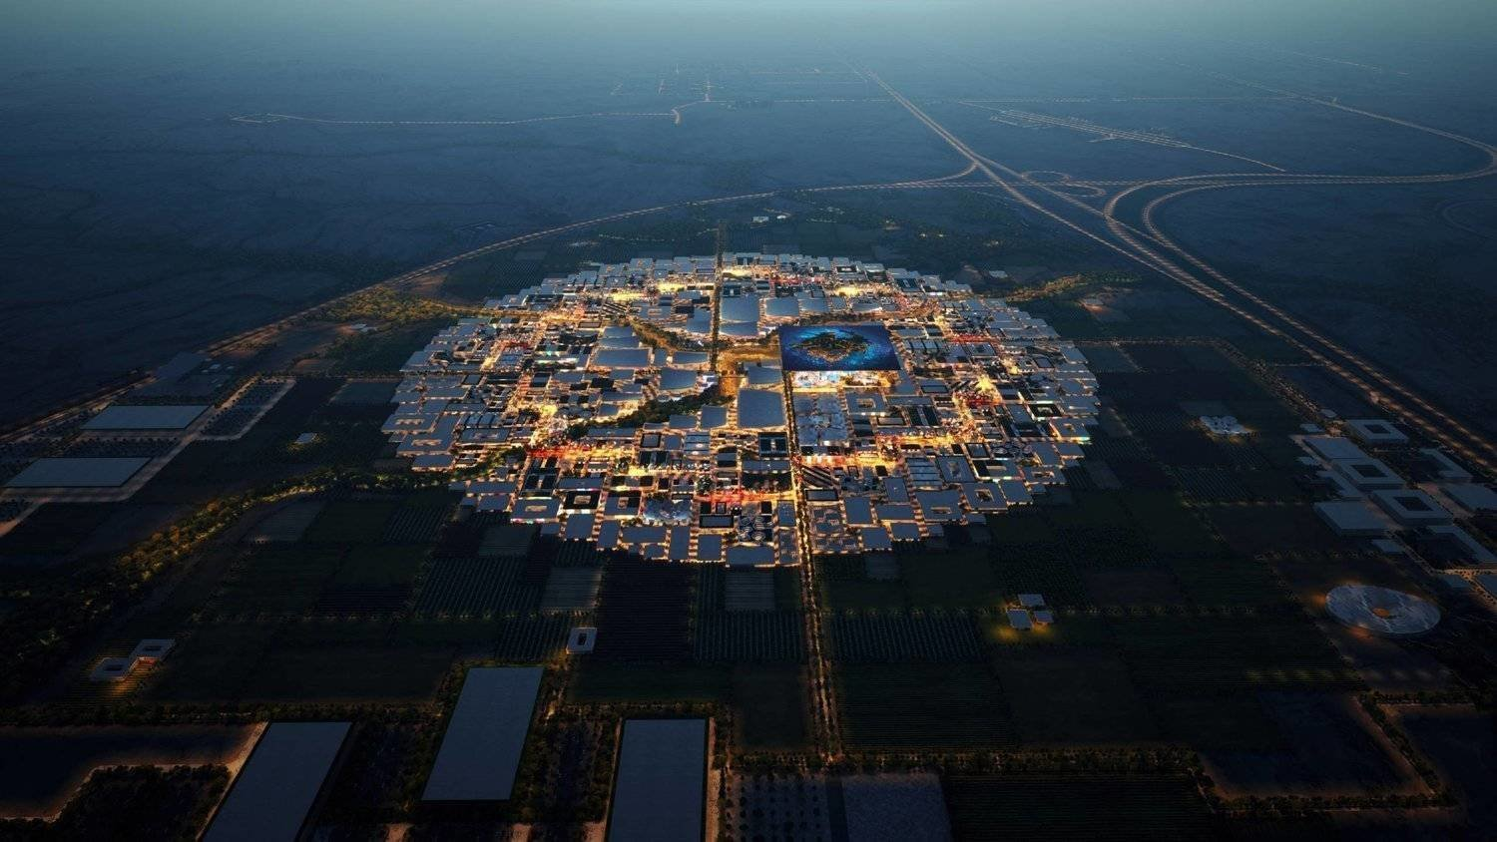
KEY EVENTS IMPACTING HOSPITALITY & TOURISM
2027 Asian Cup
2029 Asia Winter Games
The 2027 AFC Asian Cup will be held in the Kingdom across 10 stadiums in Riyadh, Jeddah and DMA
In October 2022, the Kingdom won the bid to host the 2029 Asia Winter Games in Trojena - NEOM
EXPO 2030
2034 FIFA World Cup
The World’s EXPO 2030 will be held in Riyadh. It is planned to span 6 million sqm of land and receive 40 million visitors
Investment in sports is a significant part of Saudi Arabia's Vision 2030 strategy to diversify its economy away from oil
Source: Vision 2030, MT

Slide 17
Conclusion

Slide 18
IN CONCLUSION
Reimagine
The world is experiencing multiple challenges at the same time create a need for business to reimagine their delivery & performance across the value chain
Resilience
The KSA market has seen an accelerated recovery and is proven to be relatively more resilient than others in navigating economic shocks
Strategy
A robust detailed strategy and business plan are necessary and are be interlinked to the design and delivery of projects which will realise value in line with Vision 2030
Experience
As the KSA market matures, companies should focus on end-user experiences through market segmentation and focus on the experience from pre to post sales to engage and retain the customer base.
Proactivity
In alignment with Vision 2030, numerous laws & initiatives are being launched to attract more tourists and foreign investment in KSA

Slide 19
Thank You
PWC.com
At PwC, our purpose is to build trust in society and solve important problems. We’re a network of firms in 151 countries with nearly 364,000 people who are committed to delivering quality in assurance, advisory and tax services. Find out more and tell us what matters to you by visiting us at www.pwc.com.
Established in the Middle East for 40 years, PwC has 24 offices across 12 countries in the region with around 10,500 people. (www.pwc.com/me).
PwC refers to the PwC network and/or one or more of its member firms, each of which is a separate legal entity. Please see www.pwc.com/structure for further details.
© 2024 PwC. All rights reserved

