Slide 1
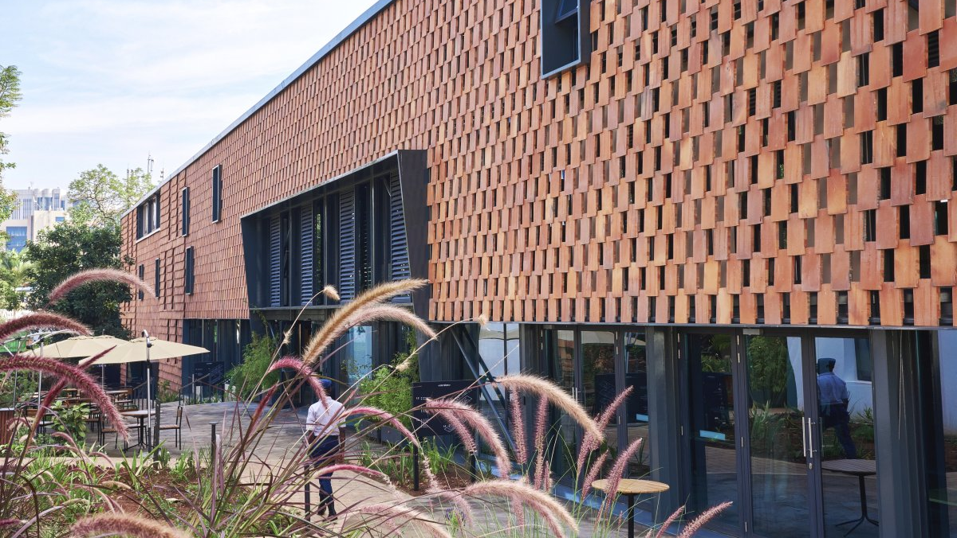

Global & African Hotel Investment Trends
FHS 2024
June 2025
Notes:
Good morning everyone,

Slide 2
Global real estate sentiment survey
Over the next six months, do you think market conditions will:
% of respondents
Improve
Stay the same
Worsen
Nov
2019
Feb May Aug Nov
Feb May Aug Nov
Feb May Aug Nov
Feb May Aug Nov
Feb May Aug Nov
Feb May
2020
2021
2022
2023
2024
2025
Source: JLL, October 2022
Notes:
This uncertainty is reflected in the results of our sentiment survey. As usual we ran this for a week on Linkedin prior to this webcast. We asked Over the next six months, do you think market conditions will improve, stay the same or worsen? This quarter we received around 2,700 responses to this question.
Following an improvement through the course of 2024, sentiment moderated at the start of the year and was impacted further by the rising uncertainty since last month, with the share expecting conditions to improve declining to 38%.

Slide 3
Policy uncertainty reaches new heights U.S. trade policy uncertainty index
March
Feb
Jan
Source: “Measuring Economic Policy Uncertainty” by Scott Baker, Nicholas Bloom and Steven J. Davis at www.PolicyUncertainty.com.
Notes:
First, the global economic narrative during the first quarter was dominated by news about trade policy and tariffs, which sharpened in April following the end of the quarter. This has weighed on business confidence and created disruption in financial markets, with expectations for growth over the rest of the year softened. GDP growth is still expected to be positive this year and next in most major markets, but the situation remains highly fluid with a wide range of potential outcomes depending on the evolution of trade, fiscal and monetary policy.

Slide 4


New liquidity cycle could better suit African CRE
Focus is shifting to income growth over a longer period without the benefit of cheap leverage.
Core fund allocations by sector (2024)
Supply shortages will inhibit capital from getting to in-demand sectors
This will lead to creativity in how capital is allocated to these sectors
We will not see any material change in sector capital allocations
Liquidity is returning to the market
New liquidity cycle
Growing number of bidders have re-entered the market
Bid-ask spreads have narrowed, though they remain wider
Source: JLL Research, Global ODCE Fund Index data as of Q2 2024; *other pertains to special purpose facilities.
4 | © 2025 Jones Lang LaSalle IP, Inc. All rights reserved.
Notes:
Sector diversification remains a top priority in the current investment climate
Growth opportunities in focus in the living, industrial and alternative growth sectors as they mature globally
Thematic strategies span a broad set of sectors of varying maturity levels globally including:
Living / Multi-housing
Further institutionalization will be strong in Japan, China and Australia as well as parts of Europe (UK, France, Spain and Italy), where market maturity remains below current levels in the U.S. and Canada
Industrial & Logistics
Global growth and innovation will be driven by structural and behavioral shifts in consumption
Growth in manufacturing accelerating in North America
Urban logistics innovation expected in Europe
Asia Pacific e-commerce boom given dense population
Life Sciences
Exponential growth expected long-term, particularly in more mature markets in the U.S. and UK
Beneficiary of office repurposing, with a strong development pipeline in many markets
Data Centres
Major markets including U.S., UK, and Singapore will see continued growth as investors are increasingly seeking exposure due to long-term growth potential
Onset of new liquidity cycle
What do we know:
Fed’s 50 bps rate cut will provide a boost to the already-bourgeoning new liquidity cycle
Active investment sales engagements up 62% vs. one year ago as of September; active debt advisory engagements up 150% year over year as of September
Bid velocity up 43% last three months vs. Q4 2023
Institutions more active (53% of winning bids on transactions $100M+ over past six months)
More pricing data points across the board; seeing cap rate compression in in-favor sectors
Seeing meaningfully lower borrowing costs; CMBS issuance up 180% YoY
ODCE redemption queues turning the corner; appraisal cap rates starting to come closer to ‘spot’ values (with exception of office)

Slide 5
Growth in transactions in Q1, but sentiment shifted.
Direct investment volumes
US$ billion
Americas
+37%
YoY in Q1 25
EMEA
+41%
YoY in Q1 25
34%
Asia Pacific
+20%
YoY in Q1 25
Source: JLL Research, deals US$5m and above excluding entity and land
Notes:
Globally, direct investment volumes were up 34% Q1 YoY to US$185 billion, albeit first quarter 2024 was a relatively low basis
Strong activity was recorded across all regions in Q1: Americas (+37% YoY), EMEA (+41% YoY) and Asia Pacific (+20% YoY)
U.S., U.K., South Korea are large markets that performed the strongest in terms of YoY growth (42%, 83% and 58%, respectively). However, U.K. volumes driven by a military housing portfolio; excluding this, volumes were up 9% YoY in the U.K.
In Asia Pacific most major markets outperformed whereas China saw a 33% decrease in transactions activity in the first quarter due to weakening sentiment on the backdrop of domestic challenges and geopolitical concerns around escalating trade wars. As a result, in China major global investors have started further decoupling from the market
Notably, cross-border investment increased 57% in Q1 2025 YoY. This marks the highest first quarter level since 2022, evidencing how the continued improvement in capital markets dynamics during much of the quarter led to additional normalization of cross-border activity, only to face increased disruption at the start of the second quarter.

Slide 6
Global hotel liquidity remains soft; rate cuts signal investor optimism While global hotel transaction volume grew 7% vs 2023, it remains behind historical averages driven by stubbornly high interest rates. Look for increased debt market clarity, underpinned by expected monetary easing, to help fuel transaction activity. JLL forecasts global hotel liquidity to grow 15% to 25% in 2025, with the Americas to grow the most followed by EMEA and APAC.
Global hotel investment volume & number of trades, 2015 – 2024
Source(s): JLL Research.
Note(s): Figures shown above each bar represent total global volume by period listed. Includes all transactions $5M+ excluding casinos. Entity-level deals are included only of real estate was traded.

Slide 7
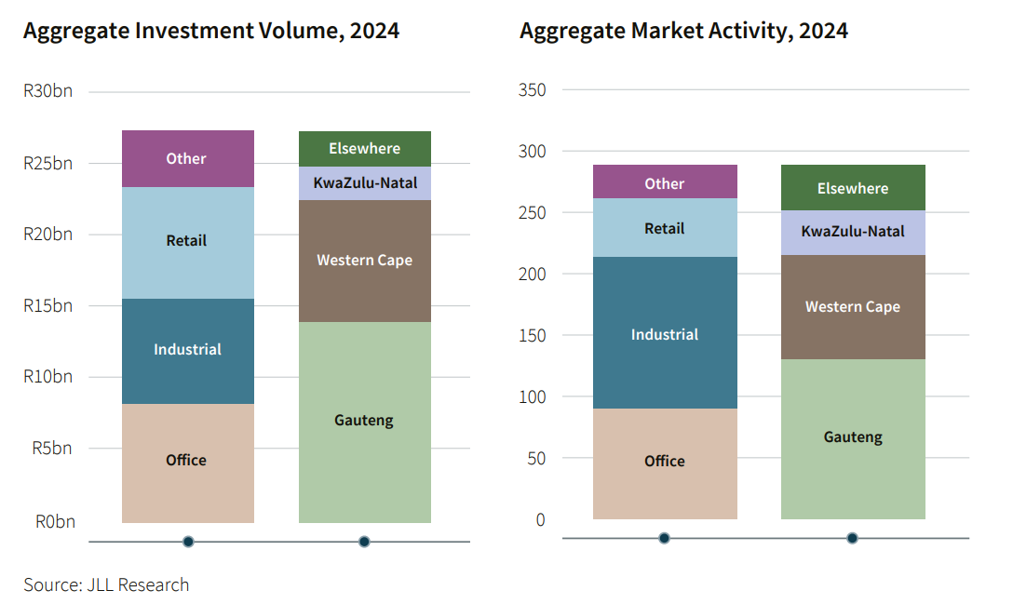
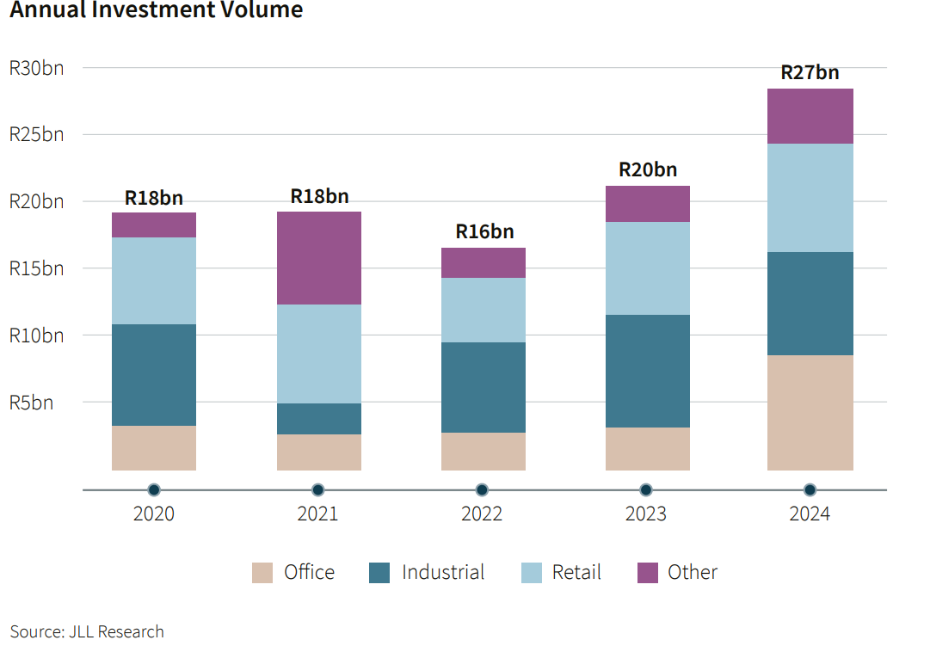
Uptick in SA CRE liquidity highlights commencement of new cycle.

Slide 8
Hotel liquidity is moderately up, but the source of capital is now more balanced, together with a moderate uptick in new developments.
Sub-Saharan Africa hotel investment volume 2013 –2024
Transaction Volumes, SSA vs. Dubai
Hotel liquidity is moderately up, but the source of capital is now more balanced, together with a moderate uptick in new development planning.
We expect liquidity growth in 2025 and 2026, primarily concentrated in South Africa, the Indian Ocean and Morocco.
Source(s): JLL Research,

Slide 9
Muted global hotel supply growth to fuel RevPAR and M&A Global hotel supply is expected to grow 220 bps less than its long-term average over the next four years as construction costs remain high and supply chain disruptions persist. Existing hotels should benefit, particularly those in urban and other high barrier-to-entry markets. Look for this to also spur hotel brands to increasingly use their balance sheets to fuel net unit growth.
Global hotel supply and number of rooms in construction, 2015 – 2028
Source(s): JLL Research, STR/Costar
Note(s): 2025-2028 forecasted supply is based on JLL estimates using number of rooms currently in the pipeline as of Nov 2024. 2015-2024 rooms in construction as of year-end. 2020 is intentionally omitted as numerous hotels were closed due to Covid.

Slide 10
The development pipeline has slowed, but arguably with a stronger realisation rate. The shortage of development funding has seen projects stall, and the pipeline of hotels under construction has also stalled. This bodes well for stronger performance in markets with measured supply growth and the right demand fundamentals.
Transaction Volumes, SSA vs. Dubai
Source(s): JLL Research,

Slide 11
Supply Clock
Size of Market
Ease of bringing in new supply
Each market is at a different point of its cycle and has unique factors such as scale and development barriers. Many markets remain in an “Ebb” phase as the barriers to new supply become inherent.
Small markets that have efficient development characteristics tend to reach oversupply quicker, regardless of demand.
Dar es Salaam
Windhoek
Kigali
Addis Ababa
Mauritius
Lagos
Accra
Johannesburg
Cape Town
Ebb of Supply Cycle
Supply Cycle Commencing
Luanda
Cairo
Abidjan
Supply Cycle Slowing
Supply Cycle Peaking
Dakar
Zanzibar
Seychelles
Nairobi
11 | © 2025 Jones Lang LaSalle IP, Inc. All rights reserved.
Casablanca

Slide 12

Key Contract Price Adjustment Provisions
Key Commodities and Materials
Key Rate Card – From Contractors
Overall YoY the Construction Input Price Index (CIPI) reflects a 1.5% increase from Apr 2025 to Mar 2024 in comparison to a 7.5% increase from Jan 2024 to Jan 2023. Stabilization of construction prices will represent consistent yields and increased appetite for development.
Key Rates | Unit | 2024 ZAR | 2025 ZAR | % Change
Concrete (25 MPa) | M3 | 1,800 | 1,850 | +2%
Reinforcement bars | t | 17,100 | 15,300 | -11%
Structural Steel | t | 56,700 | 51,800 | -9%
Global Trends & Commentary
CIPI Jan 2025 +1.5% from +7.5% in Jan 2024
CPAP +4.2% 2025 resulting in -1% decline from 2024
Steel prices steady decline from price hike in Q1 2024
Structure equates to circa 30% of build costs
Electrical / Mechanical YoY have increased respectively
Brent Crude Oil - Q1 2024 @ 85$ / barrel / Q1 2025 @ 72$ / barrel
Source: Stats SA PO151.1
+4.1%
-12.7%
-5.6%
+7.1%
+1.5%
Concrete
Rebar
Structural Steel
Electrical Components
Bricks & TIles
Notes:
Monthly our CM team track key Contract price adjustments using STATS SA
1.) Overall the CIPI index has come down nicely from +7.5% in Jan 2024 (yoy) to +1.5% in Jan 2025 representing a healthy market for developers / new builds
2.) CPAP – 1% decline to 4.2%
3.) Concrete prices have increased in line with CPAP
4.) Steel prices which account for a large portion of the sub and superstructure costs have recovered from the price hike in Q1 2024, reducing by circa 10.8% yoy.
5.) M& E have increased Yoy by 5-8.3%
6.) Brent crude oil from by 13$ a barell from Q1 2024 to Q1 2025
Overall construction prices are starting to stabilize, decreasing volatility of price fluctuations resulting in a clear forecast in terms of annual growth in the overall construction sector.

Slide 13
Global tourism recovery was at 99% in 2024 1.4 billion international tourist arrivals in 2024 with the strongest recovery in the Middle East (32%), Africa (7%) & Europe (1%). International tourist arrivals are expected to increase by 3-5% in 2025.
Bern
Global international tourism recovery compared to 2019
Source: UN Tourism (January 2025)
Notes:
Risks to recovery: Conflict (Ukraine, Israel-Palestine), uncertainty such as Trump policies and macro-economic factors (incl Liberation Day - Trump tariffs). Potential trade wars and economic recession. Resultant impact on incomes and corporates leading to decreased travel. Skift reported declines in travel to US in March. Luxury market tends to be resilient however.
T&T generally exceeds global GDP growth but economic factors such as constrained growth can hamper tourism growth.
Africa recorded 9% growth in arrivals in Q1 2025, compared to 2024, exceeding pre-pandemic traveller numbers by 16%.

Slide 14
Africa’s share of global tourist arrivals Between 2010 & 2019, Africa’s share of global tourist arrivals decreased from 5.3% to 4.7% - in 2024 it’s share increased to 5.1%.
Bern
Regional share of global tourist arrivals
Africa
50M
Africa
69M
Africa
74M
Source: UN Tourism
Notes:
Bear in mind that Asia-Pacific wasn’t fully recovered in 2024.
Absolute terms – Africa 48% Global 52% - Africa lags behind global T&T growth.
Africa CAGR 2.7% 2010-2024. Global 3.0%. World arrivals 1BN or more since 2010, excl Covid years. ME consistently exceeds Africa.

Slide 15
Forecasted tourism growth does not reflect the opportunity. Global international tourist arrivals are forecasted to reach 2.4bn by 2034 with Africa reaching 144M, increasing its share from ~5% to ~6%. The biggest gain will be the Middle East, increasing from ~5% to ~8%. Europe & Americas forecasted to lose slight.
Bern
International tourist arrivals forecast
CAGR ‘19/34
3.2%
2.6%
3.8%
2.9%
5.9%
3.7%
Source: WTTC / Oxford Economics
Notes:
Business as usual scenario.
Where will the growth in Africa go to? Cities. Geographic distribution carefully managed to ensure sustainability especially of natural areas.
2019 Africa numbers don’t correlate to UN Tourism figures so don’t mention them – OE is the source here (global total correlates)

Slide 16



Where are we investing and where is our highest ROI? More than USD23BN* invested into new airports / expansions, ICCs and hotels in the last 10 years.
More than USD23BN* invested into new airports / expansions, ICCs and hotels in the last 10 years.
Where are we investing
Where are we investing, but not primarily for tourism
Airports
Hotels
Ports
Urban
Nightlife and F&B
Bern
Convention Centers
Rail
E-Hailing and Tech Platforms
Africa can unlock $50BN in T&T growth by 2033 & add 6M jobs by addressing three policy areas.
Increase real T&T GDP
Increase in T&T jobs
Enabling environment & air infrastructure
$50bn
6mn
Visa facilitation
By 2033
Collaborative tourism marketing
Source(s): WTTC
Notes:
Real opportunity is to leverage demographic growth in Africa which can super-charge the above.
Investing to improve Africa’s enabling environment and air infrastructure. Seat capacity at time of report was well below 2019 levels from Asia. Air routes within Africa need expansion. Air fees and taxes are $64 in Africa vs $30 in Europe – address costs to travel.
Implementing best practice for visa facilitation. SA’s visa policy for Kenya resulted in 99% increase in arrivals in 2023. 41% of Tourism Update readers indicated negative impact on bookings for Namibia with new visa rules for visa exempt countries.
Implementing collaborative tourism marketing activity for Africa over a defined period. To address negative perceptions and move away from positioning Africa as once-in-a-lifetime place to visit, particularly for wildlife. We have so much more to offer.

Slide 17




A continent apart: Inter-African connectivity is key The 1,000 KM journey between two cities in Africa and Europe presents a vastly different story. While PAR is unlikely to be achievable in the near term, closing this gap materially between cities is key to promoting tourism growth.
Bern
 | Libreville to Bangui | Nine Hours | One | $1,000
 | Paris to Madrid | Two hours | Nil (Direct) | $200
Route
Time
Stops
Cost
Africa
Europe
Source: JLL Research
Notes:
Business as usual scenario.
Where will the growth in Africa go to? Cities. Geographic distribution carefully managed to ensure sustainability especially of natural areas.
2019 Africa numbers don’t correlate to UN Tourism figures so don’t mention them – OE is the source here (global total correlates)

Slide 18
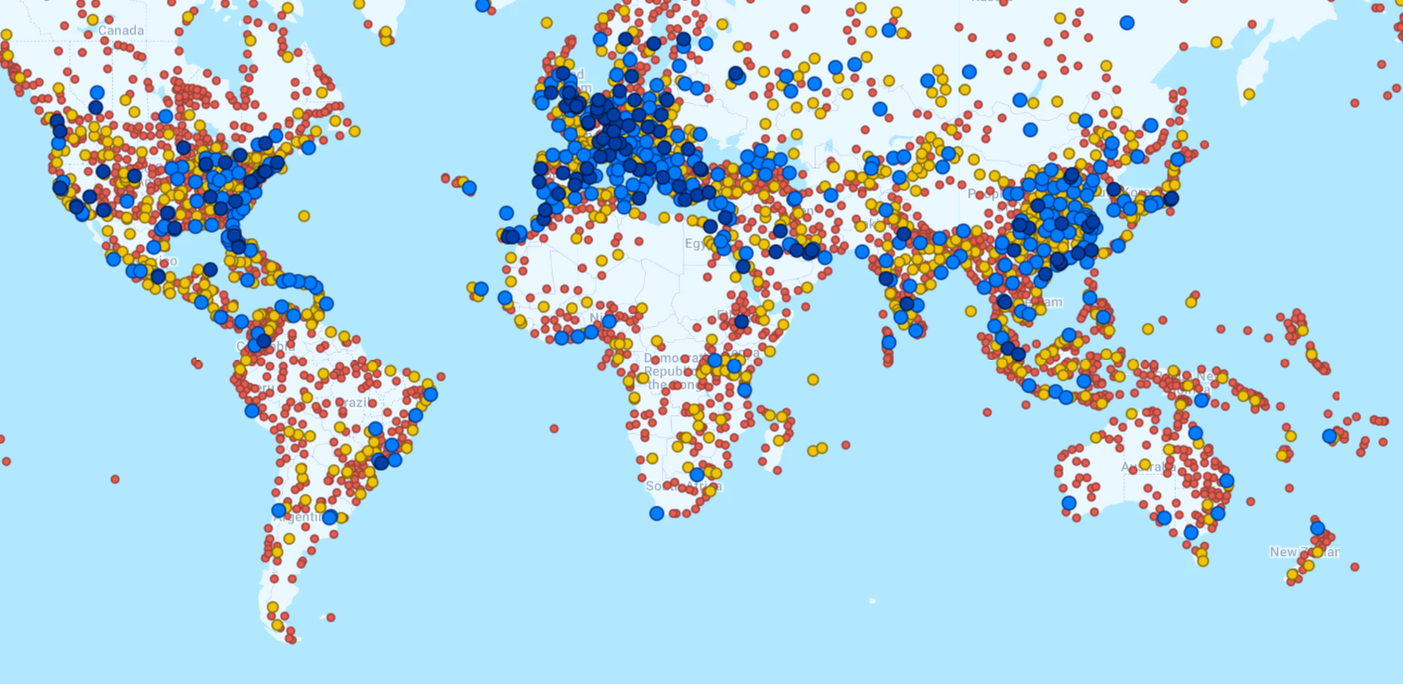
A continent apart: Inter-African connectivity is key Only Addis Ababa, Cairo, Casablanca and Marrakech have more than 100 direct connections.
Only Sao Paulo and Singapore connect to more than 100 destinations in the Southern hemisphere.
Nine out of 45 Sub-Saharan African countries have more than 30 connections, while seven out of 12 in South America have.
Bern
>100 direct connections
>30 direct connections
>7 direct connections
<7 direct connections
Source: JLL Research
Notes:
Only Sao Paulo and Singapore has more than 100 in the Southern hemisphere. Nine out of 45 Sub-Saharan African countries have more than 30 connections, while seven out of 12 in South America have. South America welcomed 32.92 million international traveller. Africa slightly more than.

Slide 19
Transparency
Rank | Country | Rank | Country | Rank | Country | Rank | Country
Highly Transparent |  | 25 | Portugal | 49 | Vietnam | Opaque
1 | UK | 26 | Chinese Taipei | 50 | Slovenia | 74 | Ecuador
2 | France | 27 | South Korea | 51 | Kenya | 75 | Algeria
3 | USA | 28 | UAE – Dubai | 52 | Argentina | 76 | Tunisia
4 | Australia | 29 | South Africa | 53 | Serbia | 77 | Angola
5 | Canada | 30 | China – Tier 1 | 54 | Macau | 78 | Panama
6 | Nederland's | 31 | India – Tier 1 | 55 | Columbia | 79 | Uganda
7 | New Zealand | 32 | Thailand | 56 | Mauritius | 80 | Mozambique
8 | Ireland | 33 | Malaysia | 57 | Puerto Rico | 81 | Ivory Coast
9 | Sweden | 34 | Romania | 58 | Malta | 82 | Lebanon
10 | Germany | 35 | Slovakia | Low Transparency |  | 83 | Tanzania
11 | Japan | Semi-Transparent |  | 59 | Morocco | 84 | Senegal
12 | Belgium | 36 | Greece | 60 | Botswana | 85 | Honduras
13 | Singapore | 37 | Mexico | 61 | Egypt | 86 | Dominican Republic
Transparent |  | 38 | Saudi Arabia | 62 | Zambia | 87 | Guatemala
14 | Finland | 39 | Israel | 63 | Sri Lanka | 88 | Ethiopia
15 | Hong Kong | 40 | Indonesia | 64 | Nigeria | 89 | Iraq
16 | Denmark | 41 | Abu Dhabi | 65 | Bahrain
17 | Switzerland | 42 | Brazil | 66 | Pakistan
18 | Spain | 43 | Bulgaria | 67 | Costa Rica
19 | Italy | 44 | Croatia | 68 | Qatar
20 | Poland | 45 | Philippines | 69 | Uruguay
21 | Norway | 46 | Turkey | 70 | Jordan
22 | Czech Rep | 47 | Chile | 72 | Rwanda
23 | Luxemburg | 48 | Peru | 73 | Ghana
The JLL Global Real Estate Transparency Index is based on a combination of quantitative market data and information gathered through a survey of JLL and Lasalle's global business network in 89 countries and 151 city markets. The index maps 256 factors
Only South Africa, Kenya, and Mauritius rank as Transparent or Semi-Transparent, which is imperative for attracting international capital.
19 | © 2025 Jones Lang LaSalle IP, Inc. All rights reserved.

Slide 20
Thank you
Wayne Godwin
CEO, JLL Africa
wayne.godwin@jll.com

