Slide 1
This is the IDC
Partnering you. Growing the economy. Developing Africa.

Slide 2
IDC Overview

Slide 3

Who we are
Overview
South Africa’s largest development finance institution.
Builds industrial capacity to fuel the country’s economic growth, by funding viable businesses.
Focuses on priority economic sectors that offer the greatest potential to unlock job opportunities.
Proactively identifies new industries and looks to grow existing pivotal sectors.

Slide 4


Overview
IDC is a purpose and values-driven development financier anchored by founding mandate
MANDATE
PURPOSE
Proactively maximise our development impact through effective and sustainable industrial development, not only in South Africa but across the continent.
Contribute to an inclusive economy by amongst others, funding black-owned companies, black industrialists, women and youth-empowered enterprises.
Growing long-term sustainability by both proactively identifying new industries and driving growth in existing priority sectors.
Supporting entrepreneurs.
Improving lives – job creation, economic upliftment, community support.

Slide 5




Overview
IDC is a purpose and values-driven development financier anchored by founding mandate
VISION
VALUES
FUND FOCUS
To be the primary driving force of commercially sustainable industrial development and innovation to the benefit of South Africa and the rest of the African continent.
Passion
Partnership
Professionalism
Growing sustainable industries and realising inclusive and transformative growth.

Slide 6
Performance Highlights & Impact

Slide 7
FY24 Highlights
Performance Highlights & Impact
Performance overview
Performance overview
R17.3 billion
(R20.7 billion in 2022/23)
-16%
IDC funding approved
R15.9 billion
(R17.8 billion in 2022/23)
-11%
IDC funding disbursed
R7.4 billion
(R5.9 billion in 2022/23)
25%
Net profit (Company)
R22.3 billion
(R11.4 billion in 2022/23)
96%
Committed to transformation funding
17 826
(34 035 in 2022/23)
-48%
Number of jobs expected
to be created
and saved through committed funds
R156.7 billion
(R161.9 billion in 2022/23)
-3 %
Total assets (Company)

Slide 8
Commercial Funding

Slide 9
Commercial Funding
We provide funding to:
Maximise the (mandated) developmental goals of the IDC
Enhance and grow industrial capacity and capabilities of South Africa
Boost economic growth (country and continent)
Boost industrial development
We use capital to provide funding to your business in the form of:
LOAN FUNDING
EQUITY FUNDING
We fund:
Entrepreneurs starting new enterprises
Companies that want to extend existing operations
Acquisitions by B-BBEE and Black Industrialists
Interest payments
Capital repayments (loans are eventually repaid in full)
Dividend receipts
Capital growth and realisation
How our funding model works:
Funded through:
Divestment of mature investment
Internal profits
Borrowing in domestic and international markets

Slide 10
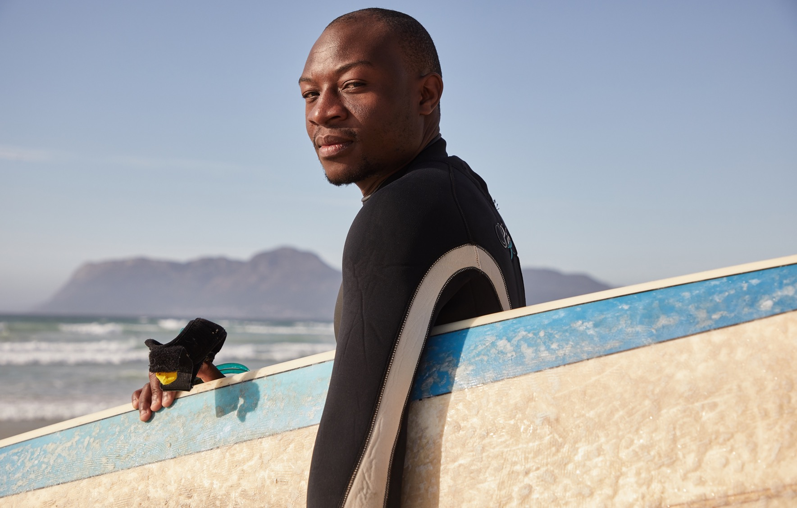

Tourism

Slide 11


What We Fund
Inclusions:
Hotels
Apartment hotels (must be operated similarly to hotels, with rooms serviced)
Lodges and Guest houses
Game Lodges
Mobile Tourism (accommodation: i.e. luxury coach trains)
Tourism attractions (funding to be applied to capital expenses for businesses whose activities are targeted at tourists)
Tourism destination management companies (existing medium to large scale companies).
Exclusions:
Casino and gambling facilities
Property developments consisting of timeshare and fractional ownership schemes (Unless supported by confirmed customer uptake)
Acquisition of game (if not part of game lodge)
Residential and/or commercial property;
Student or long-term rental accommodation
Tour operators and travel agents
Arts and Crafts (stand alone);
Standalone restaurants (not part of a tourism destination)
Other recreational facilities not linked to a substantial tourism/accommodation element.
Golf courses ;
Land.

Slide 12
Funding Requirements
What Are The Requirements
Economic merit: Project/business profitability, sustainability and ability to repay loan.
Structure: Equity contribution generally 40% to 50% of the total project costs. Black Economic Empowerment applications may qualify for a reduction in owner’s contribution based on special funding schemes that may be available from time to time.
Security: Bonds over fixed and movable business assets, personal surety and corporate guarantees.
Land/Property: Confirmation of land ownership or property ownership rights.
Management: Appointment of an experienced management company, otherwise an experienced management team should be proposed to the satisfaction of the client and IDC.
Debt Syndication: Co-funding opportunities should be actively pursued especially for large transactions.

Slide 13
How Do We Fund Businesses
Funding Appetite:
Greenfield and start-up projects; Expansions and/or refurbishments.
Building accommodation capacity substantiated by high demand; specific focus on experiential tourism to stimulate demand.
sustainable tourist attractions that provide niche product offerings.
Expansionary acquisitions and acquisitions by Black Industrialists (where they are majority shareholders and operationally involved).
Application Of Funds And Type Of Facility
South Africa, funding amount of more than R1 million
Funding to be applied towards construction costs, furniture, fittings & equipment, working capital and acquisitions (strategic/transformational)
Construction - maximum 12-year facility (Inclusive of FF&E and Working Capital for start-ups)
FF&E- maximum 6-year facility
Working capital- maximum of 5-year facility
Key financial covenants: DSCR 1.3 times; CICR 4 times
How Do We Structure Funding
Senior debt as our preferred funding instrument;
Quasi-equity, which could be considered in specific instances (if application qualifies for IDC’s ring-fenced BEE and Black Industrialist funding).

Slide 14
How Do We Fund Businesses - RoA
Preference for the SADC countries.
Minimum project size: SADC US$ 3 million and US$ 10 million for RoA
Debt syndication.
NB! Substantial benefit to South Africa in the form of (but not limited to) goods and services supplied, ownership by South African entities or other commercial relationships with South African entities.
Political Risk Insurance and/or Credit Risk Insurance may be required depending on the country risk assessment as well as the commercial risk assessment.
A lender’s technical advisor (LTA) maybe appointed at the cost of the applicant for construction projects.
A legal due diligence conducted by a legal firm appointed by the IDC will be undertaken at the cost of the applicant prior to commencement of a full due diligence.

Slide 15
Funding Schemes - EIB SME And Midcap Facility II
Objective:
To assist SMEs and MIDCAP companies to access loan financing for CAPEX, medium and long-term working capital.
Qualifying Criteria:
SMEs have a maximum of 250 employees and MIDCAP have less than 3000 employees (full time equivalent).
IDC is explicitly excluded as a final Beneficiary.
Funding provided for CAPEX and medium to long-term working capital.
Final Beneficiary (company) and project location must be in South Africa.
Total cost of a project must not exceed EUR25 million.
Pricing:
Summary 50% of the loan funding priced at IDC pricing;
Remaining loan portion priced at EIB pricing (2% below the IDC pricing).

Slide 16
COMMUNITY AND WORKERS TRUSTS
Business Support - Early Realization of Benefits (EROB) programme:
Who qualifies: Community and Workers Trusts linked to IDC funded companies.
Objective: Trusts be able to realize income whilst waiting for the declaration of dividends.
Funding: Up to R5 million grant funding to purchase assets for the trust which would in turn be leased or used for services rendering to the funded company through a contractual agreement between the trust and the company.
Social And Solidarity Economy Funding:
Who qualifies: Communities (broader consideration)
Objective: to support the growth and development of the SSE sector (social and solidarity enterprises, institutions and partnerships, initiatives) as well as the enabling ecosystem in which the sector operates.
Funding: : Up to R5 million grant funding to support ownership by marginalized people and communities or establish sustainable social enterprises that produce, trade or offer a services.

Slide 17
Investment Strategy To Support The Tourism Value Chain Development
IDC’s investment in the Tourism value chain: no. (Tourvest ), (Kivu Boats), (Hotels and Lodges – 90% ) and (Restaurant) = R5.2 billion exposure
Key strategies:
Invest in other pillars of the value chain to enhance the tourism value proposition.
Diversify the portfolio to accommodation targeted to the domestic and international leisure tourists.
1
2
3
4

Slide 18
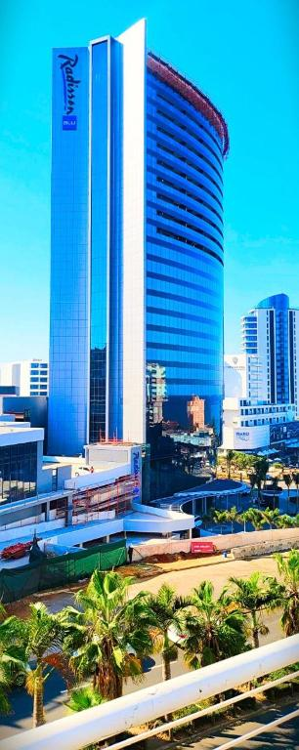
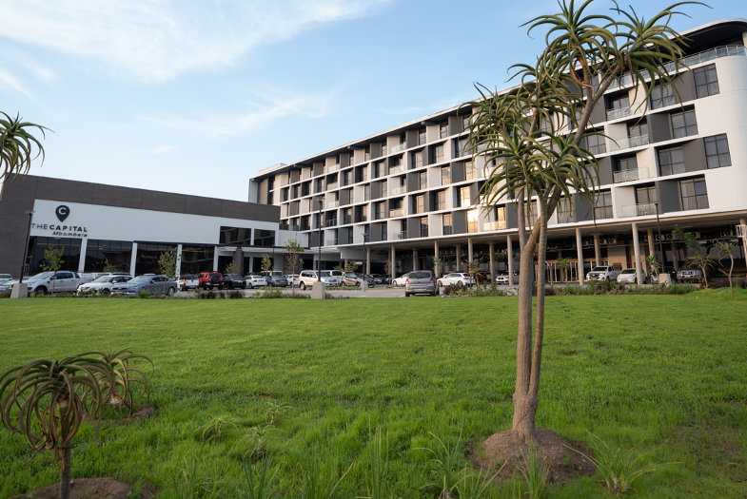
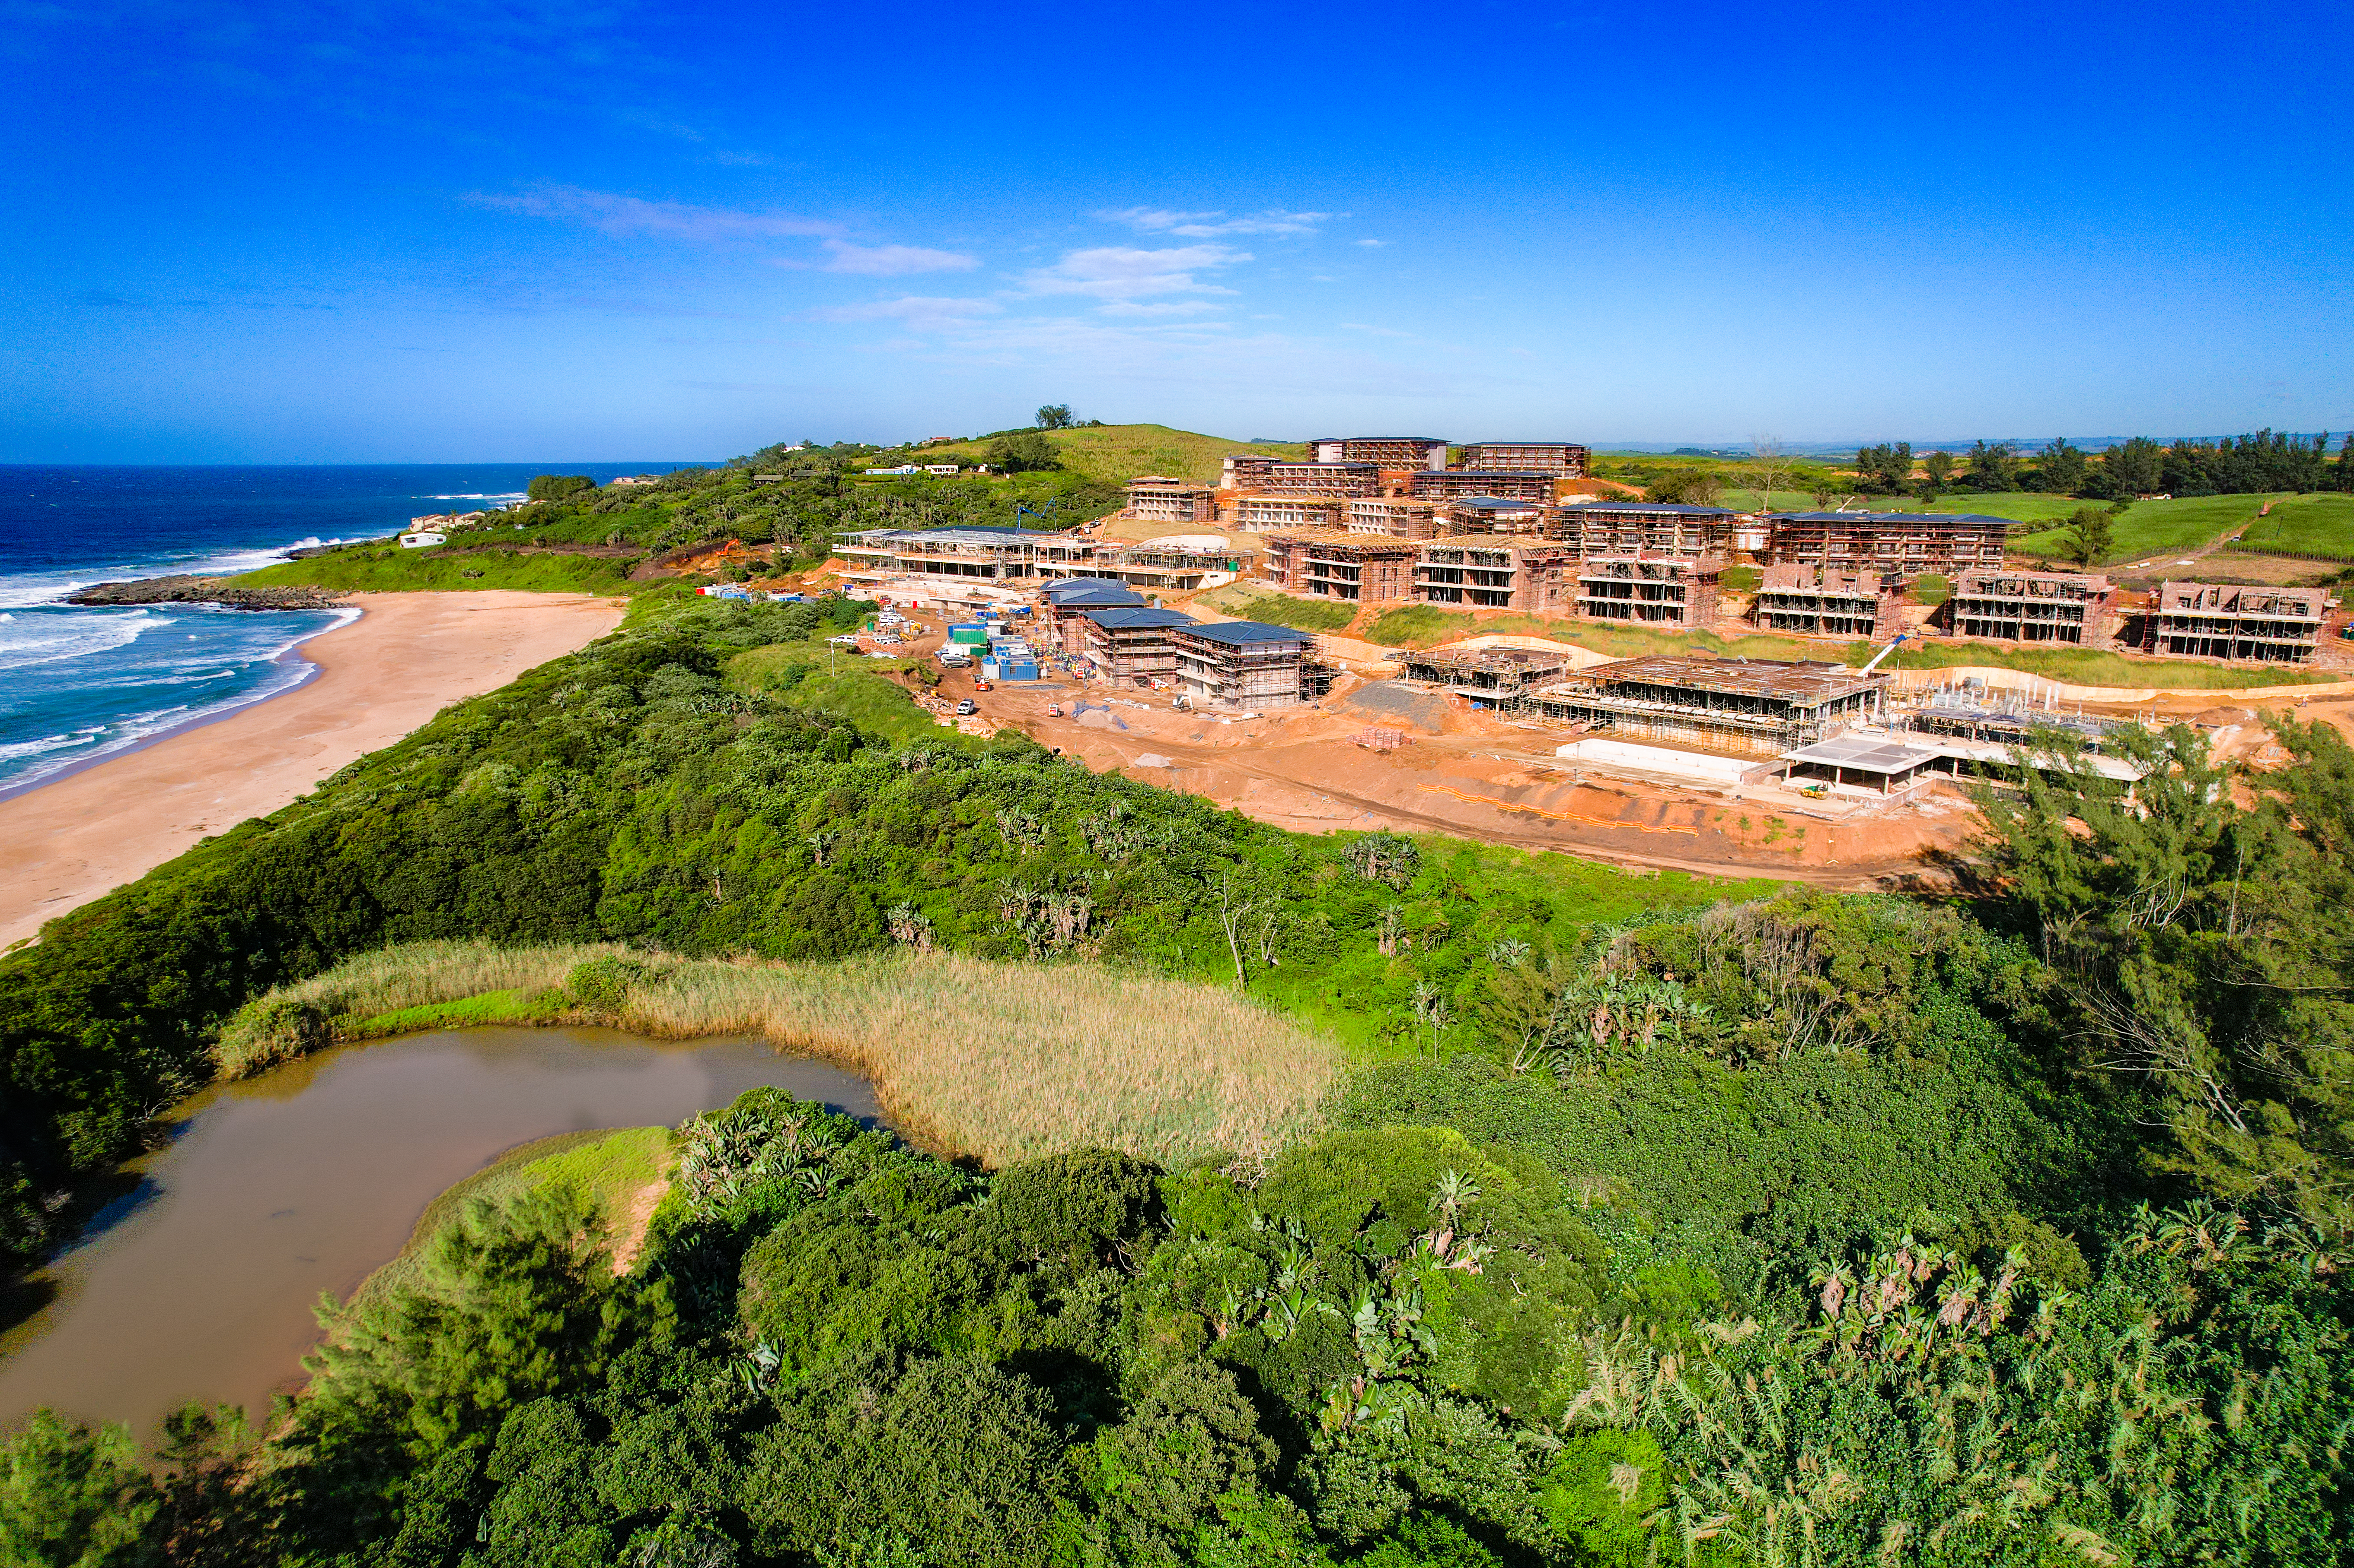
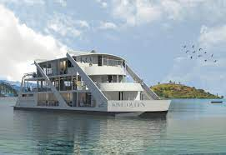
Some Of Our Current Investments

Slide 19
19 Fredman Drive, Sandown 2196
011 269 3000
callcentre@idc.co.za
www.idc.co.za

