Slide 1

Leveraging Aviation Data to Drive Hospitality ROI
Alex Stancu
Head, South & East Africa
IATA
14 June 2025
Notes:
test2

Slide 2

1. Macro outlook

Slide 3
Global GDP Growth – a new way down
World RPK and GDP Growth Rate
forecast
Source: IATA Sustainability and Economics, IMF World Economic Outlook, April 2025

Slide 4
Our world is now 67% services
Share of global GDP by sector, 1970 – 2022, %
2022:
Agri: 4.6%
Industry: 28.8%
Services: 66.6%
1970:
Agri: 9.4%
Industry: 37.3%
Services: 53.3%
Source: IATA Sustainability and Economics, UNCTAD

Slide 5
The world now is a service economy
Services, % of GDP, latest year available
Source: IATA Sustainability and Economics, World Bank, World Development Indicators, Macrobond

Slide 6
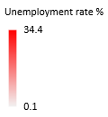
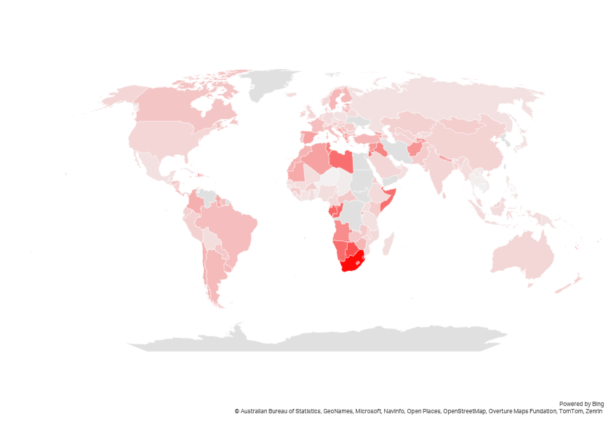
Unemployment is a big concern in Africa
Unemployment rate, % of labor force, 2024
High unemployment rates can significantly impact airlines operating in the region in several ways:
With high unemployment, many people have less disposable income, leading to decreased demand for air travel. This can result in lower passenger numbers and reduced revenue for airlines.
High unemployment often correlates with economic activity, which can reduce business travel. Business class and premium services, which are higher-margin products, sell less, impacting the margin.
High unemployment can deter foreign investment in the aviation sector, limiting airlines' growth and expansion opportunities.
Airlines might need to invest more in training and development programs to raise employees’ skill levels.
Despite high unemployment, there can be a shortage of skilled workers in specific areas such as aviation, engineering, and technical roles. This mismatch can make it challenging for airlines to find qualified talent.
To fill the skill gap, airlines might need to rely on expatriates, which can be more costly and logistically challenging.
Source: IATA Sustainability and Economics, World Bank, World Development Indicators

Slide 7

2. Tariffs

Slide 8
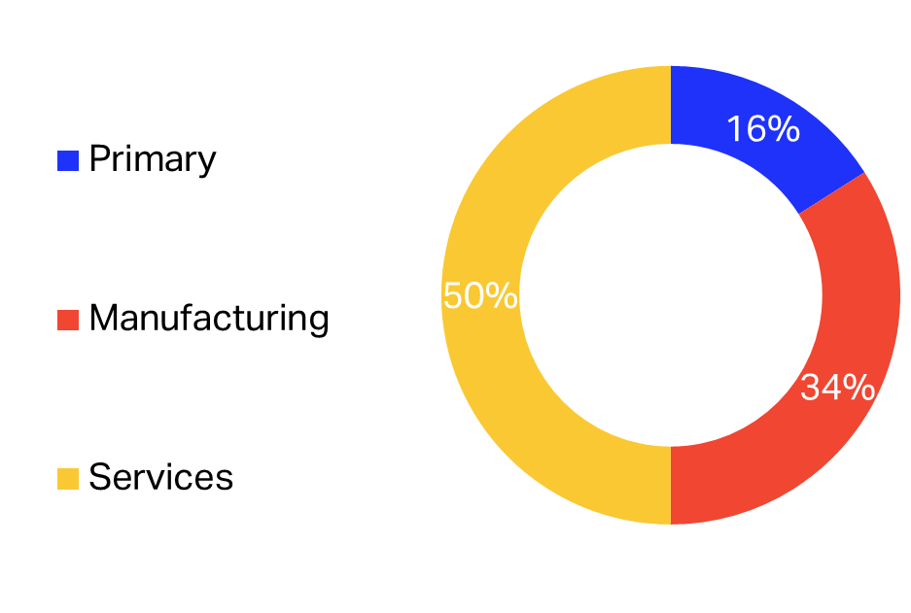
Tariffs
Trade facts
World Trade, Value Added, Share of total, %, 2018
Global trade represented a record USD 33 trillion in 2024, adding 3.7% from 2023.
Trade in services grew by 9% in 2024, or USD 700 billion, while merchandise trade grew by 2%, and USD 500 billion.
2/3 of international trade is not subject to tariffs.
Source: IATA Sustainability and Economics, “Global Trade Update”, UNCTAD, March 2025 (left), WTO (right)

Slide 9
Higher tariff could increase costs across all shipping methods
And reduce the value-to-weight ratio
Tariff rates and air transport share by merchandise category for US imports from China in 2023
Source: IATA Sustainability and Economics, World Bank World Integrated Trade Solution (WITS) and Global Trade Tracker

Slide 10
Goods and services in USD become more expensive
Exchange Rate Index vs USD, Jan 2022 = 100
Source: IATA Sustainability & Economics using data from Bloomberg

Slide 11
Most countries in debt distress are in Africa
Number of countries at different levels of risk of external debt distress, as of March 2025
Source: IMF LIC DSF, as of April 30, 2024

Slide 12
3. Jet fuel and crude oil

Slide 13
Good that lower oil prices can now support GDP growth
Nominal and real crude oil price, USD per barrel
Brent price USD 64 on 30 May
2024 high: USD 91.2 on 5 April
Real oil price using CPI as a deflator
Source: IATA Sustainability and Economics, ICE, US Bureau of Labor Statistics, Macrobond

Slide 14
Lower crude oil price will help support GDP growth
Jet Fuel Price vs Crude Oil Price, USD per barrel
15 May:
USD 82
USD 64
USD 18
Source: IATA Sustainability and Economics, Platts – Global Commodity Insights, ICE

Slide 15
Traded price of jet fuel in Africa at par with RoW but…
Jet fuel price, USD/BBL
Source: IATA Sustainability and Economics using data from S&P Global Commodity Insights

Slide 16
… into-wing price is far higher
Jet fuel price index by region, regional average = 1
The market price of the jet fuel traded in Africa does not reflect the real cost that African airlines pay. The into-wing price of jet fuel is far higher because of factors such as:
lack of competition,
high logistics costs,
marginal leverage because of volume
other charges.
Notes: Data is based on one particular month in a year and averaged over 4 years (from 2019 to 2022), regional averages are based on major airports covered in the airline survey.
Source: IATA Sustainability and Economics, IATA Jet fuel price survey for fuel uplift, 2022

Slide 17
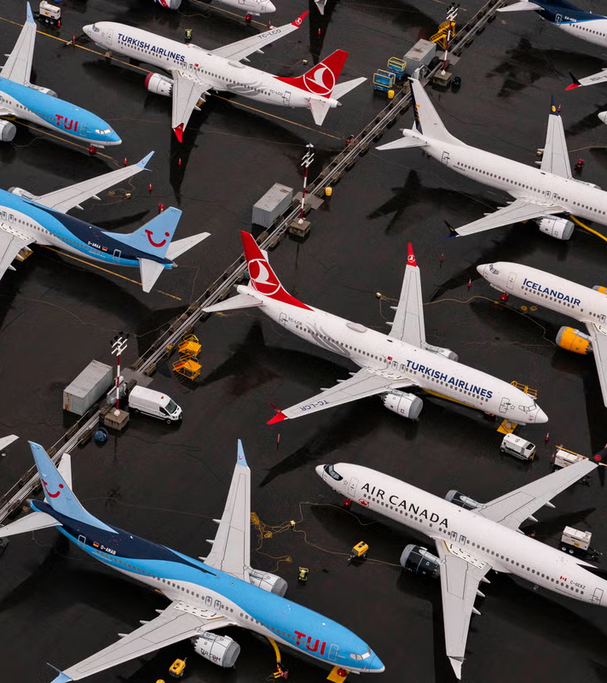
4. Capacity constraints

Slide 18
Capacity constraints will persist in 2025 and beyond
Aircraft deliveries by region
No Way!
Source: IATA Sustainability and Economics, Cirium Fleets Analyzer * May 2025 update

Slide 19
Expectations towards 2025 deliveries are falling
Revision of scheduled aircraft deliveries
Source: IATA Sustainability and Economics, Cirium Fleets Analyzer * March 2025 update

Slide 20
The global backlog is at record high
Global aircraft backlog (total number of outstanding orders)
Source: IATA Sustainability and Economics, Cirium Fleets Analyzer

Slide 21
Slower deliveries halt decline in fuel consumption
Average age of global fleet and average fuel consumption per ATK, USD cents
14.8 years
Source: IATA Sustainability and Economics, Cirium Fleets Analyzer

Slide 22
Africa operates the oldest fleet in the world
Average age of commercial fleet, years
The African fleet is the oldest among all regions, with an average age that is 5 years older than the industry standard. This gap continues to widen, presenting several challenges:
Increased Fuel Consumption: Older aircraft are generally less fuel-efficient, leading to higher operational costs and greater environmental impact.
Higher Maintenance Costs: Aging aircraft require more frequent and extensive maintenance, driving up costs and potentially leading to longer downtimes.
Supply chain challenge: Aircraft parts are more difficult to get in Africa and more expensive.
5.0 years
3.7 years
Source: IATA Sustainability and Economics using data from Cirium

Slide 23

5. Traffic

Slide 24
Africa’s higher than average traffic growth in 2025
Passenger and cargo growth rates, % and corresponding load factors. %
Source: IATA Sustainability and Economics

Slide 25
Industry load factors continue to grow
Passenger load factors by region, Q1 2024 vs Q1 2025, %
Source: IATA Sustainability and Economics, IATA Information and Data – Monthly Statistic
Notes:
The relatively slower YoY increase in Available Seat-Kilometers (ASK) of 5.0%. - Persistent supply chain issues faced by aircraft manufacturers curbed industry's ability to increase capacity to meet the higher demand. Consequently, PLF reached a new high in Q1 at 81.2%, an increase of 0.3ppt. This pattern was observed across multiple regions apart from Americas.
Aircraft supply-demand imbalance

Slide 26
Resilient demand in established markets
Southern and Eastern Africa have decreased in Q1 2025
Passenger growth rate by sub-region of traffic segment origin, Q1 2025, YoY, %
Source: IATA Sustainability and Economic, DDS

Slide 27

6. Financial performance

Slide 28
Revenue growth is on the passenger side
Airline passenger, cargo, and ancillary and other revenue, USD billion
Source: IATA Sustainability and Economics using data from Airfinance Global
Notes:
Air passenger demand grew strongly in 2023, with RPKs increasing by 37% YoY. With capacity not quite keeping pace, airlines benefited from a sharp increase in the load factor to 82.2%, up from 78.7% in 2022. This underpinned another year of recovery in the financial performance of the airline industry.
Demand has stayed strong in the face of higher passenger yields, suggesting a rather immutable need for air transportation and a limited price elasticity of demand for air travel. It needs to be noted, that despite high growth, the real fare (incl. ancillaries) is significantly below pre-Covid levels (15% below 2019 and 32% below 2013).
Growth in traffic is expected to decelerate in 2024, after two years of a vigorous catching up from the pandemic lows. Together with stabilizing passenger yields, this should translate to a 15% YoY increase in passenger revenues (ticket revenue only).
Total passenger revenue (including ancillaries and other) should grow at a slightly slower pace, by 14% YoY, as ancillary revenue keeps being diluted by the recovering average distance traveled to pre-Covid levels. Ancillary revenues per passenger will therefore drop closer to pre-Covid levels following the temporarily change in the à la carte buying behavior of travelers during the pandemic years.
( Global Outlook, p.15)

Slide 29

2025 Net Profits at 36 USD billion = 3.7% margin
Photo: NohKaliKai Falls, Meghalaya, India, by travelmelodies.
Notes:
Every region has improved from 2022. Regionally, North America is in the lead with USD 11.5 billion in 2023, followed by Europe and the Middle East.

Slide 30
Africa has higher unit cost of operations
Cost category per ATK, as of 2023, USD cents
African airlines face significantly higher operational costs compared to the global average.
African airlines often operate with limited economies of scale due to smaller market sizes, less frequent flights and shorter distances. This leads to higher per-unit costs for various operational categories, including flight equipment maintenance and overhaul, and flight crew salaries and expenses.
Source: IATA Sustainability and Economics, based on a sample of 12 African airlines excluding Ethiopian

Slide 31
Borrowing costs are higher in Africa
10-year government bond yields, %, inflation, %, as of June 2025
Source: IATA Sustainability and Economics, using data from Bloomberg as of June 2025, *) 20 year bond yield

Slide 32
Ticket taxes & charges vary widely across Africa Adding significantly to travel costs in some countries
International passenger ticket taxes and charges (economy cabin, highest applicable rate), USD per ticket, 2024
Source: IATA Sustainability and Economics, IATA TTBS, xe.com

Slide 33
Profits vary across regions
Africa keeps lagging other regions
Net margin by region
Source: IATA Sustainability and Economics using data from Airfinance Global

Slide 34

USD 7.2 per passenger in 2025
Net profit per passenger by regions, USD per passenger, 2025
USD | 2024 | 2025
Middle East | 28.5 | 27.2
North America | 10.1 | 11.1
Europe | 8.0 | 8.9
Latin America | 4.1 | 3.4
Asia Pacific | 2.3 | 2.6
Africa | 1.2 | 1.3
Industry | 6.8 | 7.2
Source: IATA Sustainability and Economics

Slide 35

Thank you!

