Slide 1



Tech ROI Unlocked
What Every Hospitality Investor Should Know
PRESENTED BY:
Frank Wagner
General Manager
ACT International

Slide 2

ACT International
The Global Hospitality IT Partner
FAST. EXPERTS. WORLDWIDE

Slide 3
Tech ROI matters more than ever!

Slide 4
The Digital Imperative in Hospitality
Post-COVID digital acceleration
Shift in guest expectations
Competitive pressure from asset-light tech-driven models
Digital transformation isn't optional—it’s fundamental!
© STR

Slide 5
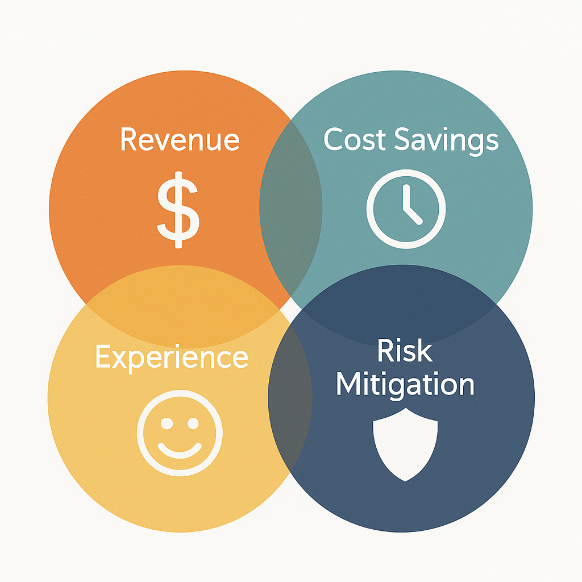
Understanding Tech ROI

Slide 6

Multi-Dimensional Returns

Slide 7





Core Technologies Driving ROI
PMS
POS
Revenue
Management &
Booking Engines
Guest Facing
Tech
Back Office Systems
Automation
Integration
Analytics
Throughput
Mobile Ordering
Spend per Guest
Dynamic Pricing
Channel Optimization
Mobile Check-In
Digital Concierge
Personalization
Self-Ordering
Accounting
Procurement
Workforce Management

Slide 8
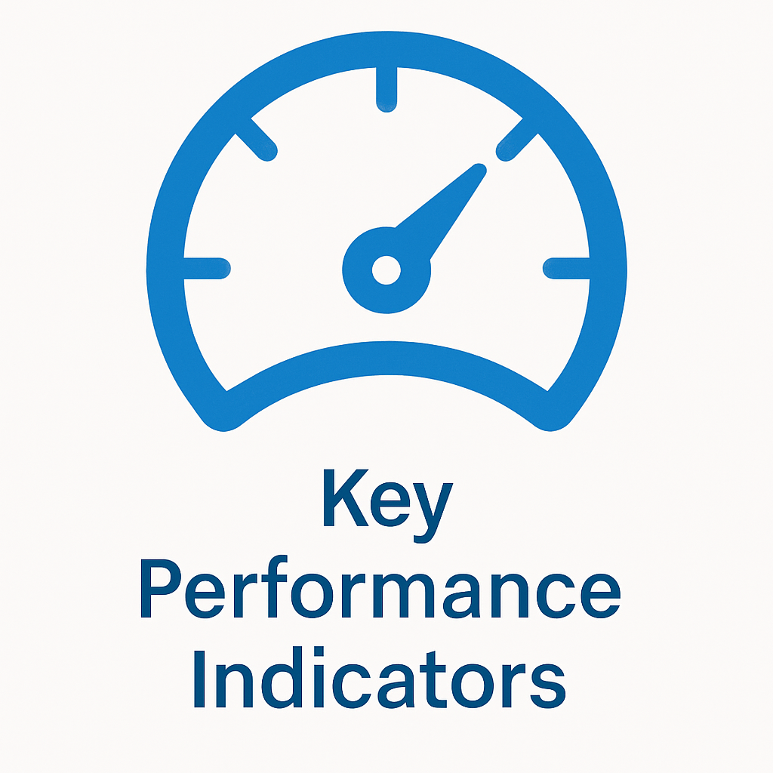


ROI Metrics that Matter
RevPAR uplift, Labor Cost Savings,
ADR Impact, Cost Reduction
Tech vs. CapEx vs. Marketing ROI
What is a healthy ROI Timeline?

Slide 9
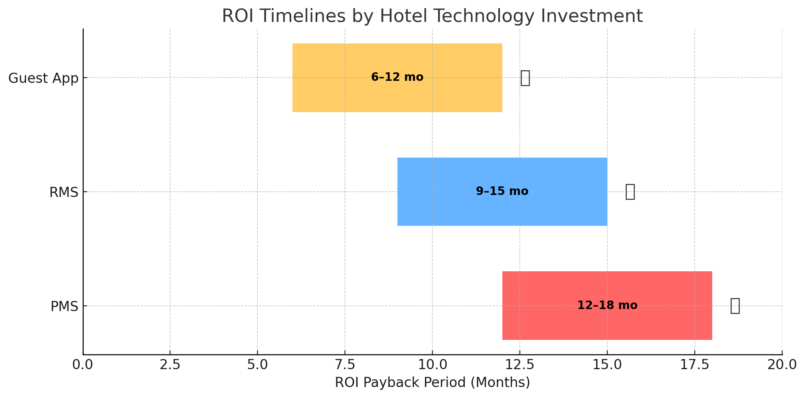
What does “Healthy” Look Like?

Slide 10




Where ROI Goes to Die
Overestimating Short Term Gains
Underinvesting in Training & Change Management
Lack of Integration Planning
Measuring ROI in Silos

Slide 11


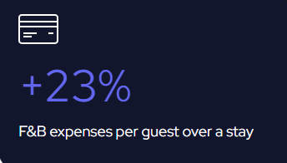
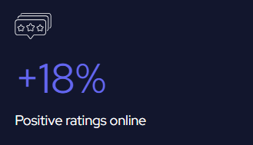
ROI in Action – Real-World-Wins
Single Effect:
Urban Hotel: Maashof Netherlands
Switch from manual price management to RevControl RMS:
+15%
Increase in ADR
Multi-Dimensional Effect:
Iconic Chain Hotel: Molitor Hotel & Spa, Paris
Implementation of the SKEAT digital guest app:

Slide 12
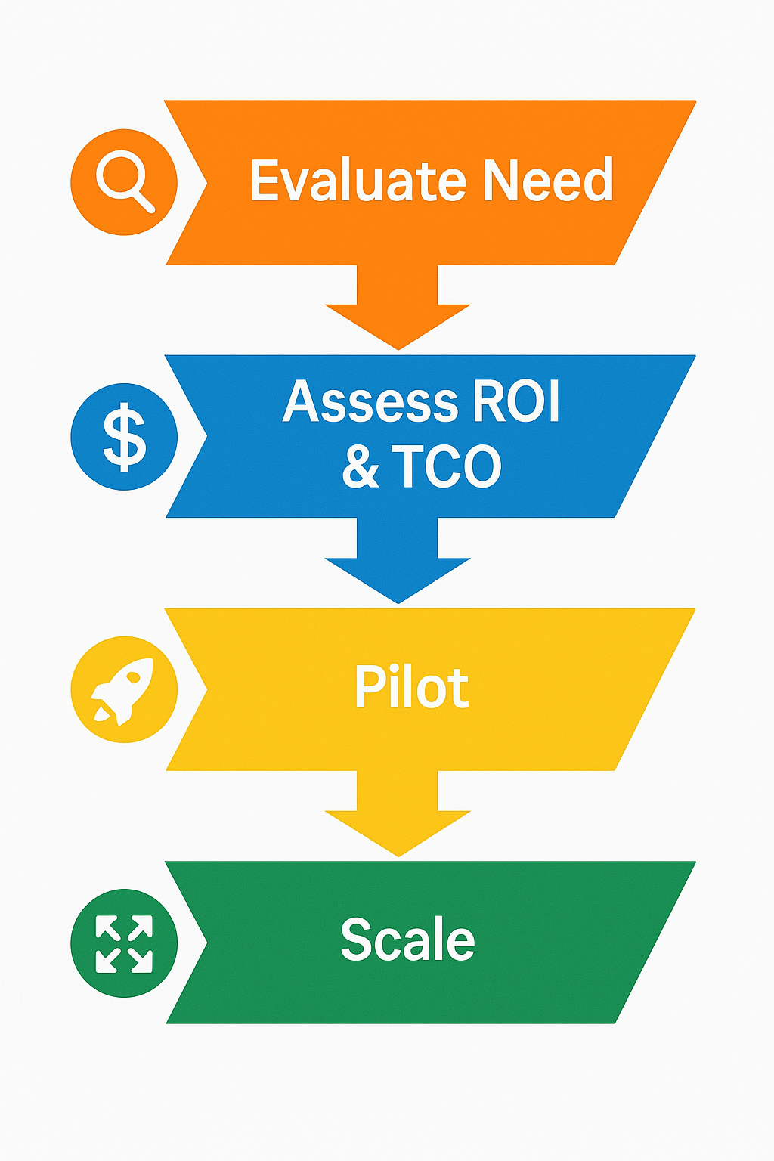
Investor Playbook for Tech ROI

Slide 13
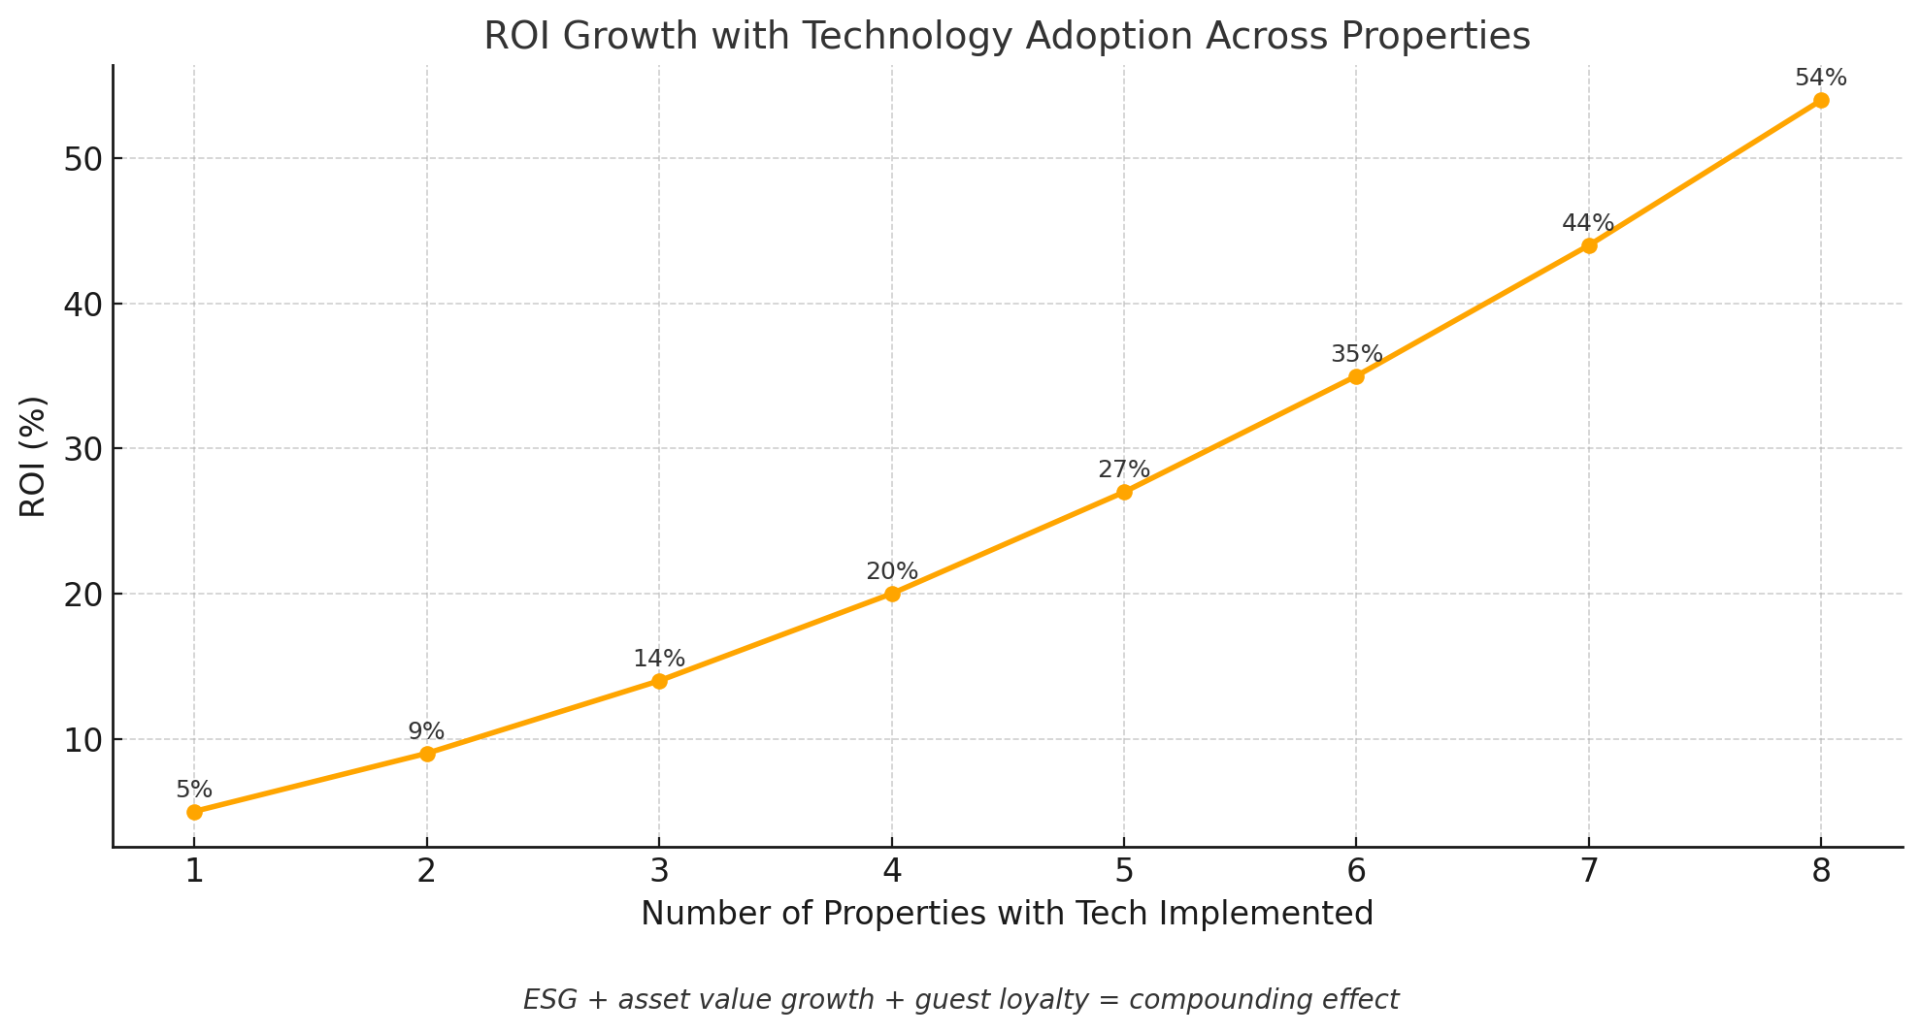
Portfolio-Wide ROI Compounding

Slide 14
3 Things to Remember
ROI is measurable but not automatic
Integration multiplies value
Smart tech = stronger long-term asset

Slide 15
Thank You!
Frank Wagner
frank.wagner@act.eg

