Slide 1
MEA EXPERIENCE- CASE STUDY

Slide 2
REGIONAL CLUSTERING-ALEPH HOSPITALITY
ALEPH’s Regional Operating Model Enables us to:
Optimize resources through shared services
Enhance performance through centralized expertise
Lower operating costs while maintaining quality
Clustered Function
Description
Examples from Aleph Portfolio
Centralized Revenue Management services caters to our entire portfolio resulting in savings of manning of approx 1.5 FTE per hotel + savings in commissions
Revenue Management
Dynamic pricing, yielding, distribution and forecasting handled centrally
Aleph Portfolio Clustering Impact
Cluster 1 (JOC Dubai): 5 FTEs reduced, 35% savings, business stabilized without cannibalization.
Cluster 2 (Morocco): 2 FTEs reduced, 40% payroll savings.
Cluster 3 (Nairobi): 3 FTEs reduced, 30% payroll savings.
Overall Outcome: ~2% reduction in total revenue allocated to Sales & Marketing (S&M) expenses.
Sales & Marketing
Clustered commercial departments and cross selling across portfolio.
Group contracts, regional procurement audits and finance support
Shared vendor deals in Nairobi led to 25% in savings including Payroll for Finance & Procurement teams
Finance & Procurement
IT & Technical Services
Central team handles PMS/IT setup and troubleshooting remotely and on-site
Centralized IT support for all hotels across MEA, resulting in standardized IT operations and compliance leading to savings of approx. 30%
Human Resources
Centralized recruitment of key personnel, talent mapping and mobility across properties
For the two Hotels operating in Morocco, HR clustering approach saves approx. 25% of HR department payroll cost.

Slide 3

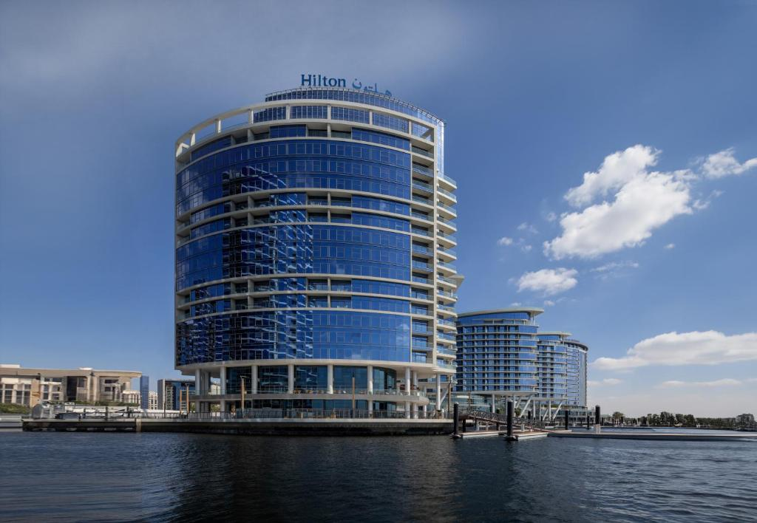


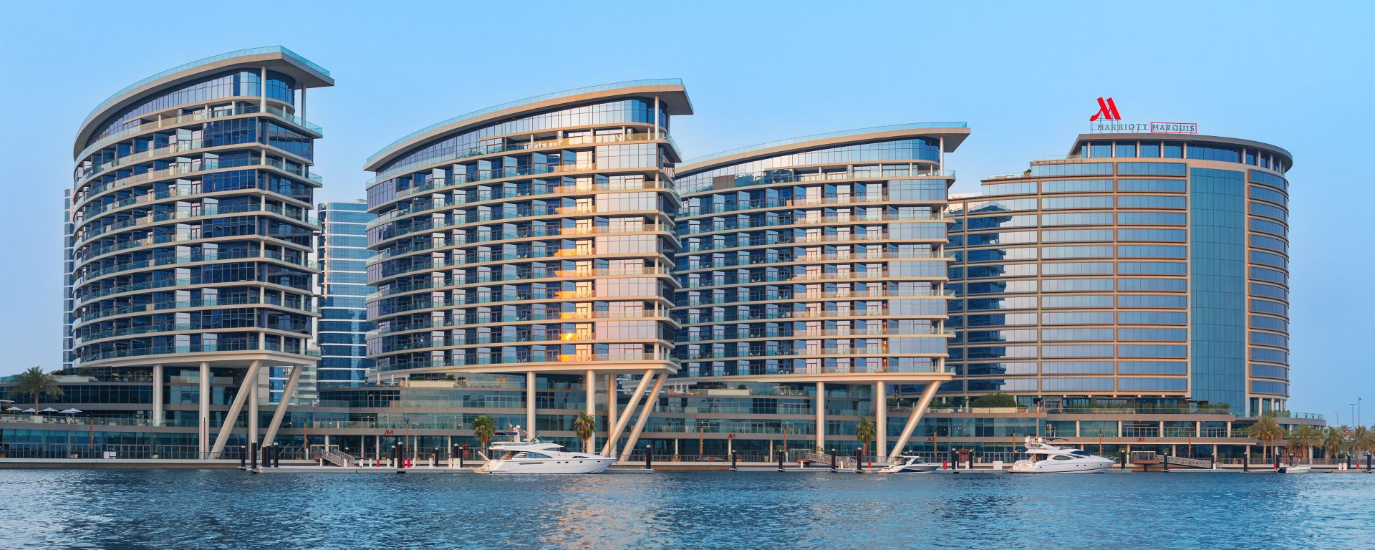

JEWEL OF THE CREEK - STRATEGIC DUAL BRAND MANAGEMENT
Location:
Jewel of the Creek, Dubai – Landmark mixed-use development.
Composition:
Marriott Marquis: 4 towers | 436 rooms & suites + 156 serviced apartments
Hilton Residences: 1 tower | 180 Hotel rooms & serviced apartments
Brand Strategy:
Independent brand search by Aleph
Brand search to determine optimal mix
Secured ”Marquis” designator after extensive negotiation
Dual brand chosen to diversify system & Loyalty program deliveries
Rationale for Dual Branding:
Synergistic Reach: Combined Marriott Bonvoy & Hilton Honors ecosystems
Diversified Demand: Corporate/leisure + relocation + long stay
Performance Balance: Limits reliance on single brand

Slide 4




JEWEL OF THE CREEK - EXECUTION, SYNERGIES & OWNER VALUE
Efficient Mobilization:
Pre-opening completed in just 3 months, delivering AED 7– 8M in savings
Deployed Aleph’s fast-track operational blueprint and centralized mobilization team.
Operational Synergies:
Single unified management team across all 5 towers.
Shared services for engineering, housekeeping, procurement, and finance.
Optimized back-office systems delivering scalability and service consistency.
Governance & Brand Standards:
Aleph acts as a strategic intermediary between brands and ownership.
Ensures full compliance with Marriott & Hilton standards.
Dual-brand protocols implemented to protect brand integrity.
Asset Management Mindset:
Aleph Operates with an owner-first, fiduciary mindset.
Focus on CapEx planning, long-term asset value, and sustainable profitability.

Slide 5
QUESTIONS?

