Slide 1



Pipeline Watch: Investment Hotspots & the Future of Hospitality Expansion in Africa
PRESENTED BY:
Trevor Ward
Managing Director
W Hospitality Group, Lagos

Slide 2
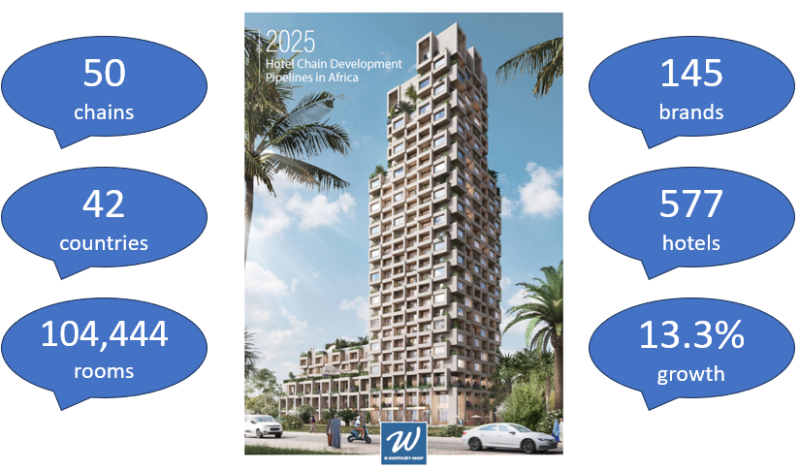
Notes:
Usual intro

Slide 3
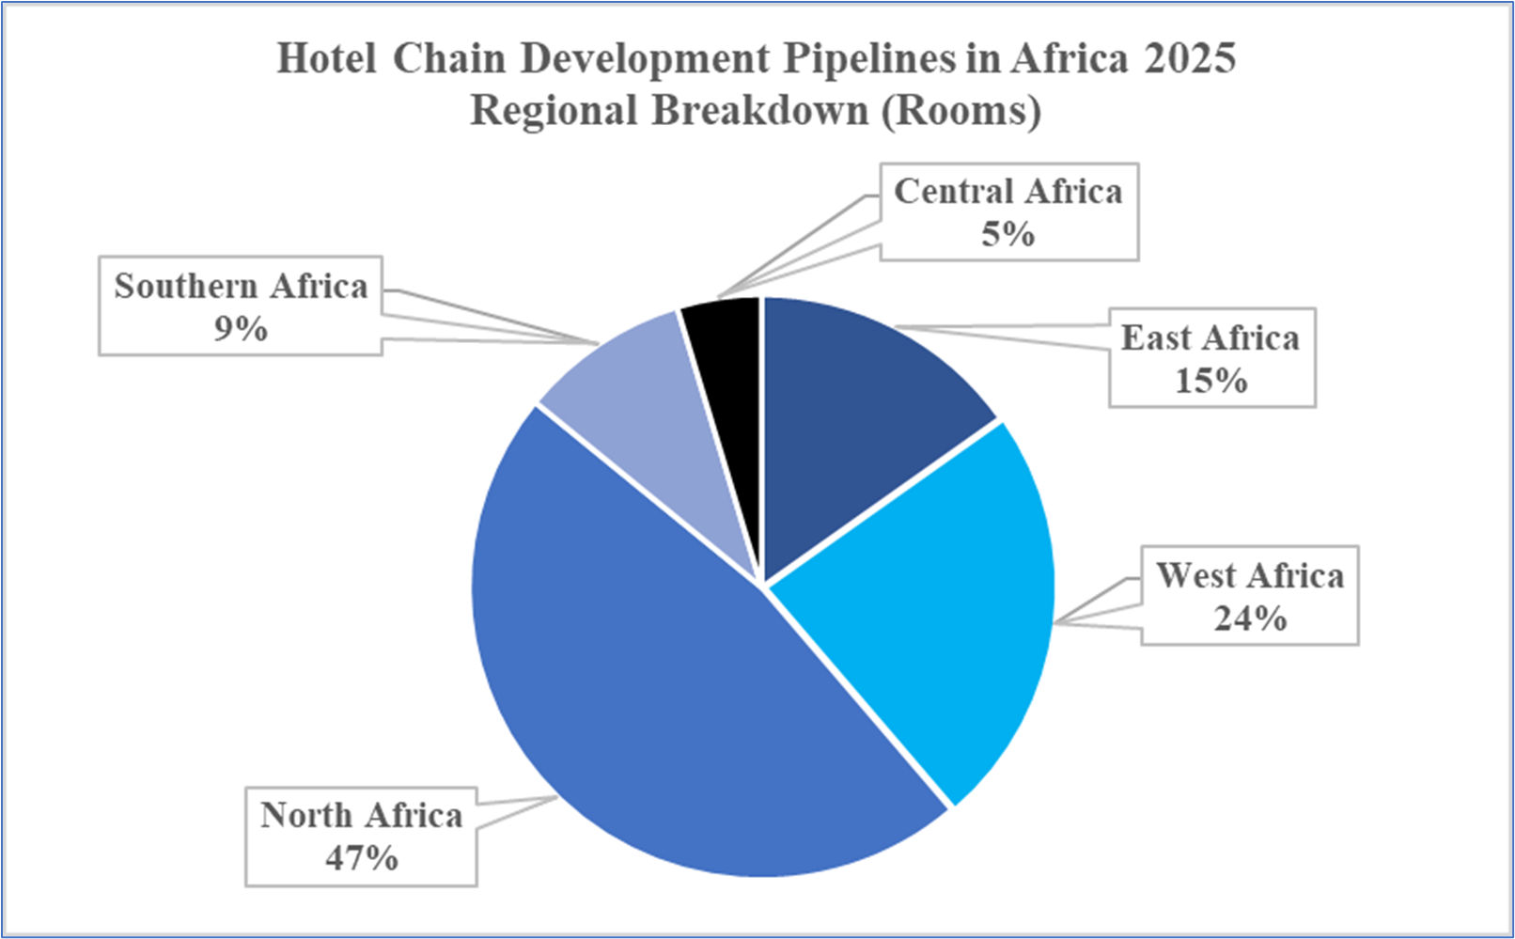
Notes:
Note the predominance of two regions – North Africa, which is only 4 countries out of 5, and West Africa, with 13/16. Not much happening in Central Africa – unsurprising given the instability of several countries there.

Slide 4
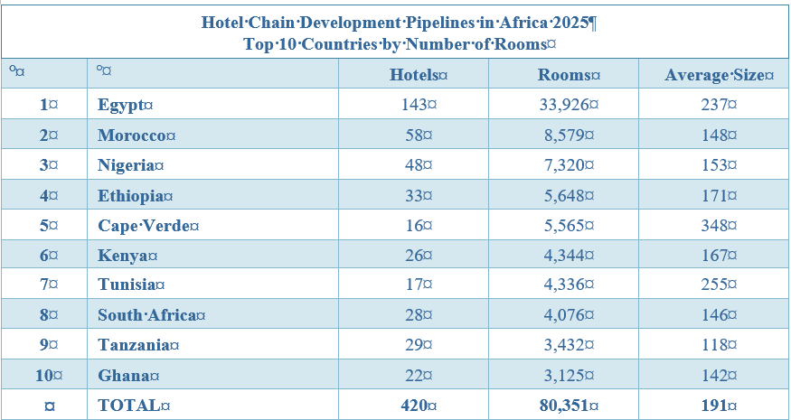
Notes:
The main countries – Egypt dominates as usual, with 25% of the entire pipeline projects, and 35% of pipeline rooms. Cape Verde makes it into #5, despite the fewer projects – largest average size, BBBs.
Tanzania is there, it includes Zanzibar, which is one of the current hotspots. When it comes to resort pipelines in Africa, Zanzibar comes in at #3, after Sharm El Sheikh and Boa Vista (Cape Verde)

Slide 5
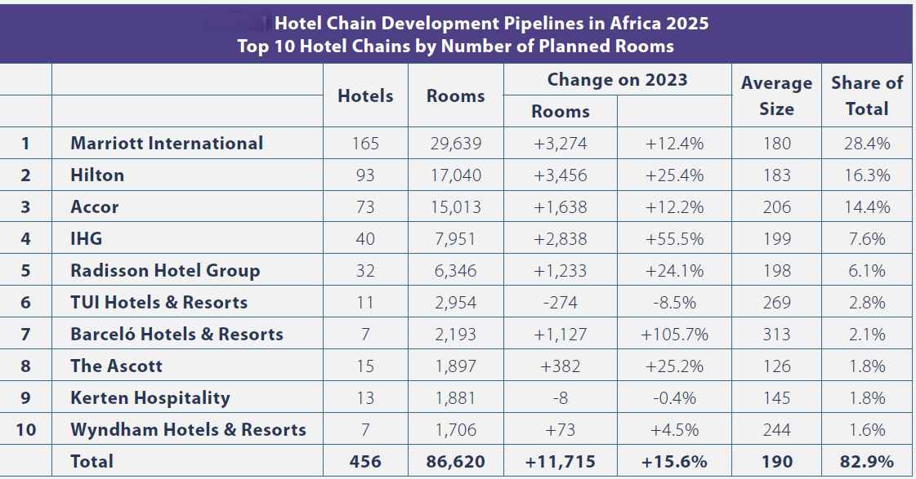
Notes:
Who’s signing these deals – as Egypt dominates the where, Marriott dominates the who. With almost 30% of the total pipeline.
The big 5 are, well, the big 5 in the pipeline.

Slide 6
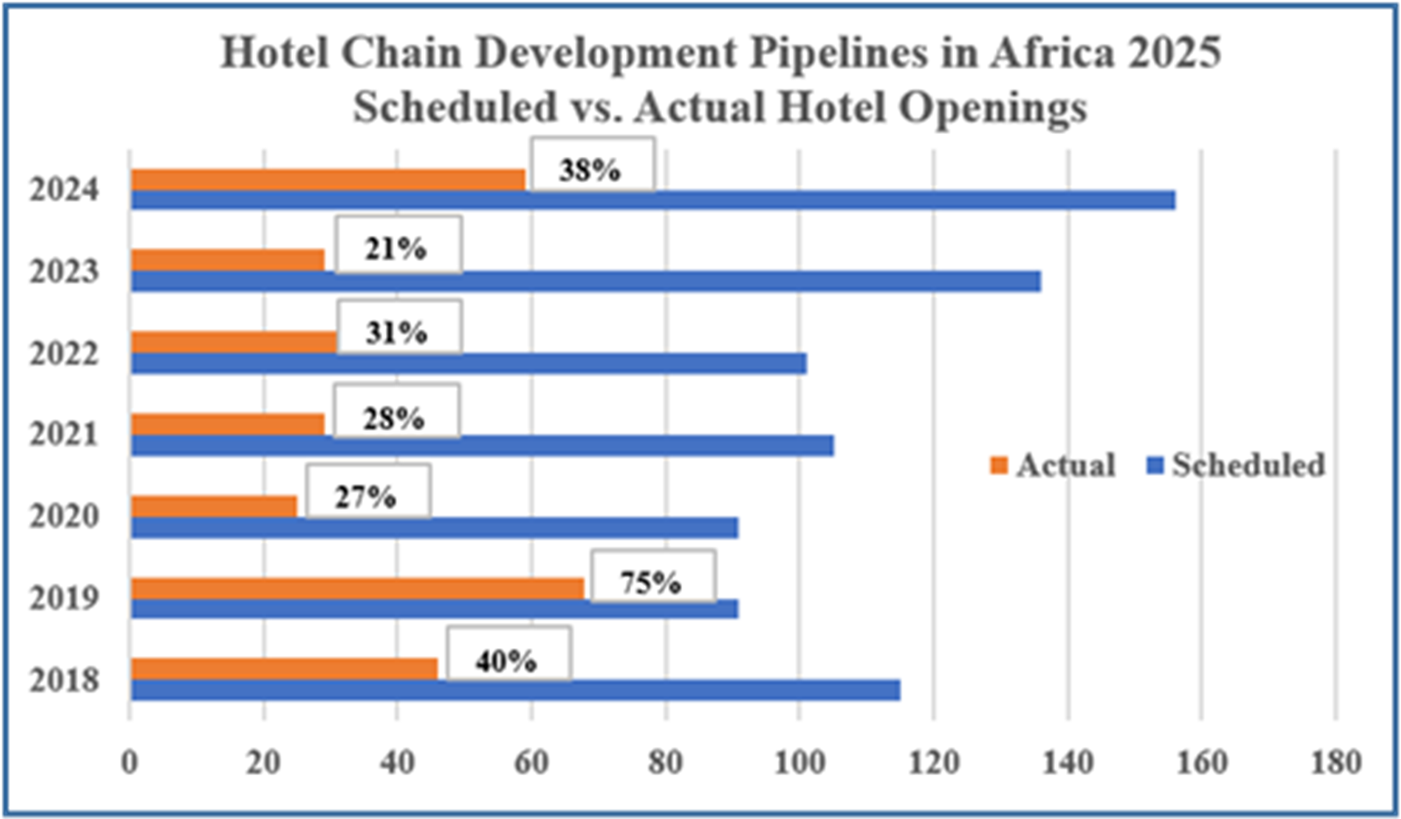
Notes:
But my focus this year is not just on the pipeline, but on what’s actually happening here in Africa.
This chart shows the percentage of the pipeline hotels that actually opened on time. By “on time” I mean in the year that the chains anticipated they were going to open, according to the data they provided. So the blue bar is anticipation, the orange bar is achievement, progress towards the holy grail of NUG. 2019 – 75%. No surprise that 2020 to 2022 were pretty dire, but it’s a struggle to understand why 2023 was so bad. We got better last year, with 59 hotels and resorts opening, out an anticipated 157.

Slide 7
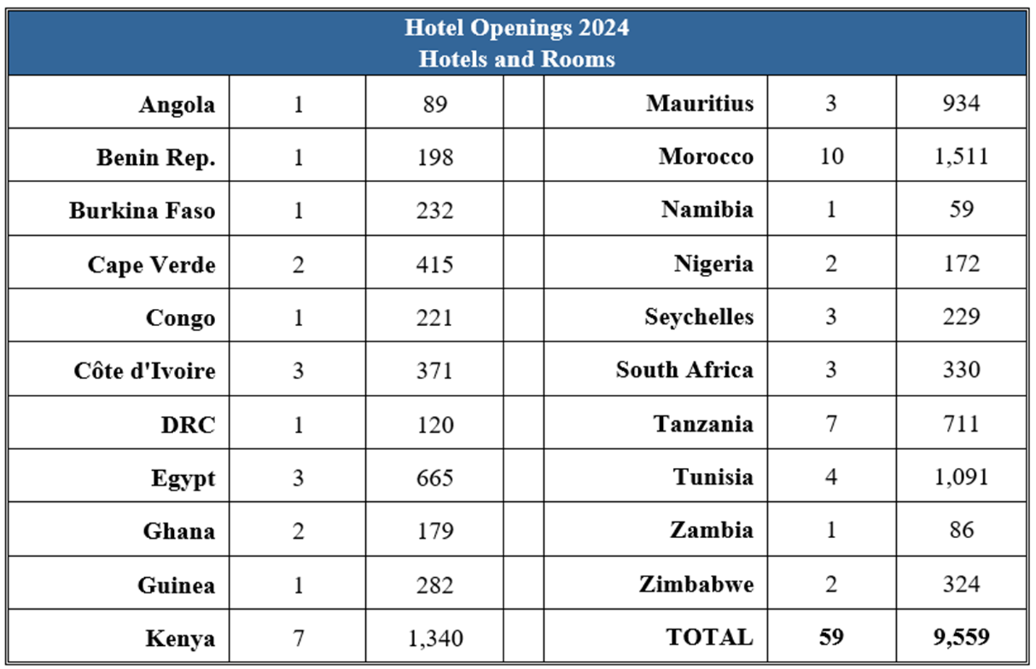
Notes:
59 hotels and resorts, 21 countries.

Slide 8
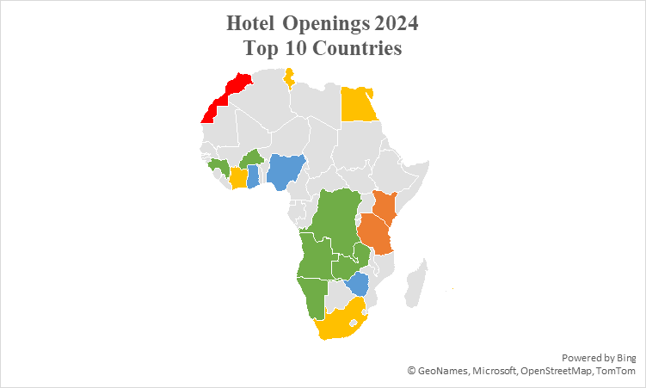
Notes:
Maybe a bit easier to see, with Morocco taking top spot (10), Kenya and Tanzania in joint 2nd place (7), but Egypt lacking behind despite its dominance of the pipeline.

Slide 9
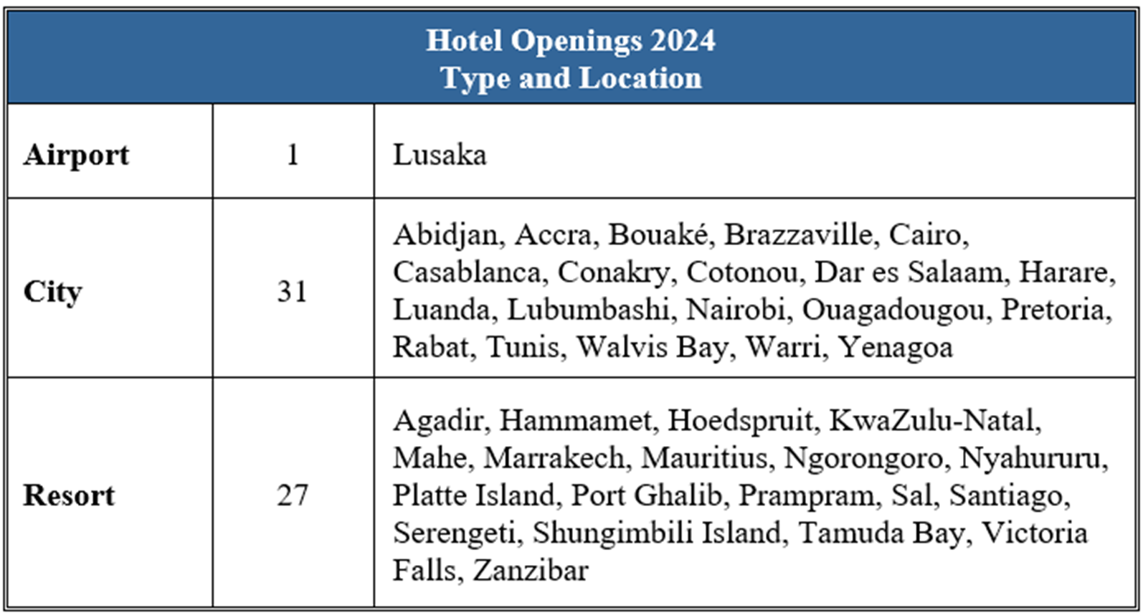
Notes:
Note that the split between city hotels and resorts is pretty even. Although in the pipeline, the resorts are about 30% of the total (and city hotels are most of the rest), they accounted for 46% of total openings – the chains are opening more resorts proportionately. Why? I am sure there are resort-focused sessions on the agenda, you can debate that question there.

Slide 10
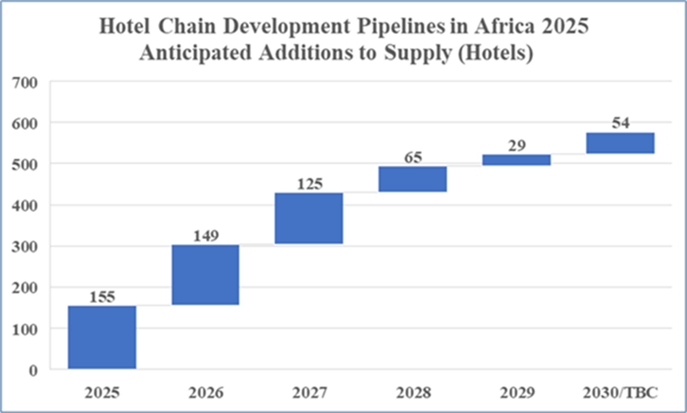
Notes:
The chains tell us that they’re scheduled to open 304 hotels and resorts this year and next, that’s 100 up on the expectations for 2024 and 2025, and three and a half times what opened in the last two years. It’s good to be optimistic about growth, but when one considers that (according to the data that the chains themselves provided) some 20 per cent of those hotels that are due to open by the end of next year are not yet under construction, that optimism may be just a tad over-egged?

Slide 11
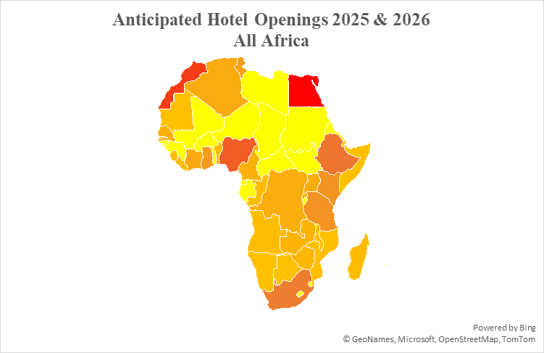
Notes:
This is where the chains anticipate they will open hotels in 2025 and 2026, with an interesting stretch of yellow, which is countries with no anticipated openings – mirroring exactly the coup belt, plus Libya, Central Africa Republic and Sudan, not known for their stability, and some tiny ones like Burundi, Lesotho and Eswatini.

Slide 12
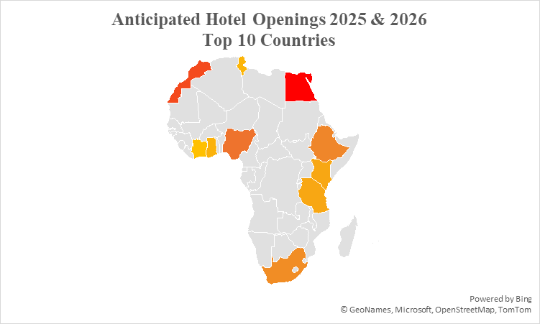
Notes:
Egypt 46 – 25 in Cairo
Morocco 35 – 14 Casablanca, 6 Marrakech
Nigeria 29 – 17 Lagos
Ethiopia 25 – 15 Addis
South Africa 23 – 9 Cape Town
Kenya 16 – 8 Nairobi
Tanzania 16 – 10 Zanzibar
Ghana 13 – 10 Accra
Tunisia 12 - spread
Côte d’Ivoire 9 – 7 Abidjan

Slide 13
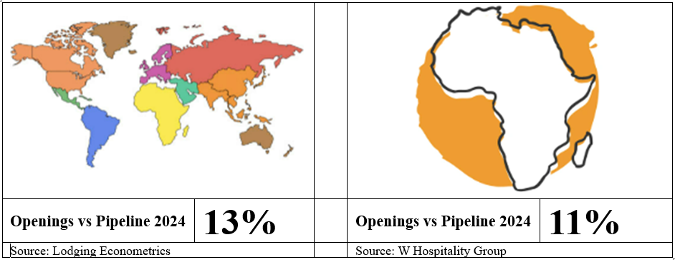
Notes:
Here’s a different way of looking at the numbers. Lodging Econometrics report that the global pipeline at the end of 2023 was about 15,200 hotels, and that about 2,000 properties opened in 2024. That’s 13%. So at 11% of pipeline properties opening, we weren’t so darned far away, were we?

Slide 14
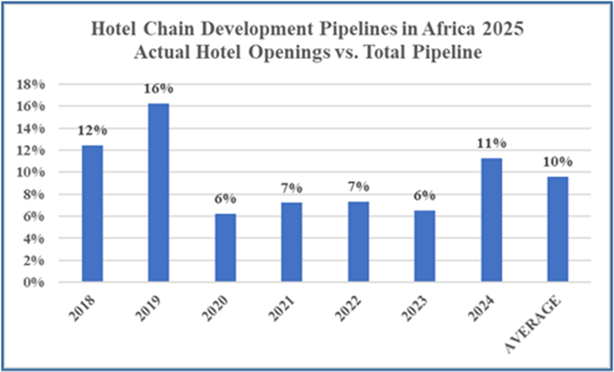
Notes:
These are the historical figures – 2019 still stands out as the benchmark to aspire to, whatever measure we use.

Slide 15
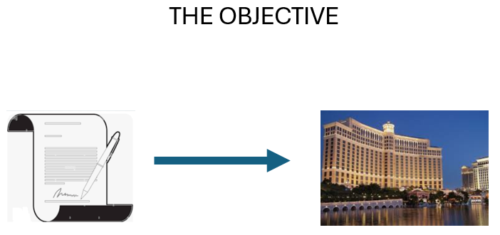

Slide 16
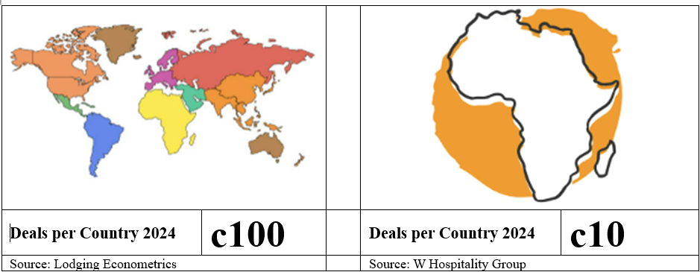
THE CHALLENGE
Notes:
Here’s the nub.. Where are the hotspots? Depends entirely on your perception of and appetite for risk, no? Follow the crowd to where it happens – or rather where it’s supposed to happen – or jump in as a pioneer? Is the fact that there are no pipeline hotels in 12 out of 54 countries – almost a quarter – an opportunity or a bridge too far? The investors at this conference are the ones to answer that everlasting question!

Slide 17
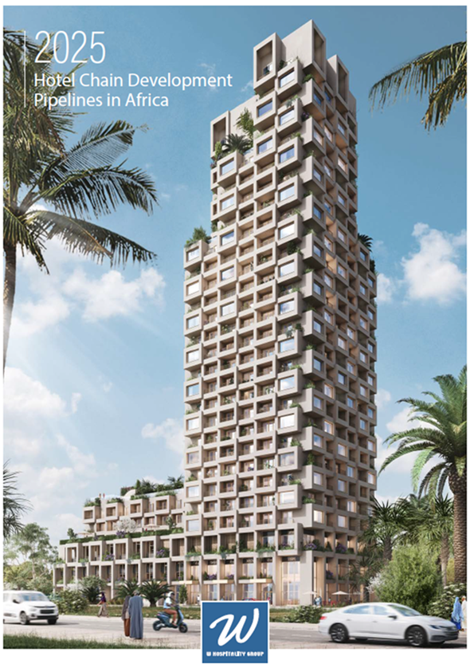
WWW.W-HOSPITALITYGROUP.COM
Notes:
Thanks for listening, you can download the 2025 pipeline report here.

