Slide 1
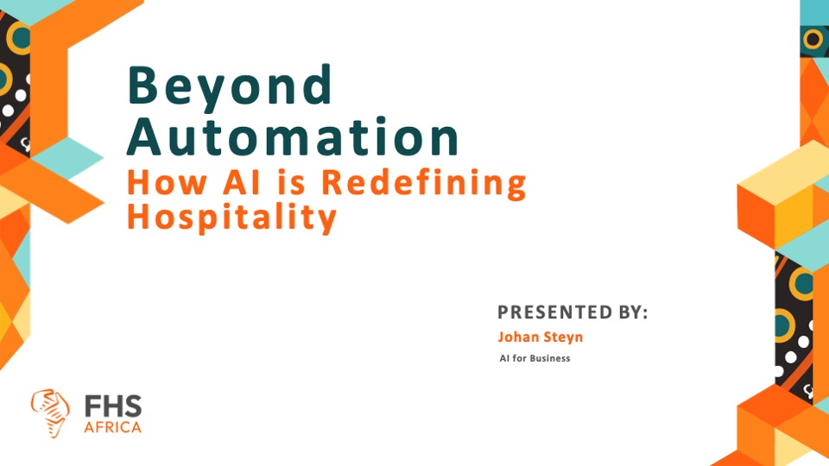

Slide 2

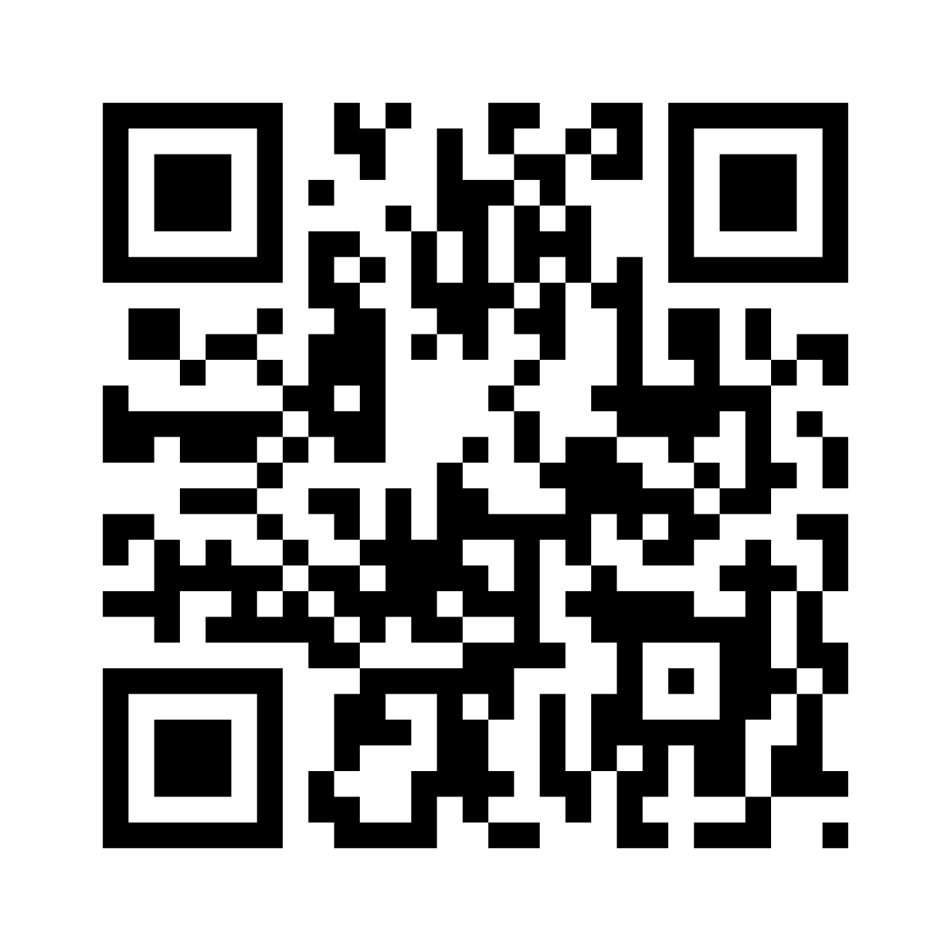
A QR code story…

Slide 3



Slide 4

The good…

Slide 5
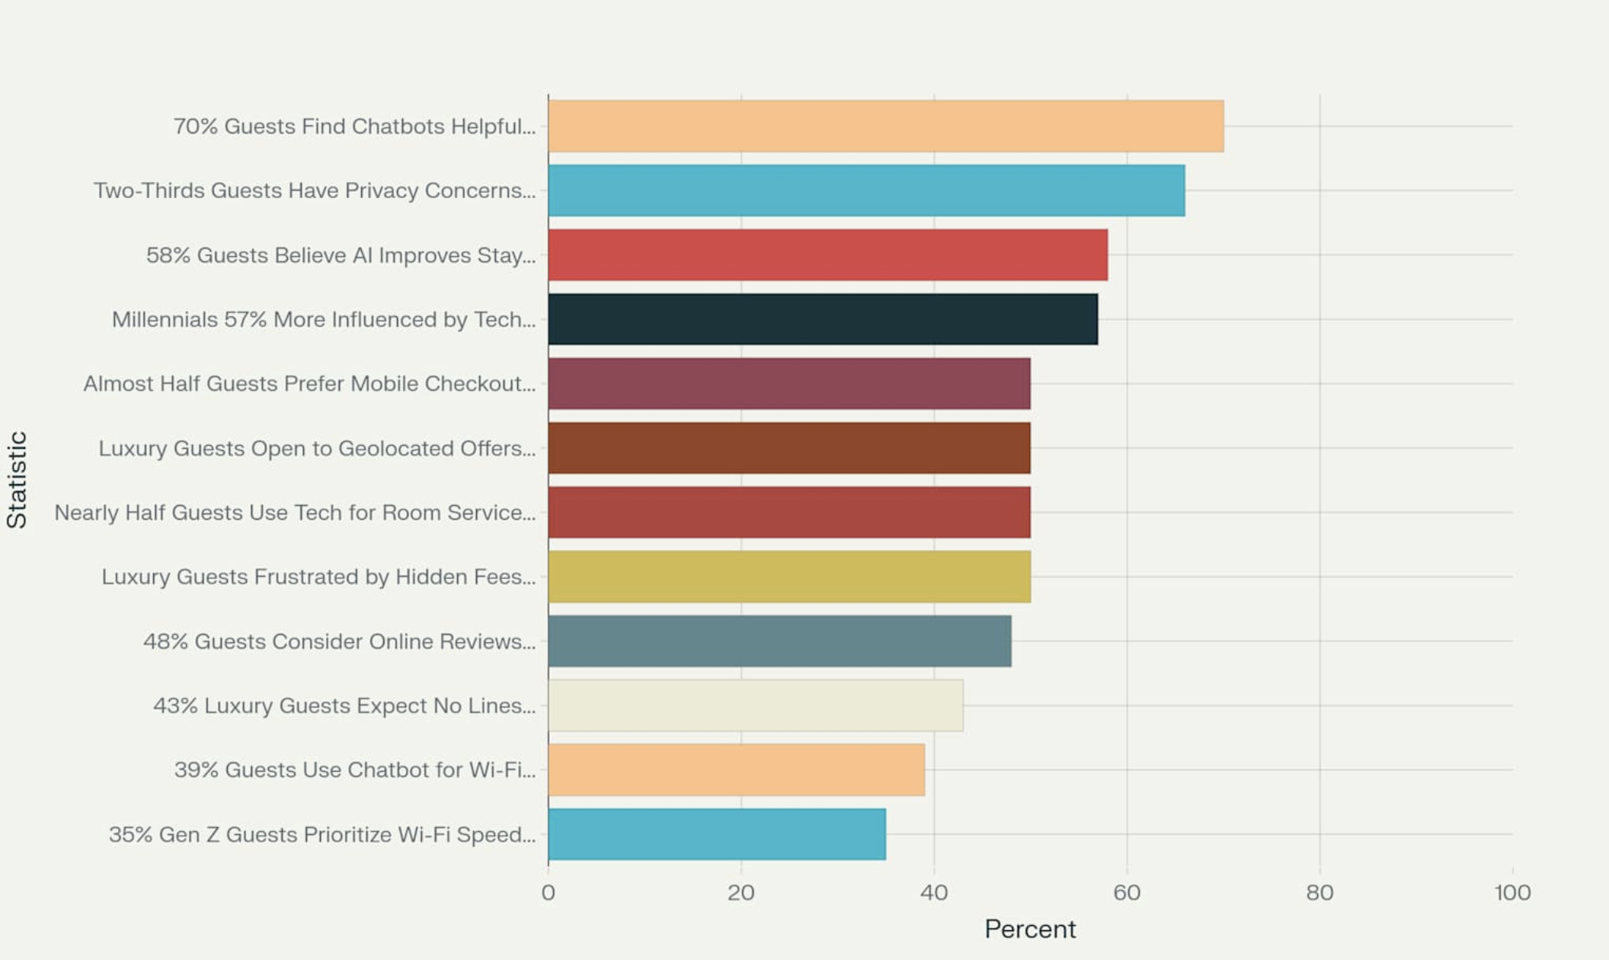
The 2025 State of Hotel Guest Tech Report
Source data: https://hoteltechreport.com/news/2025-state-of-hotel-guest-technology-report

Slide 6
The 2025 State of Hotel Guest Tech Report
The high value guests place on chatbots for simple inquiries
The influence of technology on millennial booking decisions
Privacy concerns with voice-activated devices
The importance of online reviews, mobile checkouts, and
fast Wi-Fi
The growing expectation for AI-driven, personalized, and contactless experiences
Source data: https://hoteltechreport.com/news/2025-state-of-hotel-guest-technology-report

Slide 7
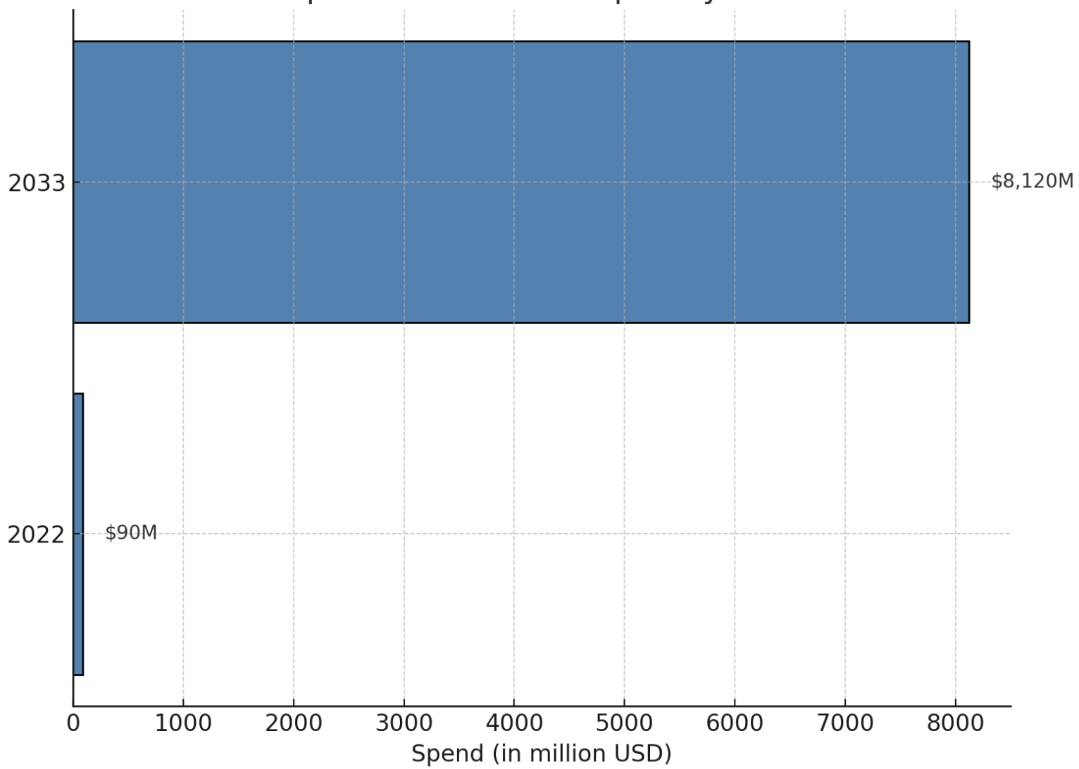
AI Spend in Africa’s Hospitality Market
Source data: https://www.moore-southafrica.com/MediaLibsAndFiles/media/southafricaweb.moorestephens.com2020/Documents/African-Hospitality-Confidence-Index-2024.pdf

Slide 8
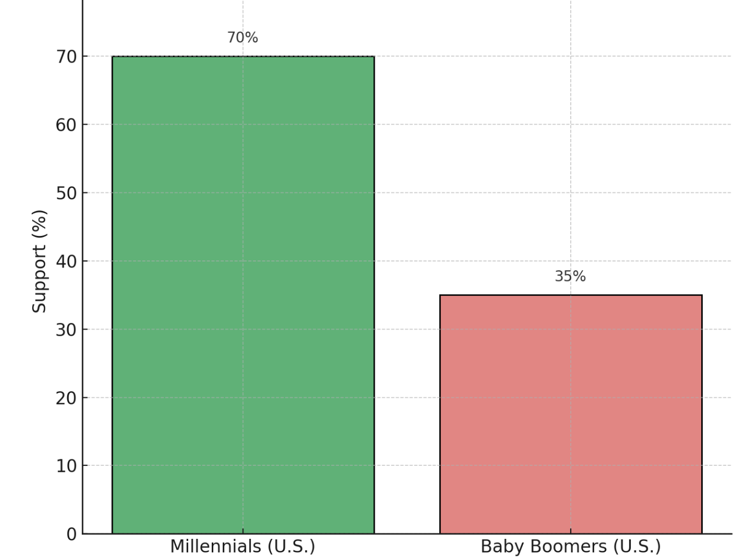
Support for Brands Using AI in
Customer Service by Age
Source data: https://www.moore-southafrica.com/MediaLibsAndFiles/media/southafricaweb.moorestephens.com2020/Documents/African-Hospitality-Confidence-Index-2024.pdf

Slide 9
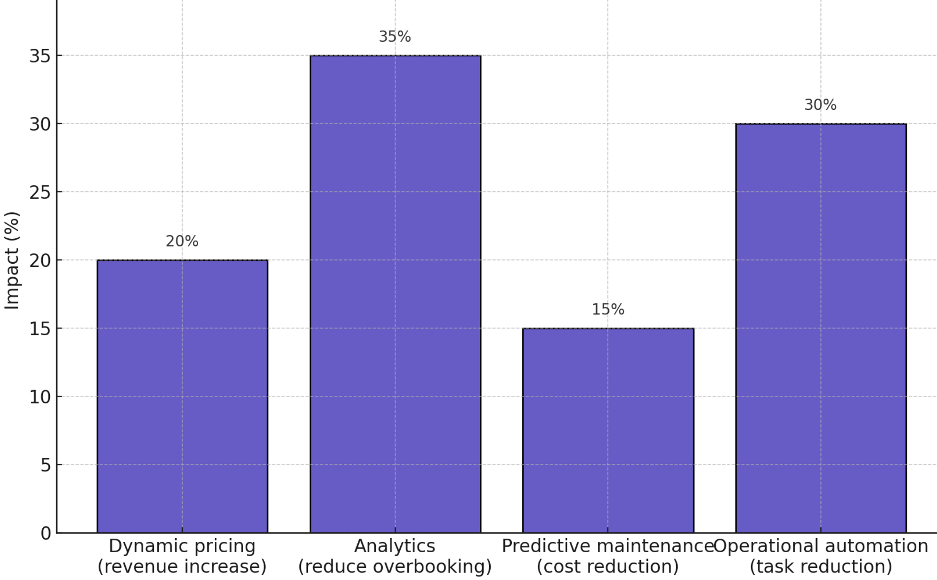
Impact of AI Applications in Hotel Operations
Source data: https://www.eself.ai/blog/ai-in-hospitality-industry-uses-and-benefits-of-ai-in-hotels/

Slide 10

The ugly…

Slide 11
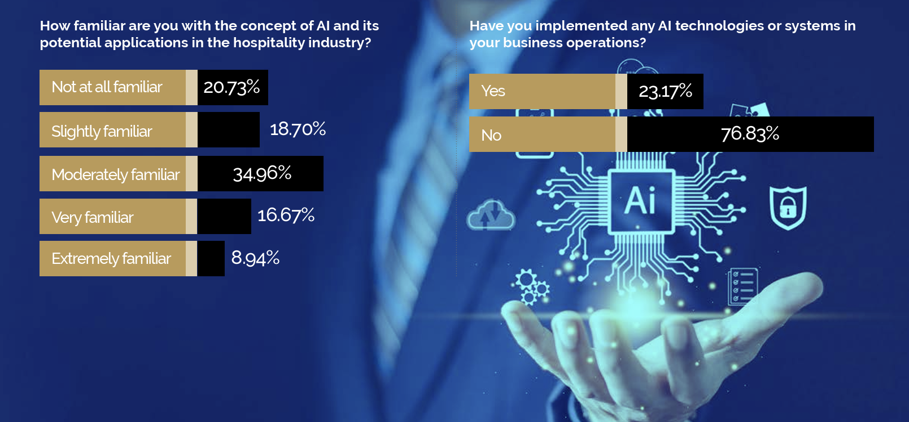
AI Adoption in Africa: Business Leaders
Source data: https://www.moore-southafrica.com/MediaLibsAndFiles/media/southafricaweb.moorestephens.com2020/Documents/African-Hospitality-Confidence-Index-2024.pdf

Slide 12
Henn Na Hotel (Japan): Robot Hotel Backlash
The hotel once boasted a fully robotic staff—243 robots handling reception, portering, and in-room service—but by 2019, over half were fired due to poor performance.
Reception robots struggled with speech recognition.
Porter bots couldn’t navigate effectively.
In-room assistants misinterpreted snoring as voice commands.
Guests ultimately demanded human staff, prompting a rollback.

Slide 13
Generative AI (“ChatGPT-Only”) Projects: 100% Failure Rate
Quicktext reports that 100% of hotel projects relying solely on generative AI have failed.
Initial capability jumps quickly stall—progressing from 40% accuracy to just 60% over multiple years.
High cost and effort fail to yield diminishing returns, leading to abandoned projects and burnt budgets.

Slide 14
Sophisticated Chatbot Hallucinations & Knowledge Gaps
Chatbots built on generative models frequently produce hallucinations—plausible but incorrect responses.
A hotel example: the chatbot erroneously provided wrong refund policies, leading to guest disputes
Without rigorous knowledge engineering and hybrid architectures, AI systems risk undermining guest trust.

Slide 15
60% of Hotel Groups Struggle with Digital Transformation
According to industry data, 42% of AI/automation initiatives fail due to:
Incompatible legacy systems
Data silos causing 30% forecasting errors and operational inefficiencies.
These failures have led to:
Overbookings, cancelled bookings, and costly compensations.
Wasted investment and operational disruptions.

Slide 16
Loss of Human Connection & Guest Experience
Critics warn AI can de-humanise hospitality.
Guests report interactions feeling “mechanical and devoid of warmth” Robotic service—though efficient—can degrade the emotional, empathetic service fundamental to guest satisfaction.

Slide 17
Let’s get practical

Slide 18

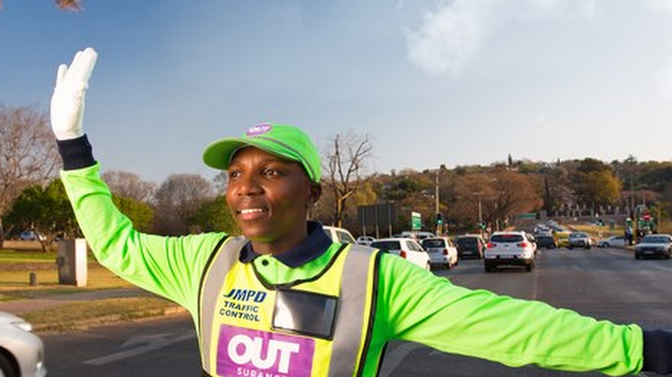
There are many jobs that only humans can do

Slide 19

Consume your own products

Slide 20

Where to start on your AI journey

